Slide 1
Training package for the prevention of Xylosandrus invasions and the application of early warning, monitoring and rapid response protocols
Module 1. The biology of Xylosandrus crassiusculus and Xylosandrus compactus
Module 2. Xylosandrus and associated fungi
Module 3. Invasion history and pathways
Module 4. Prevention: reducing vulnerability through forest interventions
Module 5. Early warning and monitoring
Module 6. Containment
Module 7. Supporting technologies: smart traps and app
June 2022

Slide 2
Authors:
Module 1: Massimo Faccoli, University of Padua
Module 2: Carmen Morales Rodriguez, University of Tuscia
Module 3: Teddy Urvois, INRAe
Module 4: Paolo De Angelis, University of Tuscia
Module 5: Stefano Speranza, University of Tuscia
Module 6: Alain Roques, INRAe
Module 7: Claudio Belli, Terrasystem Srl
Editing: Gertruud van Leijen, on behalf of Circeo National Park

Slide 3
Support technologies: SAMFIX Agent & X-traps
C. Belli, G.V. Laurin, P. Laranci, G. Tramontana, R. Bianconi, M. Tomassucci, A. Ribeca, M. Corvi

Slide 4
Why develop an ICT system for SAMFIX project
X-Traps – a smart way to catch and count Xylosandrus
Samfix Agent app – a tool for citizen science activities
X-Platform – a smart gate to share SAMFIX data

Slide 5
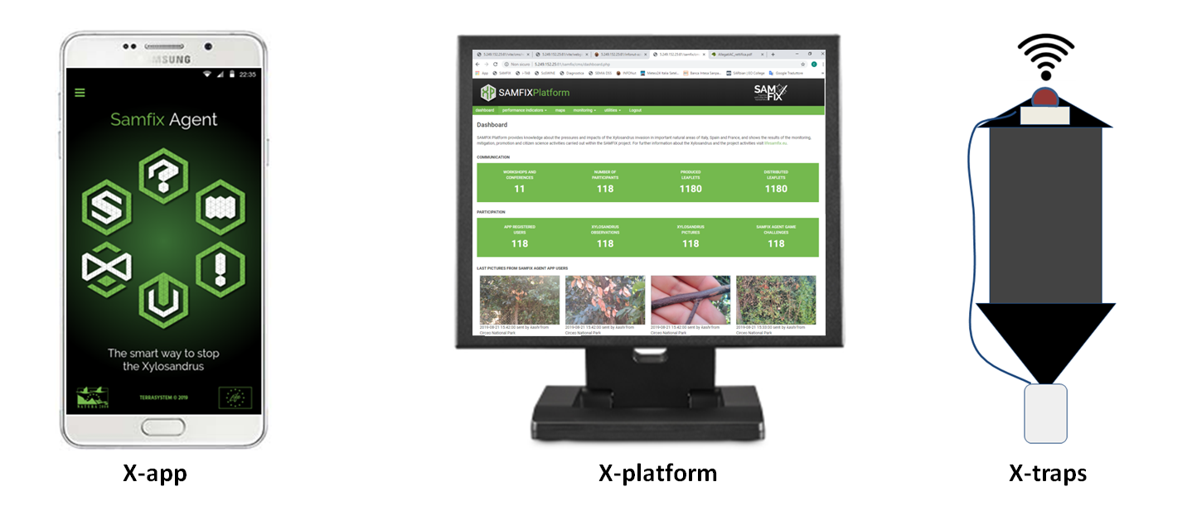
ICT System

Slide 6
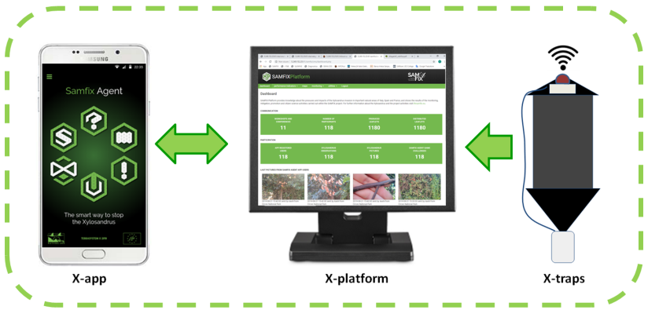
ICT System
Goals and functions
store, publish and communicate data produced by the project
exchange data between the partners and stakeholders
tool for citizen science activities
tool for monitoring activities and results achieved by the project
data gathering from users useful to verify or extend monitoring activities
exchange data with external data base and services
…
partners
stakeholders
users/citizens
remote sensing/GIS data

Slide 7
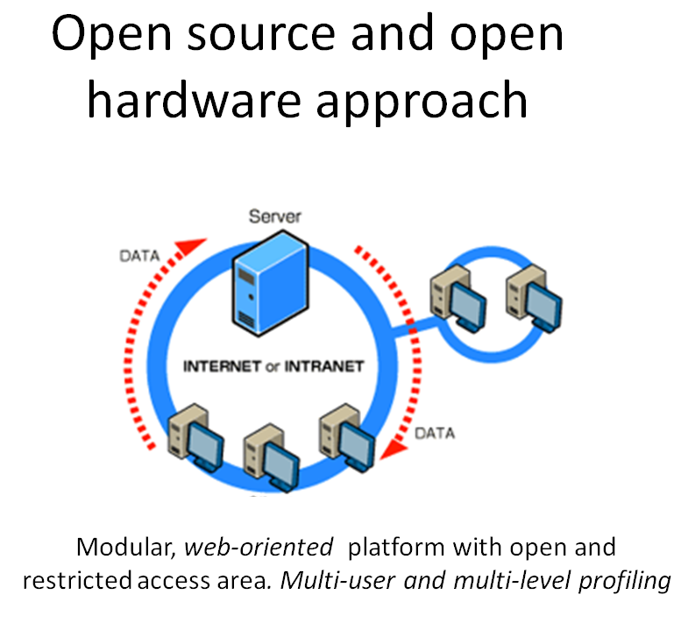
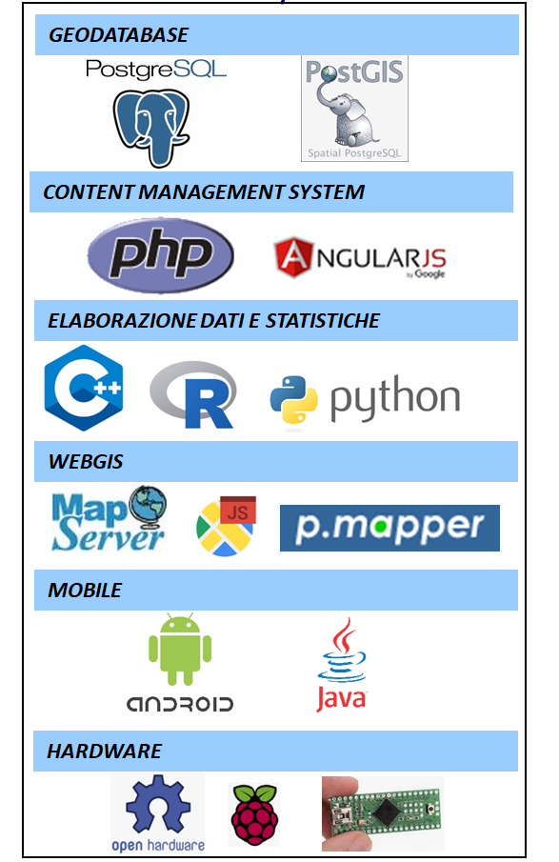
Result from the Life SAMFIX Project
27/05/2022 – Rome (IT)
Open Source frameworks

Slide 8
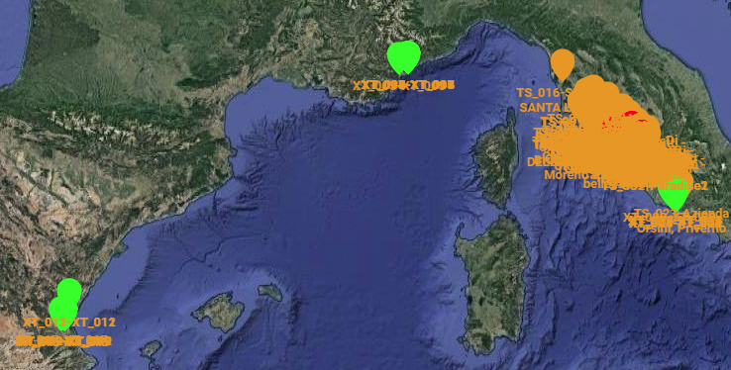
Result from the Life SAMFIX Project
27/05/2022 – Rome (IT)
Objectives
Developing and integration of 24 X-Traps; an automatic trap for the capture and detection of Xylosandrus.
Possible daily and sub-daily catch counts.
Acquire images, micro-meteorological, vegetation and geoposition data, useful to real time monitoring.
Support trapping campaigns especially in hot or inaccessible areas, minimising maintenance efforts.
Possibility to adapt and use the X-Trap module (OEM) in different traps types.
24 X-Traps (green marks) have been installed in SAMFIX parks (8 for each country: IT, FR, SP)

Slide 9
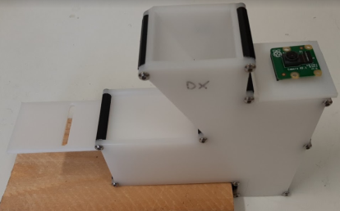
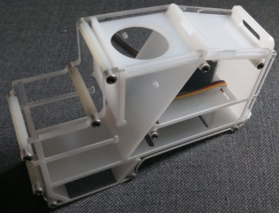
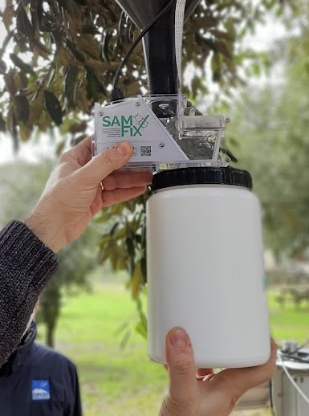
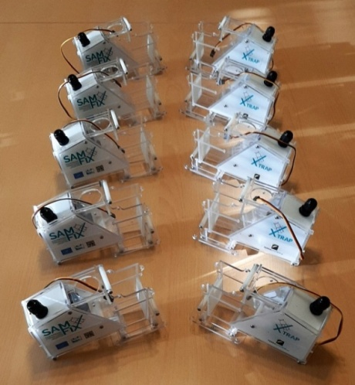
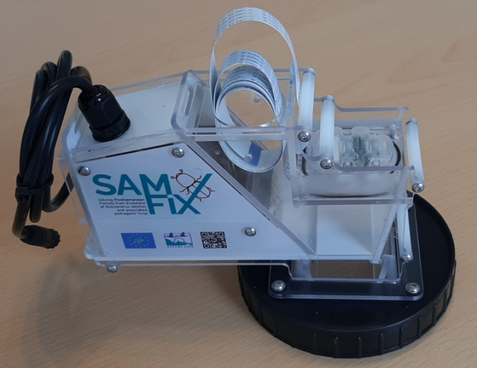
Result from the Life SAMFIX Project
27/05/2022 – Rome (IT)
Version 1
Version 2
Production
Version 3
Production

Slide 10
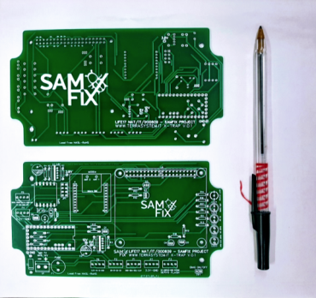
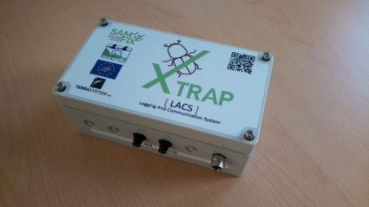
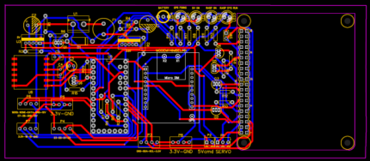
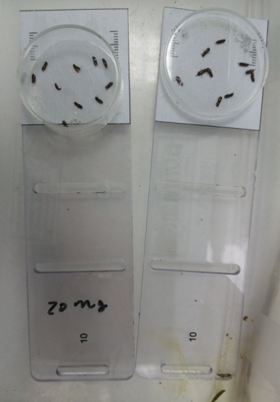
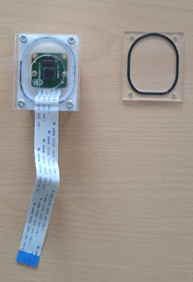
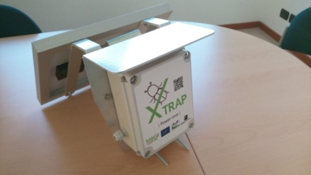
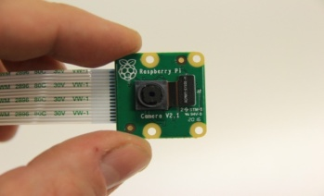
Result from the Life SAMFIX Project
27/05/2022 – Rome (IT)
PCB design
PCB
LACS – Logging and comunication system
Power unit
Guillotine
AF - camera

Slide 11
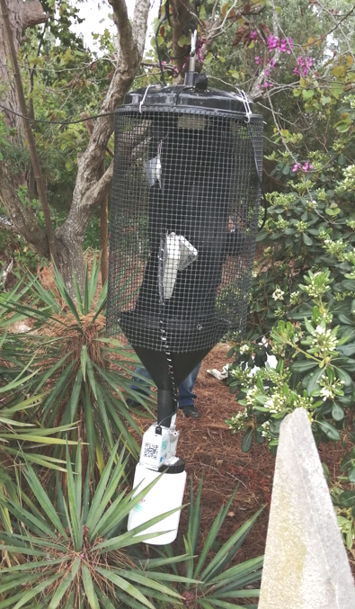
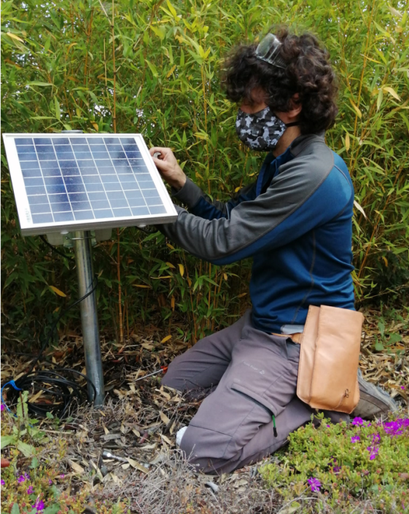
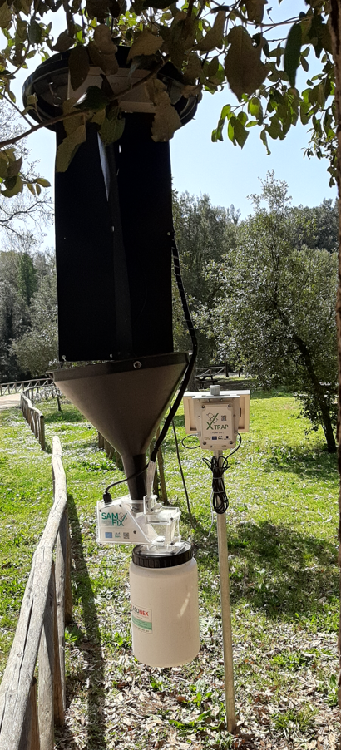
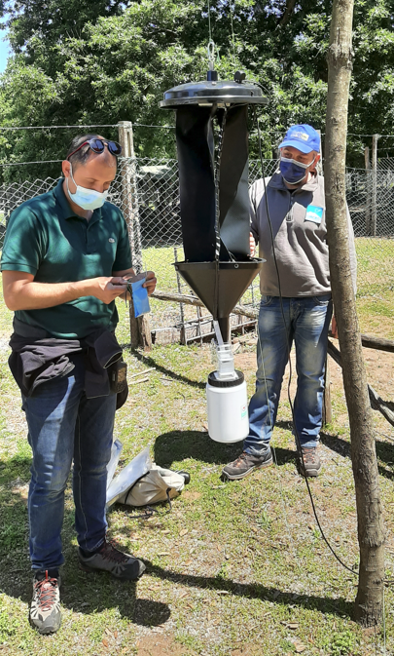
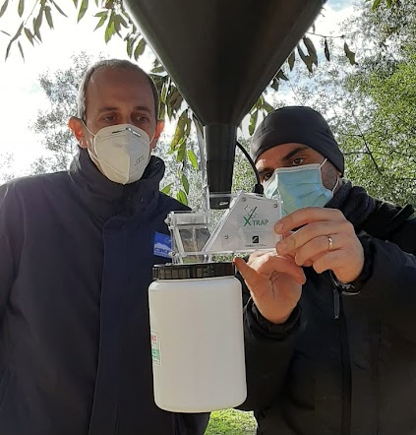
Result from the Life SAMFIX Project
27/05/2022 – Rome (IT)

Slide 12
X-Traps results
A trapping campaign with 24 X-Traps in 2021 was carried out. In France and Italy the traps were removed at the end of the season. In Spain they were left in the field.
More than 3500 images (+3500 with led illumination) were acquired on a daily rate.
The counting and recognition of the insects was carried out through laboratory determination, in the same way as for the traditional traps
Data analysis shows that there are no significant differences in the ability of x-traps to catch insects
A new 2022 campaign is ongoing
We are finalising the development of an automatic algoritm for detecting Xylosandrus specimens

Slide 13
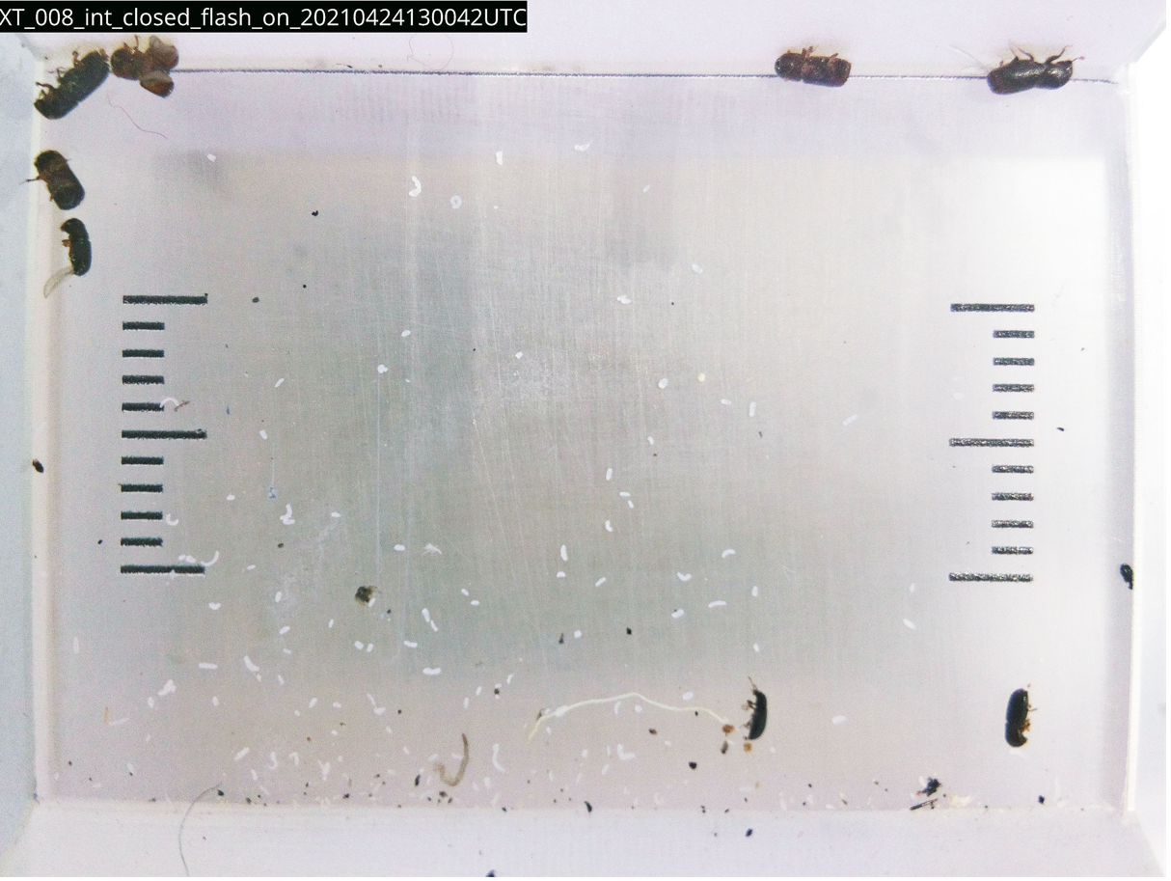

Slide 14
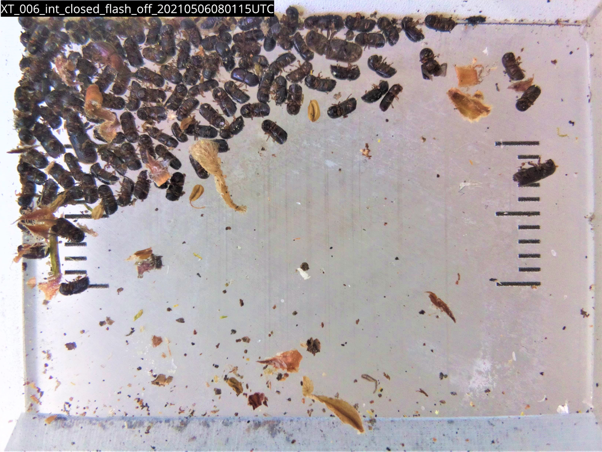

Slide 15
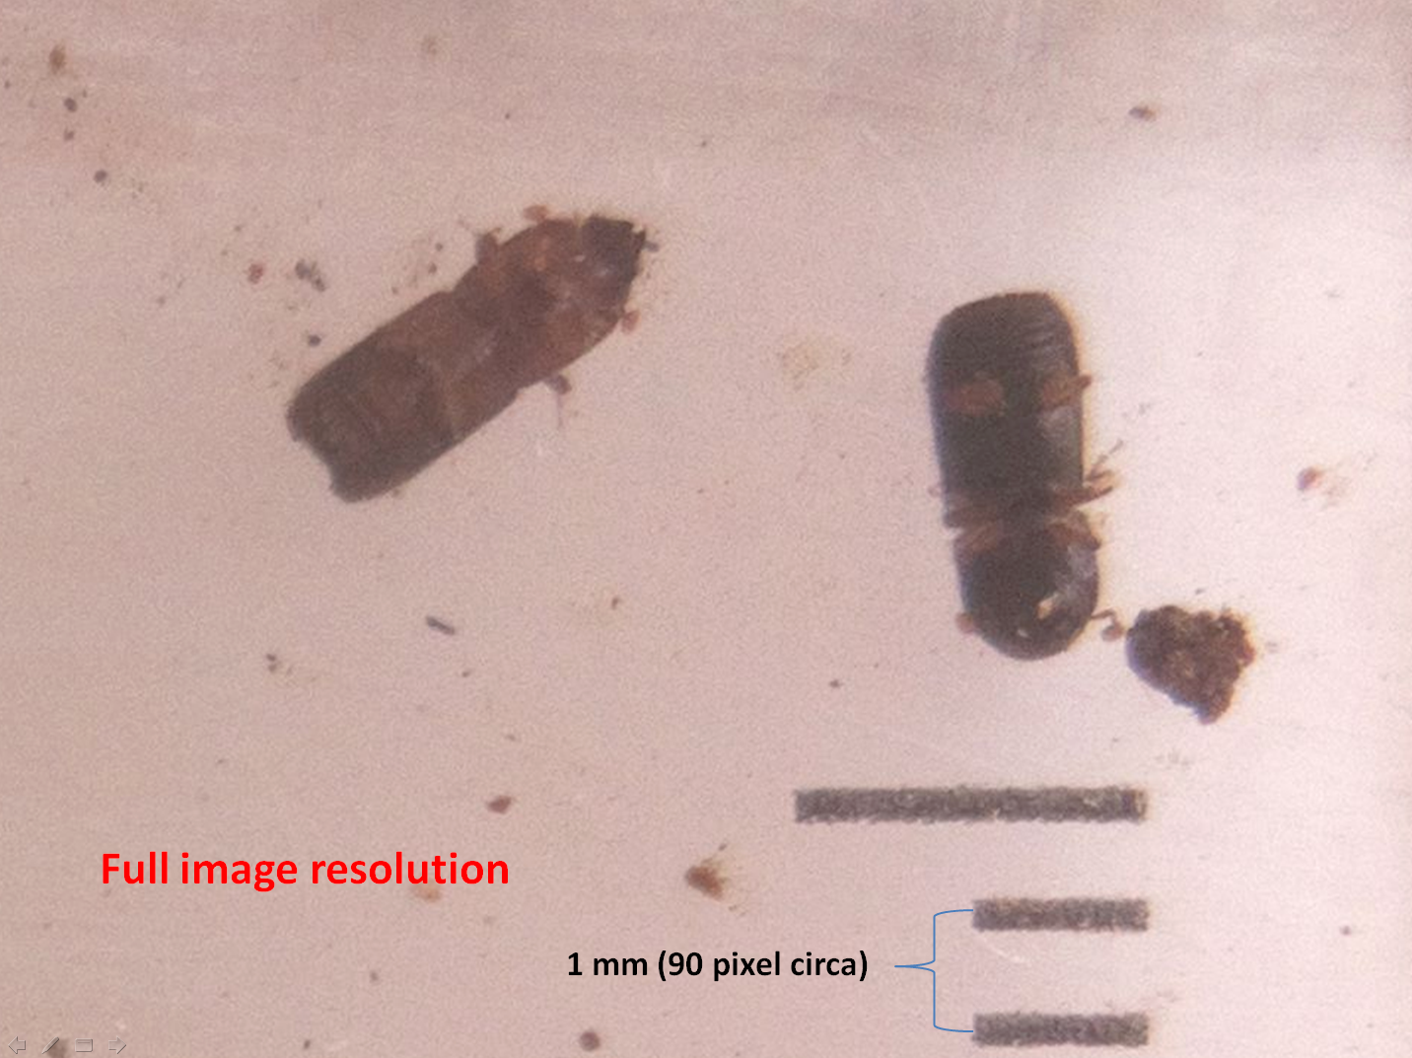

Slide 16
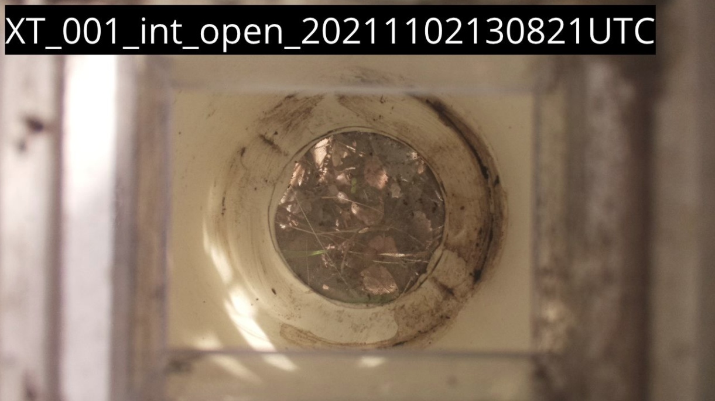

Slide 17
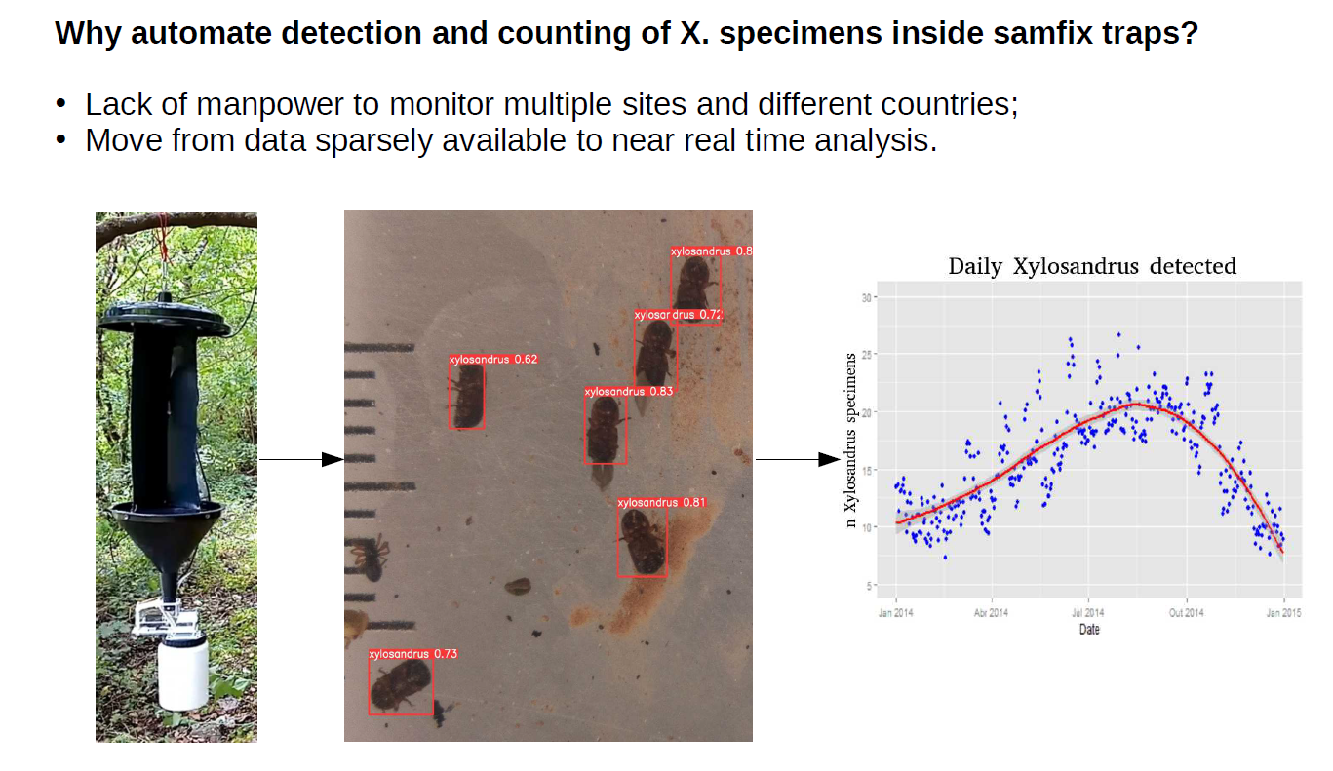
X-traps: detecting Xylosandrus specimens by means of Deep Learning and Computer Vision

Slide 18
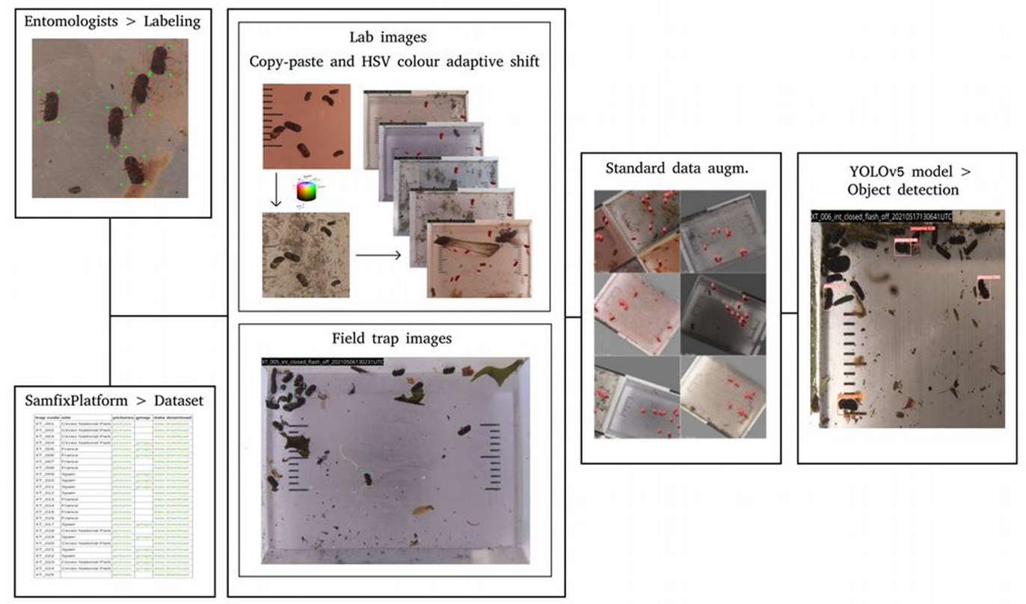

Slide 19
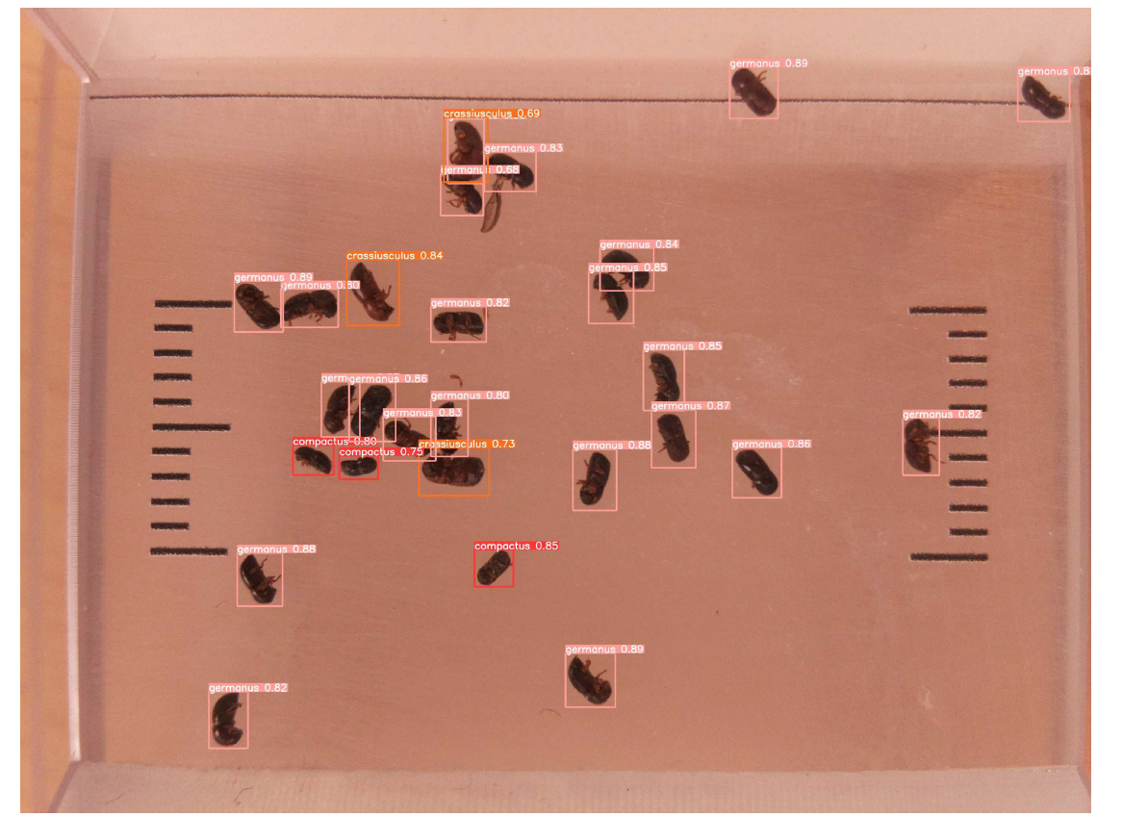

Slide 20
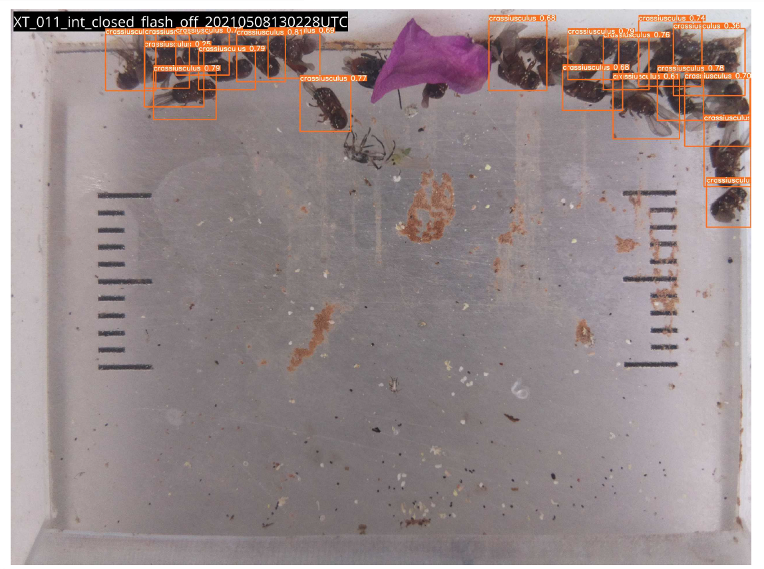

Slide 21
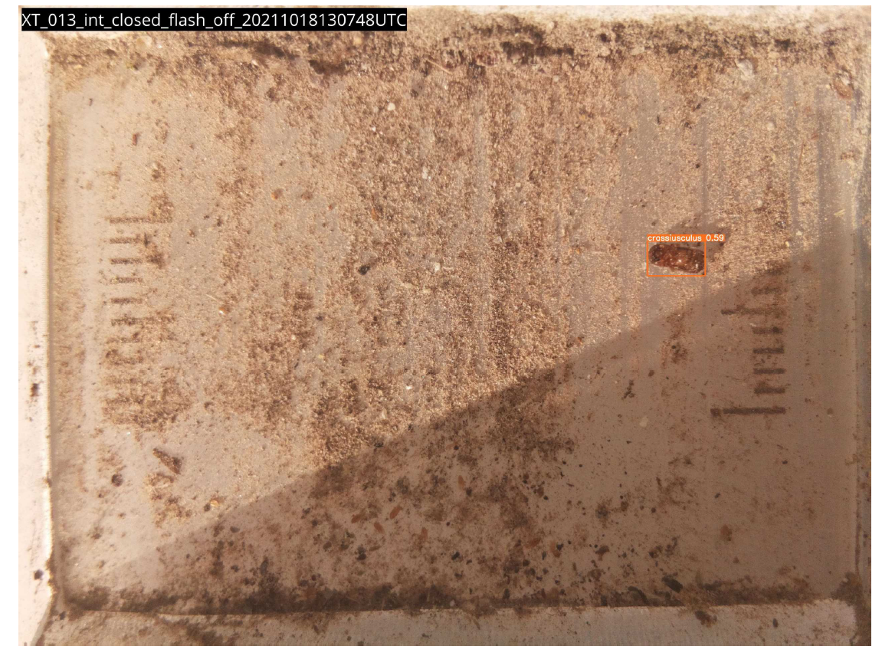

Slide 22
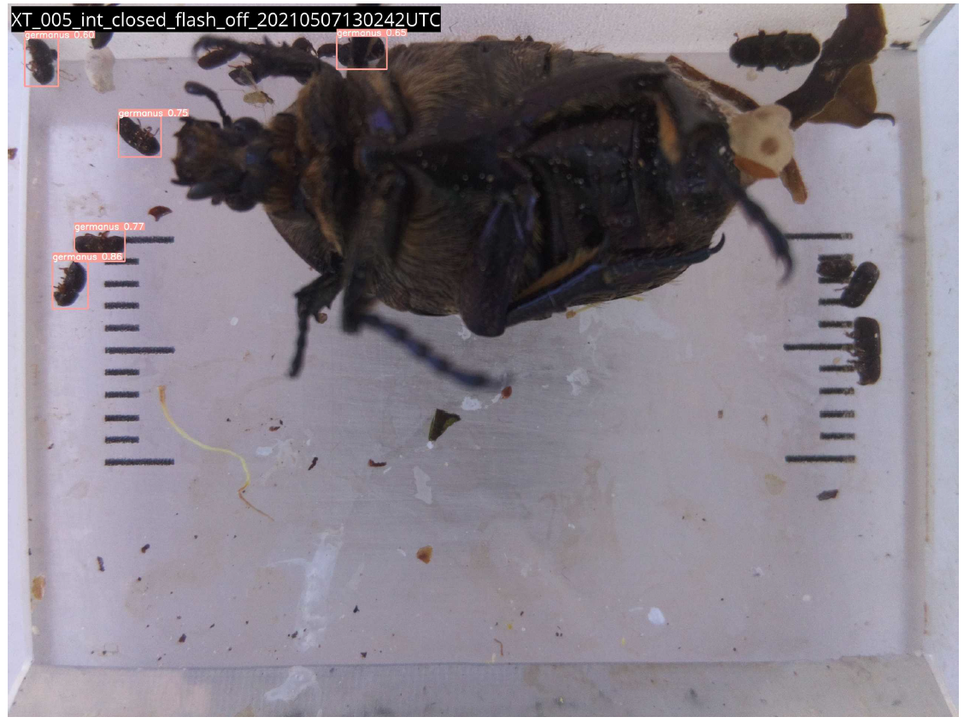

Slide 23
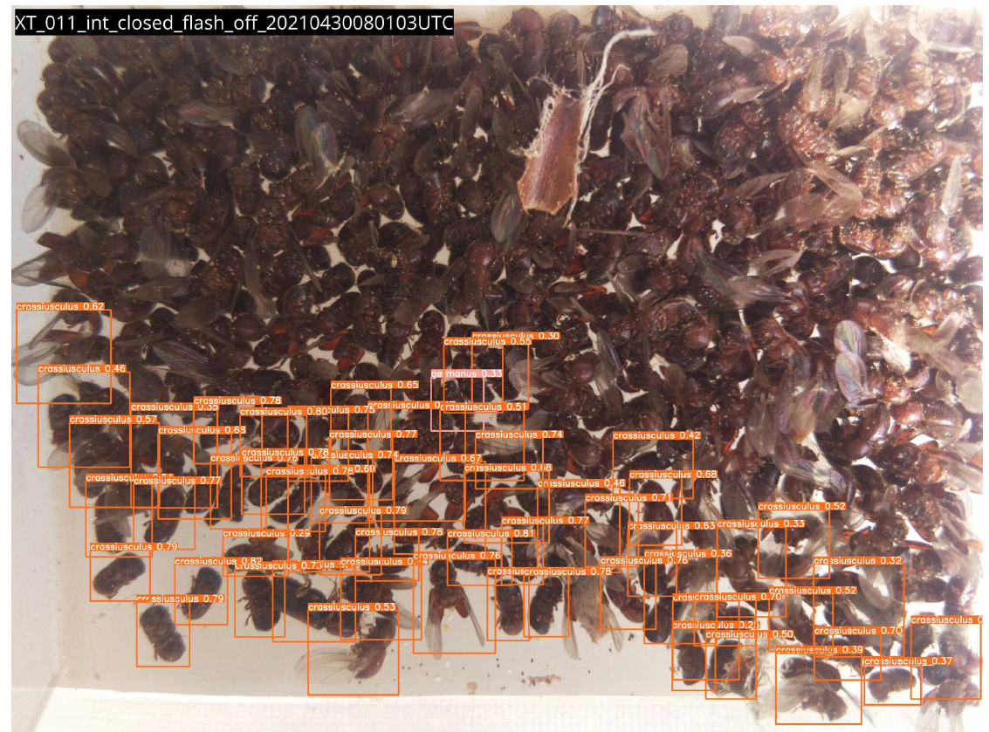

Slide 24
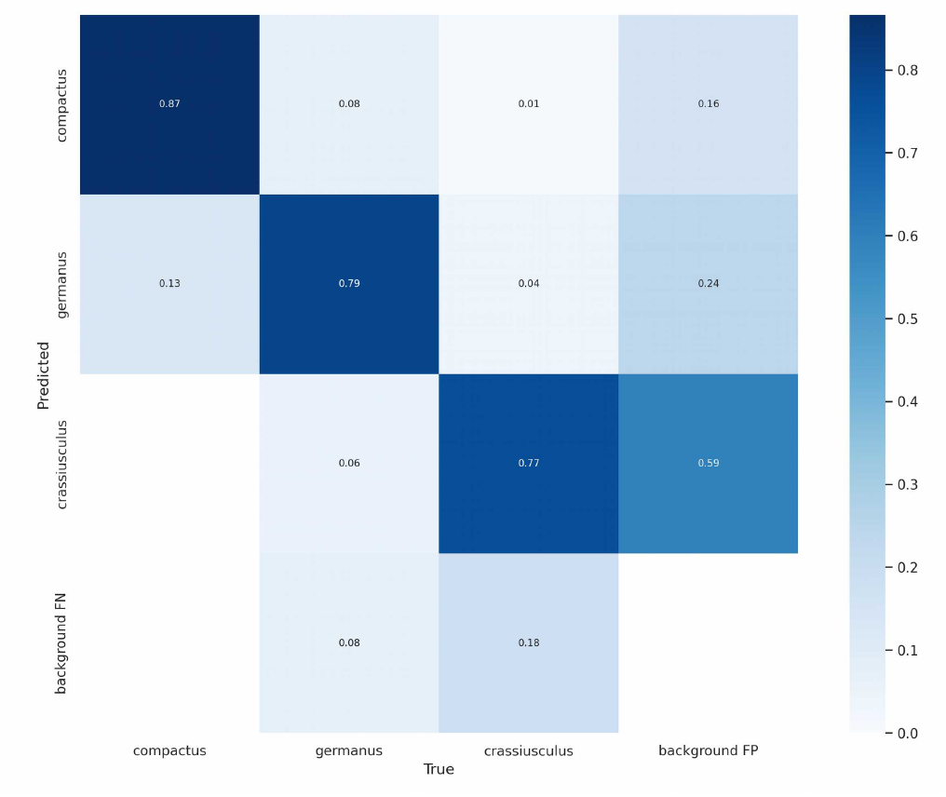

Slide 25
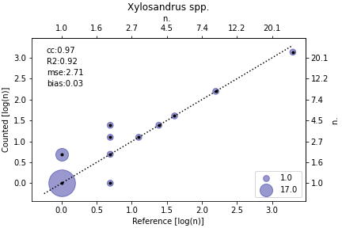

Slide 26
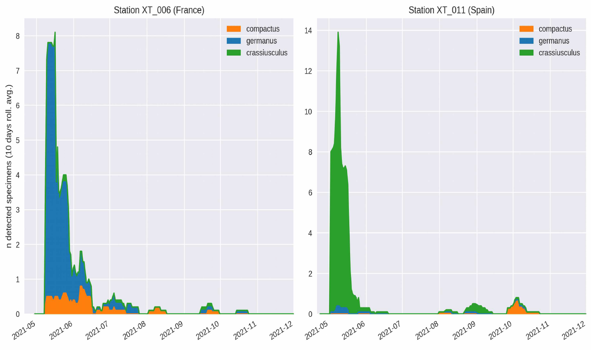

Slide 27
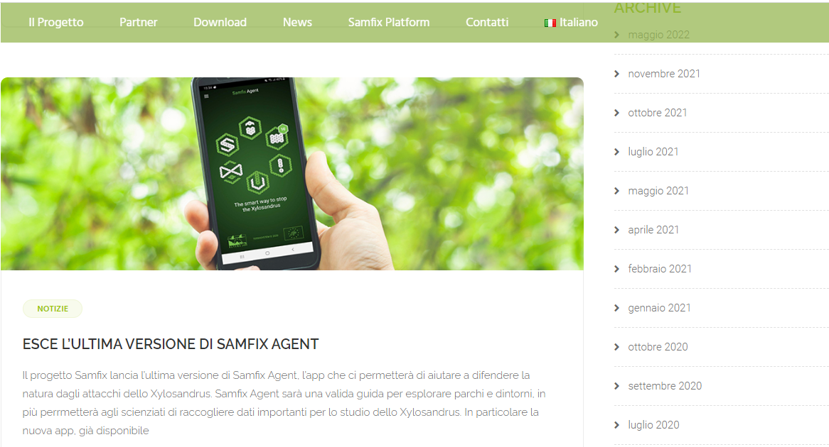
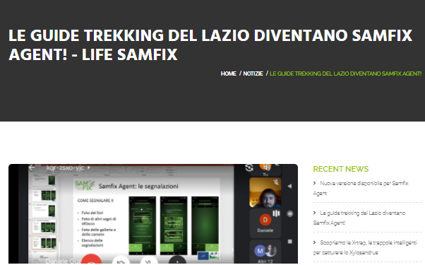

Slide 28
App: Samfix Agent
Objectives
Main features
Promoting information, awareness-raising, monitoring and sharing through Citizen Science activities
Supporting the recognition of the insect and its damage
Collection, validation, archiving and valorisation of in situ observations
Android App
Multilingual (English, French, Spanish, Catalan, Italian) depending on phone configuration
Identification guide, editing and sending Xylosandrus alerts, map section
Interactive game offering missions to be carried out in the parks in search of Xylosandrus
Requires authorisations for camera data and location

Slide 29
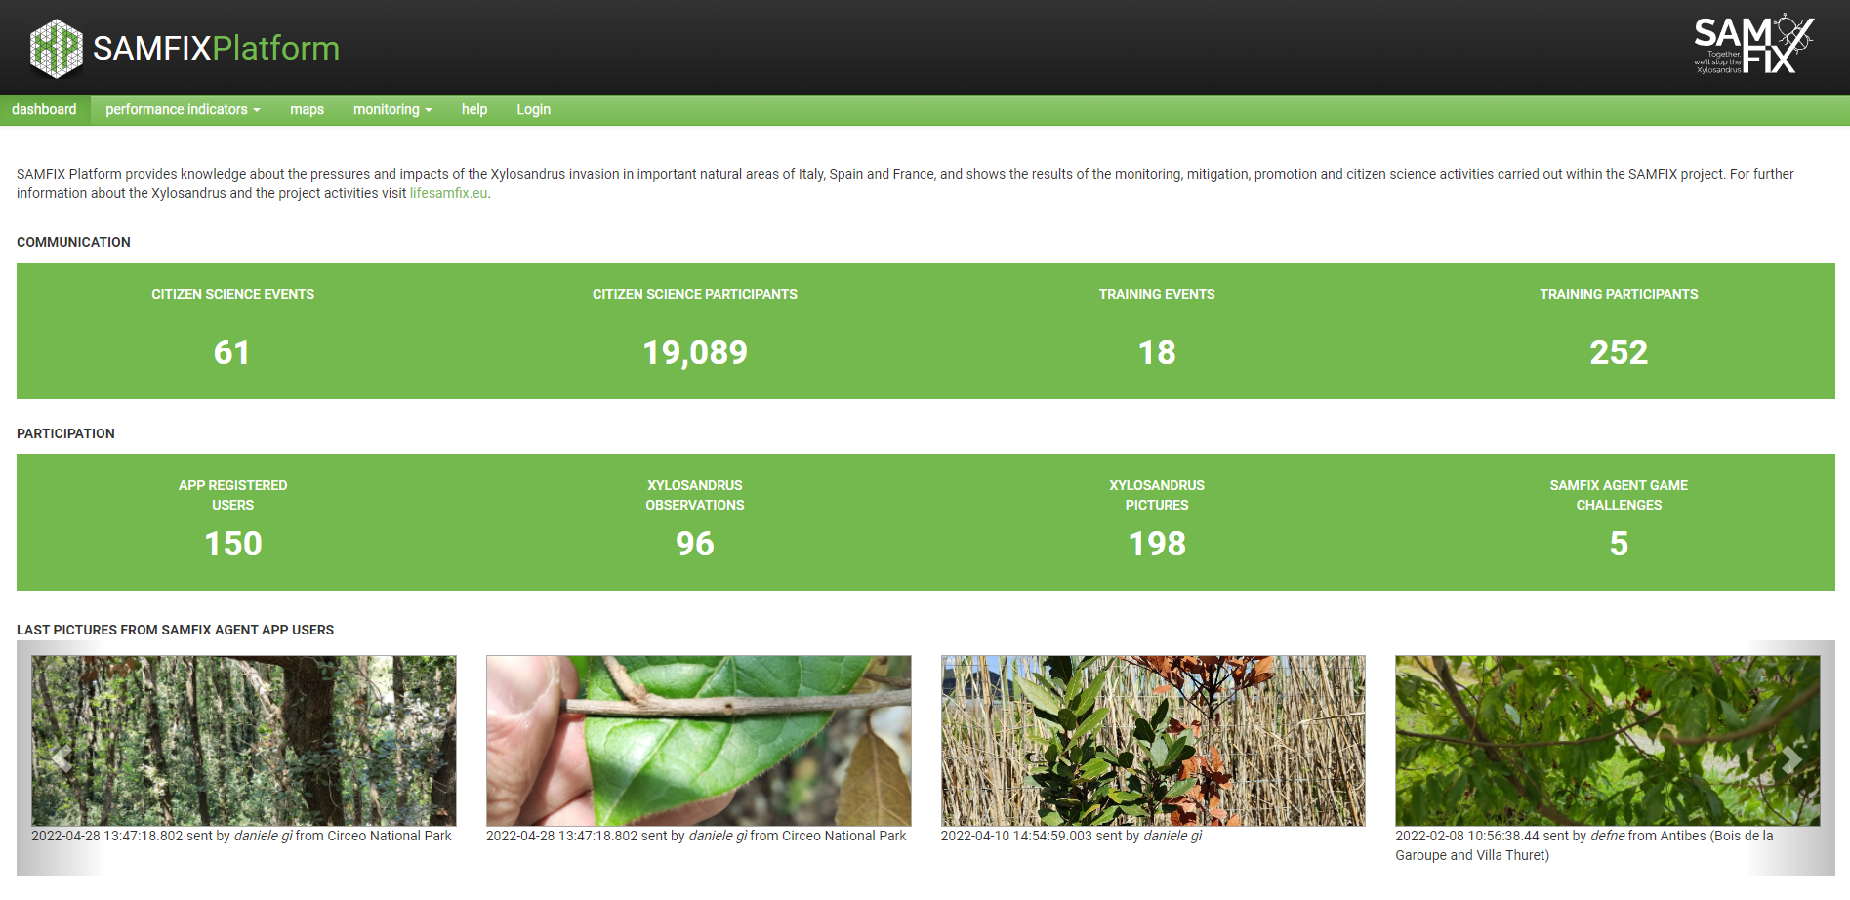

Slide 30
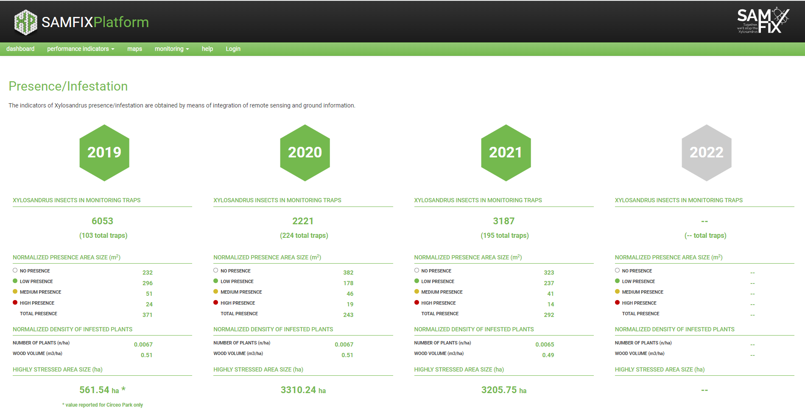

Slide 31
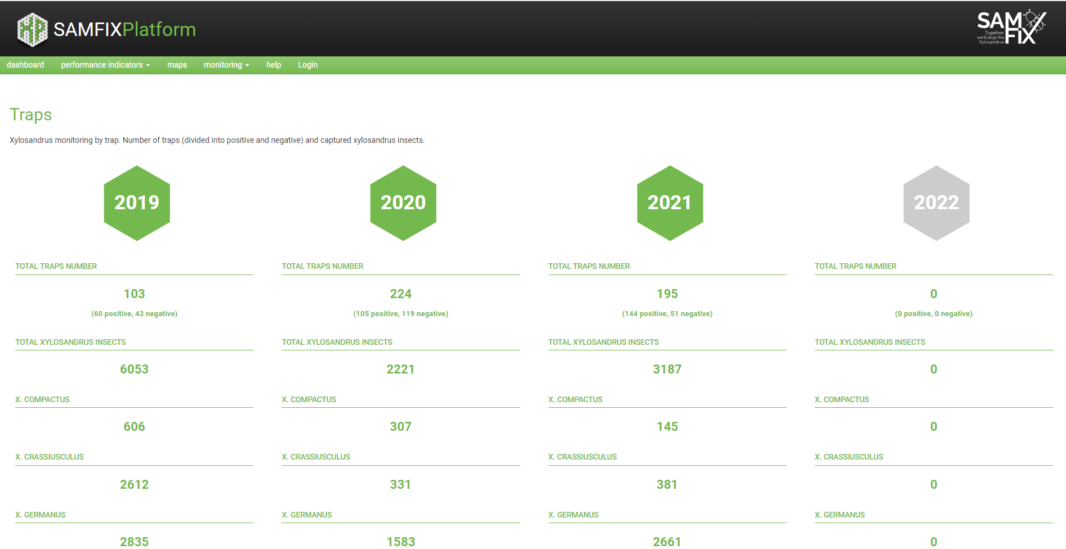

Slide 32
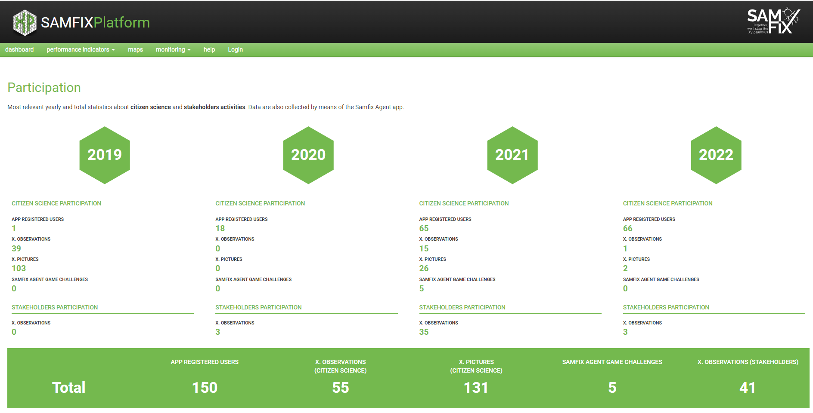

Slide 33
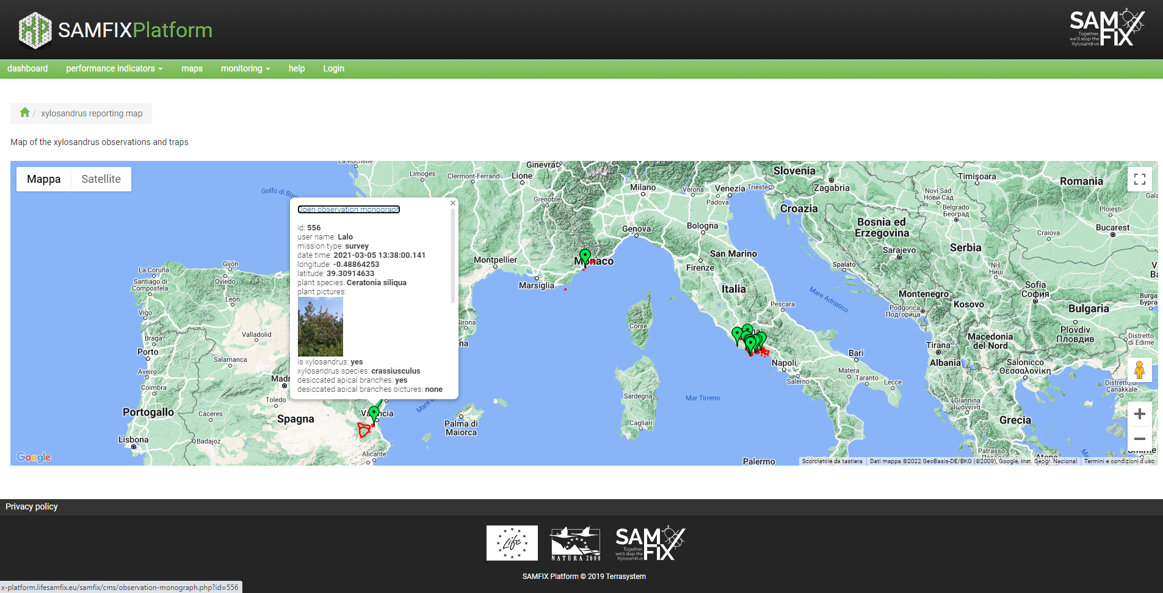

Slide 35
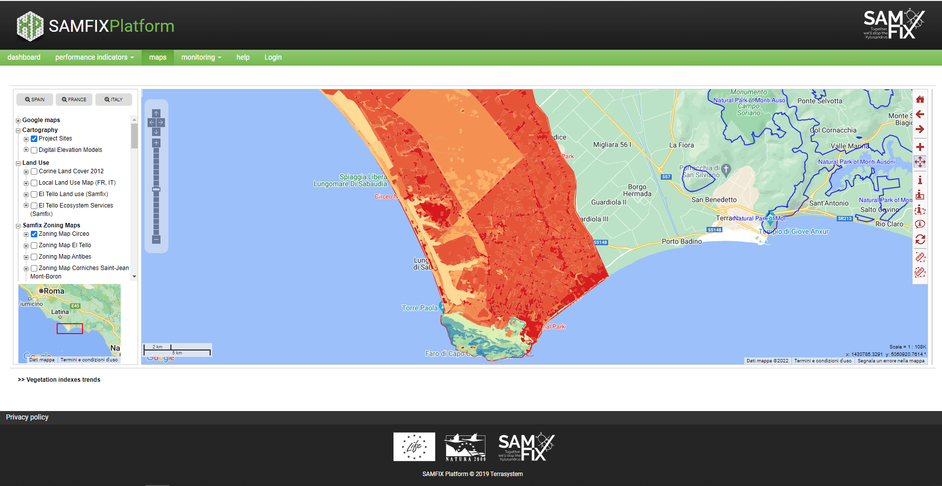

Slide 36
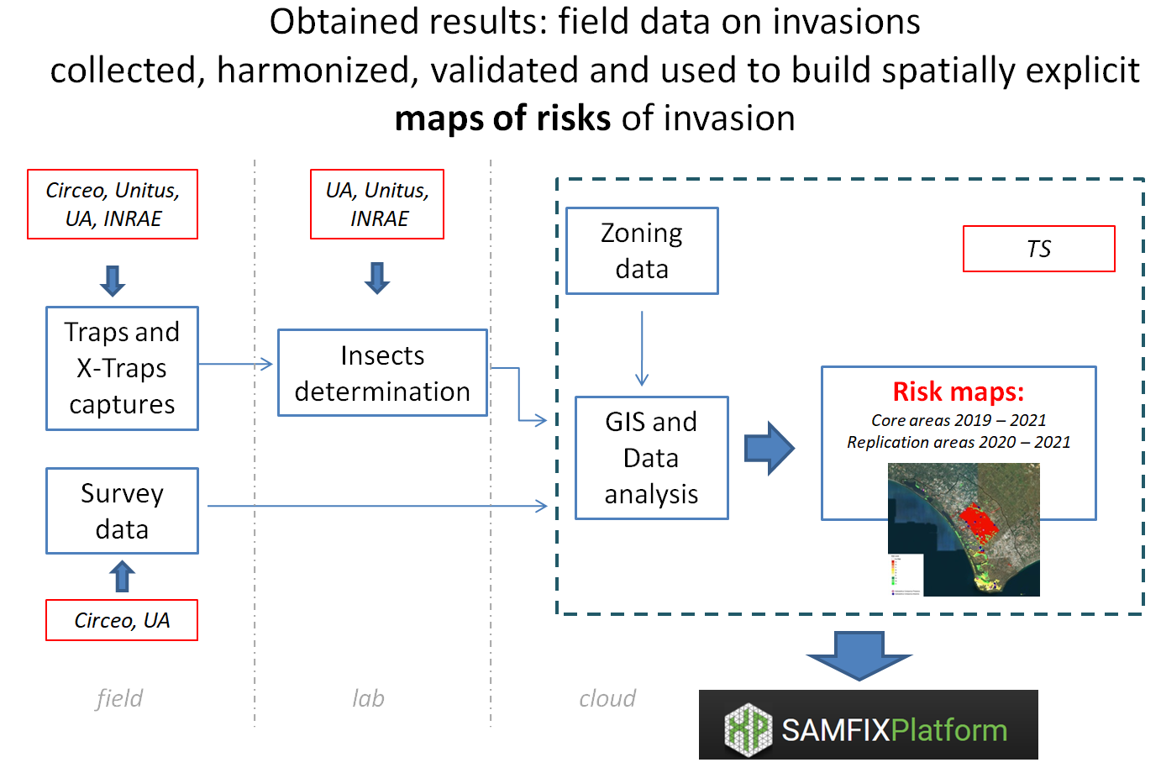

Slide 37
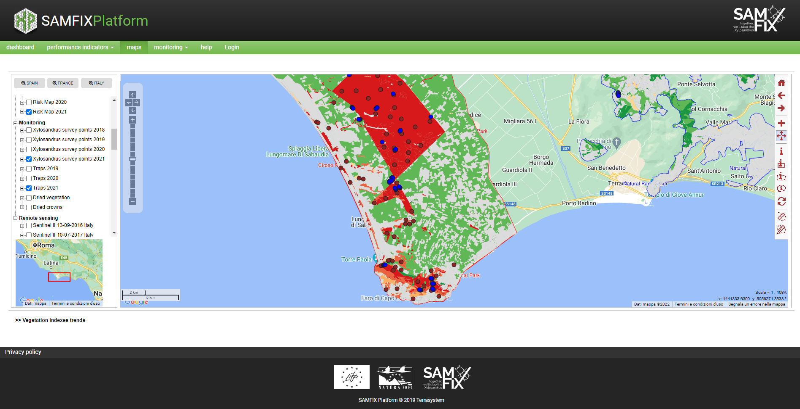

Slide 38
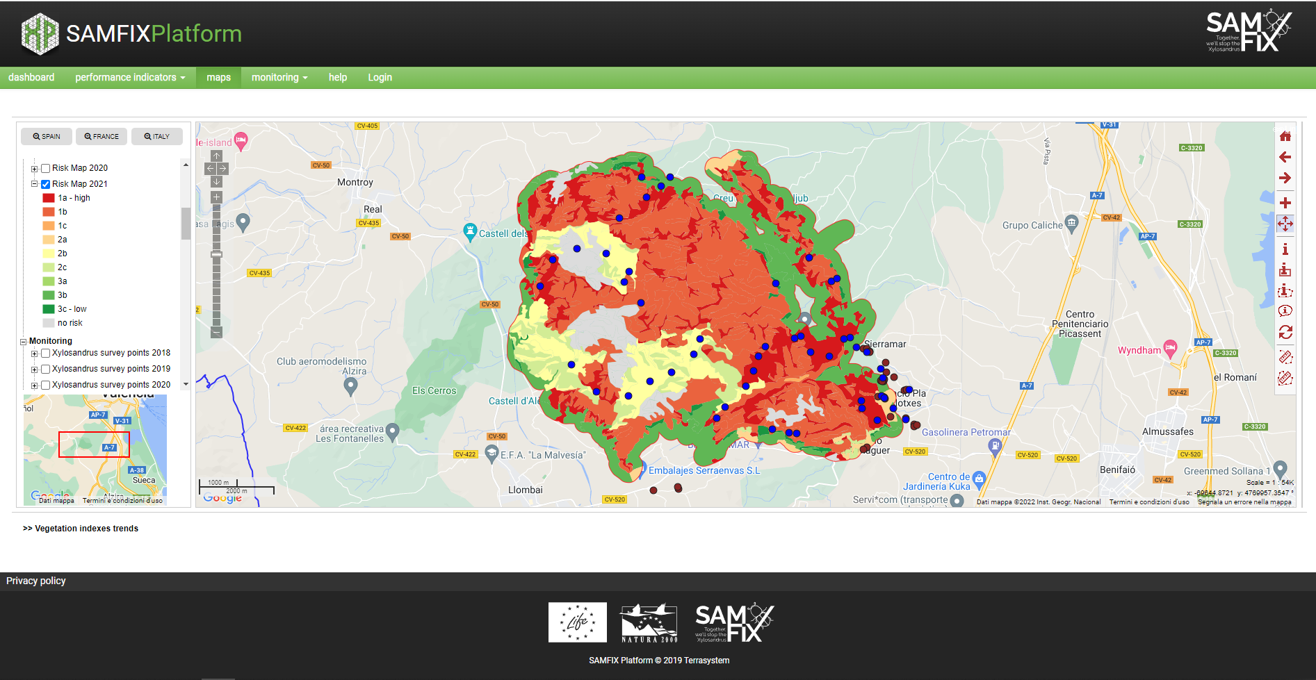

Slide 39
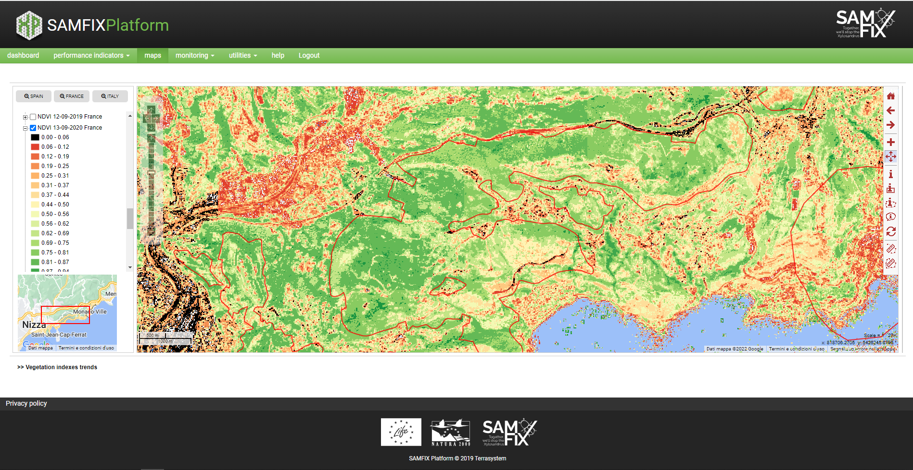

Slide 40
Thank you!

Slide 41
The contents of this training package are the sole responsibility of the LIFE SAMFIX partnership and do not necessarily reflect the opinion of the European Union or its agency CINEA.
For more information:
www.lifesamfix.eu
E-mail: xylosandrus@parcocirceo.it
Address: Via Carlo Alberto 188, 0416 Sabaudia (IT)
Tel. +39 077 3512240
Follow us on and

