Slide 1
Training package for the prevention of Xylosandrus invasions and the application of early warning, monitoring and rapid response protocols
Module 1. The biology of Xylosandrus crassiusculus and Xylosandrus compactus
Module 2. Xylosandrus and associated fungi
Module 3. Invasion history and pathways
Module 4. Prevention: reducing vulnerability through forest interventions
Module 5. Early warning and monitoring
Module 6. Containment
Module 7. Supporting technologies: smart traps and app
June 2022

Slide 2
Authors:
Module 1: Massimo Faccoli, University of Padua
Module 2: Carmen Morales Rodriguez, University of Tuscia
Module 3: Teddy Urvois, INRAe
Module 4: Paolo De Angelis, University of Tuscia
Module 5: Stefano Speranza, University of Tuscia
Module 6: Alain Roques, INRAe
Module 7: Claudio Belli, Terrasystem Srl
Editing: Gertruud van Leijen, on behalf of Circeo National Park

Slide 3
Push-Pull
an efficient method for Xylosandrus containment ?
Alain ROQUES
INRAE Zoologie Forestière Orléans, France

Slide 4
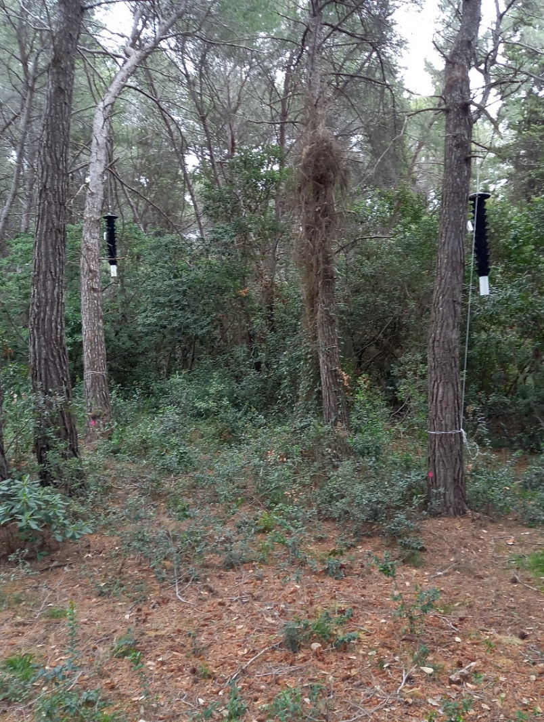
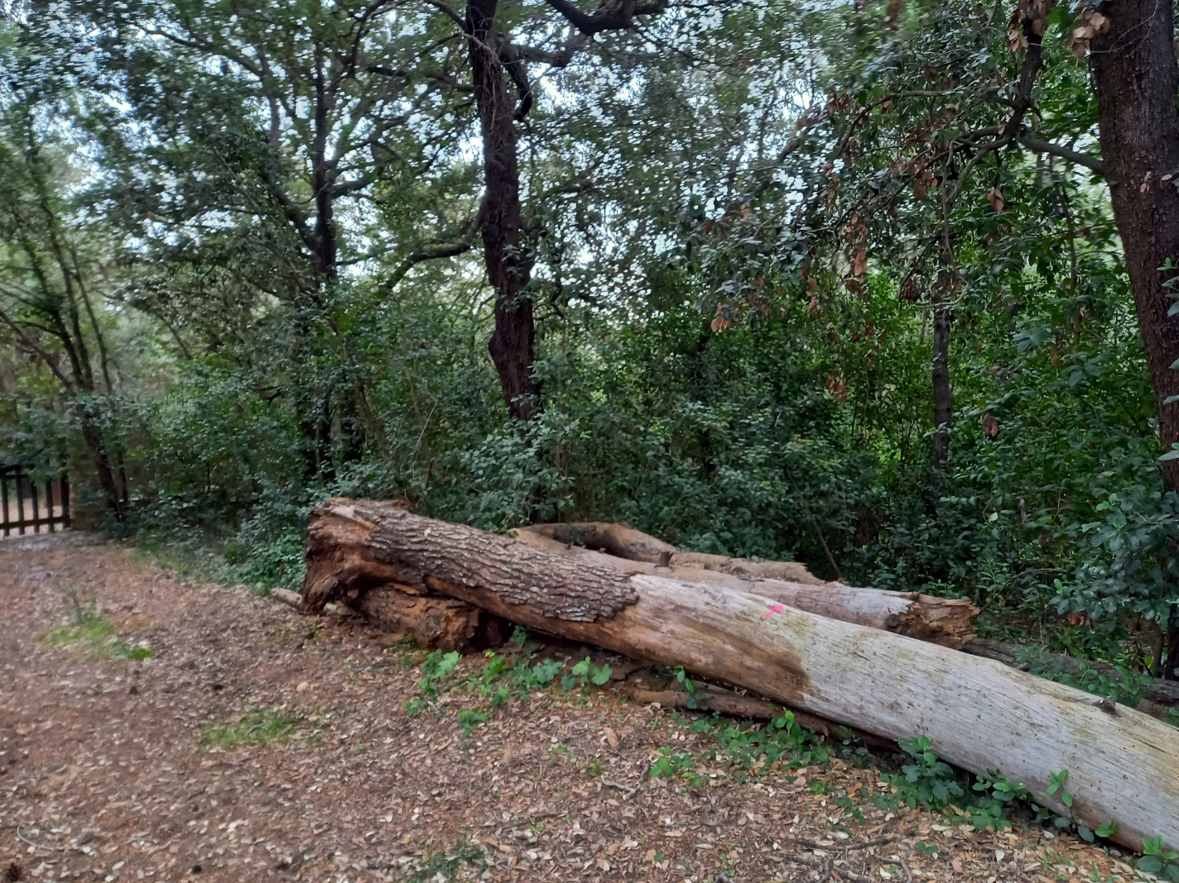
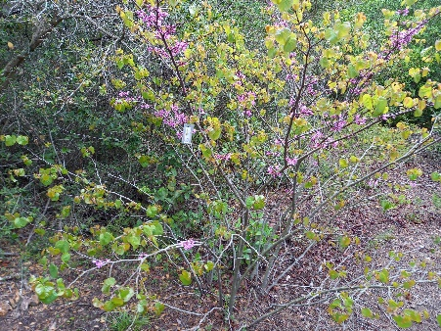
Push-Pull principles
In an infested plot, a repellent (here, Verbenone) is used to push the beetles out of the plot where traps baited with attractants are capturing them (pull)
Settlement mandatory in early spring before any dispersal flight of female beetles

Slide 5
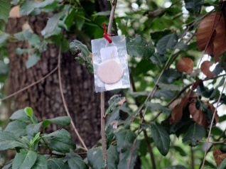
4 treatments to test for Push-Pull efficiency
T1- Push-pull: Verbenone stapled on trunks in the plot and 3 traps baited with the attractants at the periphery of the block
T2- Control: no repellents, no push attractants
T3- Pull - Trapping efficiency test: 3 traps baited with attractants at the periphery of the block, no verbenone
T4 –Push- Repellent efficacy test: Verbenone stapled on trunks in the block, no attractive traps at the periphery
Forest/Park
V
V
V
V
20
m
V
V
V
V
V
V
Edge
>20m
>20m
>20m
20m
T1
T2
T3
T4
20m
Open space

Slide 6
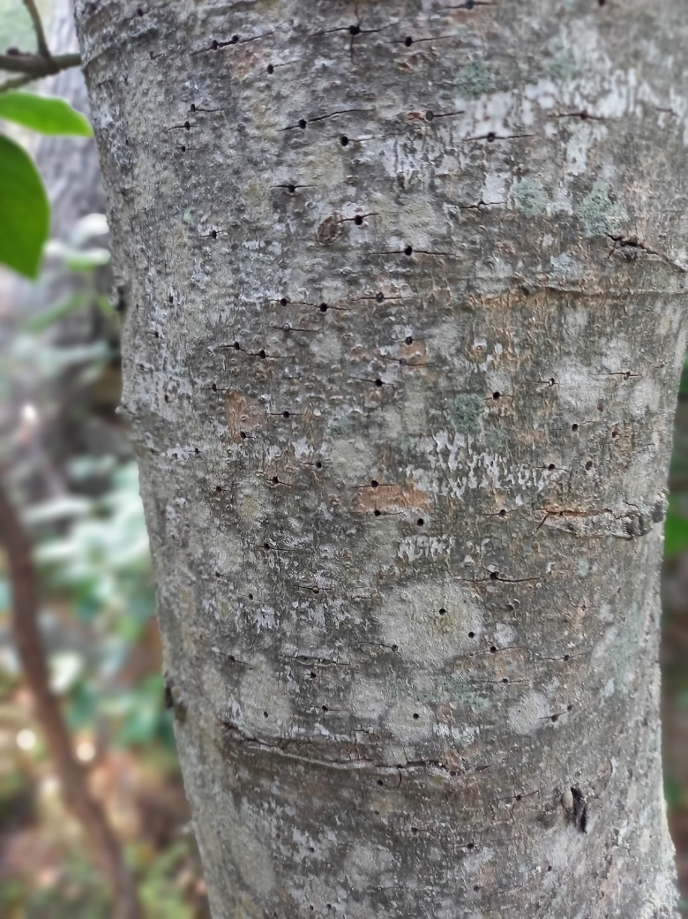
Differences in beetle damage between onset and end of the tests to reveal the Push-Pull efficiency
Device installed before any spring flight (March):
Entry holes to be counted on trunk and on 10 branches and 10 apical shoots ca. 50cm long per tree on all trees and shrubs of each block.
Beetles captured in the traps of Push-Pull and Pull treatments collected to compare the catches
When beetle flight is over (October):
Entry holes to be counted on trunk and branches on the same trees and shrubs as in spring
Calculation of the difference in the number of entry holes per block

Slide 7
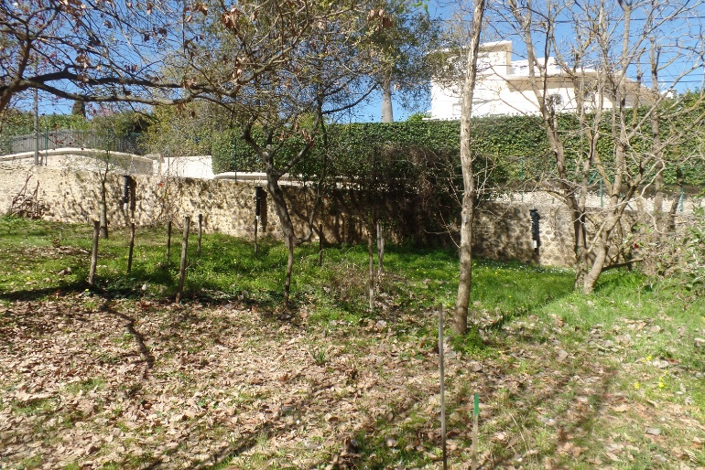
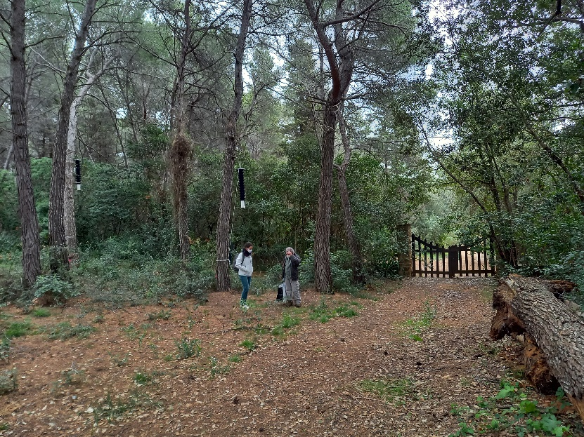
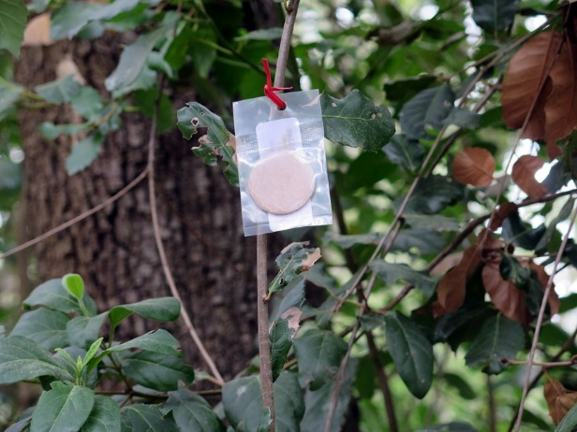
3 similar trials carried out in different environments during 2021 in France and Italy
An urban botanical garden: Villa Thuret , France
A protected forest on an island: Ste Marguerite island, France
A protected natural park: Circeo National Park, Italy

Slide 8
Example of trial at Villa Thuret Start 15 March- End 18 October 2021
Push-Pull
Push
Pull
Control

Slide 9
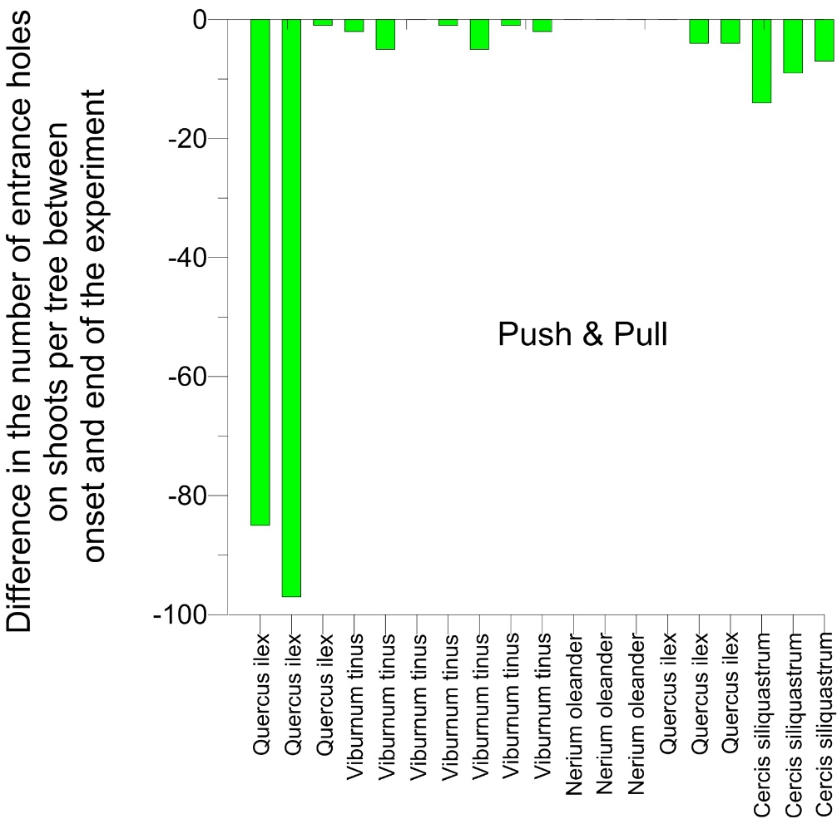
Decrease in damage by X. compactus in push-pull plots more important at Ste Marguerite than at Thuret
Negative effect
Negative effect
Villa Thuret
Positive effect
Ste Marguerite
Positive effect
Infestation too low in Circeo plots for any analyses

Slide 10
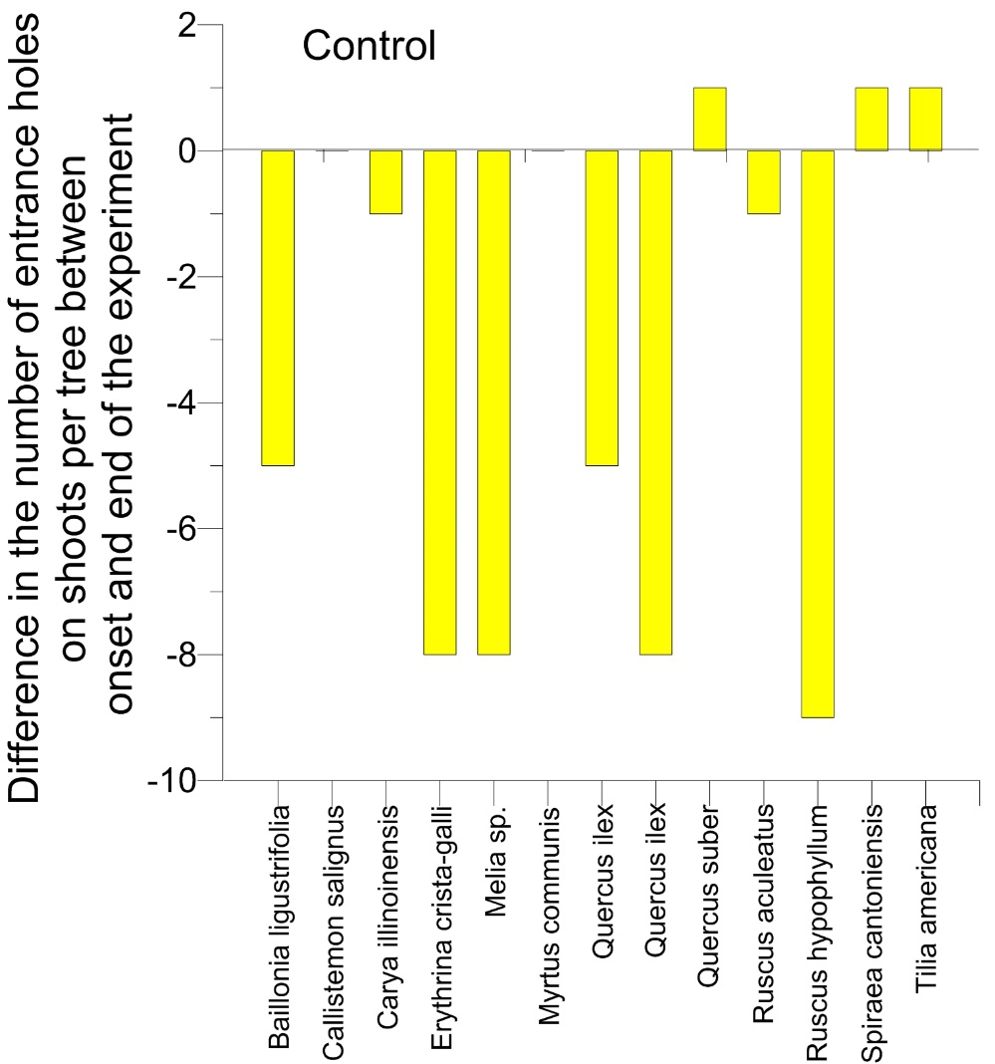
However, the decrease was also observed in the untreated control plots !
Villa Thuret
Ste Marguerite

Slide 11
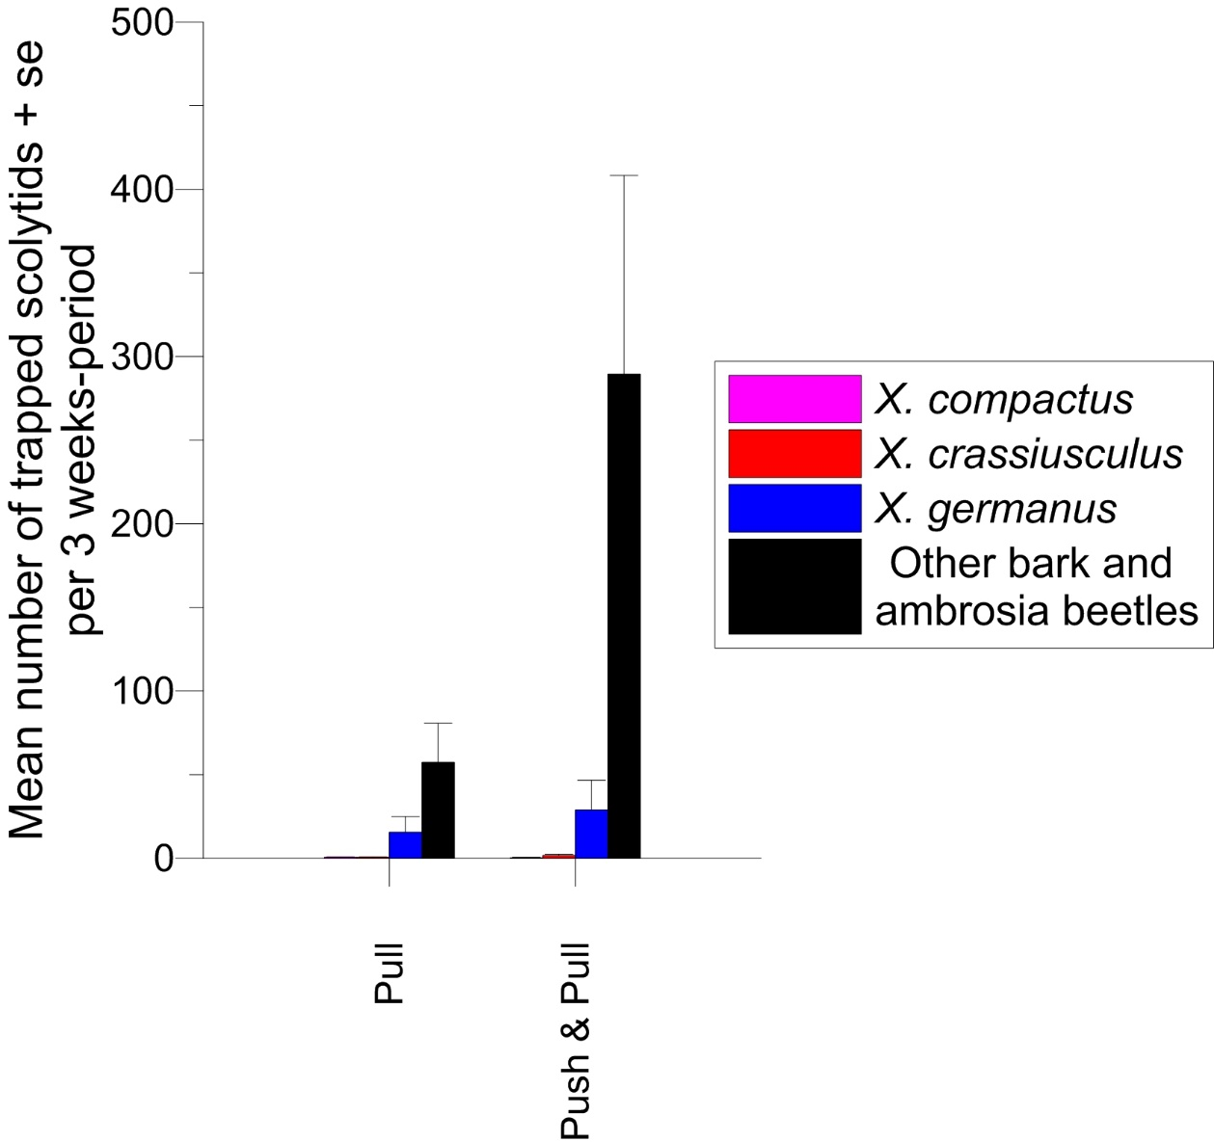
Why such a decrease in damage in all plots ? The low density of Xylosandrus is revealed by the limited trap captures
It is preventing any definitive conclusion
… but Push-Pull appeared to be effective for pushing out and trapping other bark beetles

Slide 12
Conclusions on the Push-Pull tactic
This is a promising tool
Push-Pull caused the displacement of hundreds of bark and ambrosia beetles other than Xylosandrus spp., thus clearly showing it may allow to contain some of these species
However, the current Xylosandrus damage was too low in the tested plots, especially for X. crassiusculus, to expect any visible effect on their containment
The next step is to carry out similar tests in a context of large Xylosandrus density

Slide 13
The contents of this training package are the sole responsibility of the LIFE SAMFIX partnership and do not necessarily reflect the opinion of the European Union or its agency CINEA.
For more information:
www.lifesamfix.eu
E-mail: xylosandrus@parcocirceo.it
Address: Via Carlo Alberto 188, 0416 Sabaudia (IT)
Tel. +39 077 3512240
Follow us on and

