Slide 1


Training package for the prevention of Xylosandrus invasions and the application of early warning, monitoring and rapid response protocols
Module 1. The biology of Xylosandrus crassiusculus and Xylosandrus compactus
Module 2. Xylosandrus and associated fungi
Module 3. Invasion history and pathways
Module 4. Prevention: reducing vulnerability through forest interventions
Module 5. Early warning and monitoring
Module 6. Containment
Module 7. Supporting technologies: smart traps and app
June 2022

Slide 2
Authors:
Module 1: Massimo Faccoli, University of Padua
Module 2: Carmen Morales Rodriguez, University of Tuscia
Module 3: Teddy Urvois, INRAe
Module 4: Paolo De Angelis, University of Tuscia
Module 5: Stefano Speranza, University of Tuscia
Module 6: Alain Roques, INRAe
Module 7: Claudio Belli, Terrasystem Srl
Editing: Gertruud van Leijen, on behalf of Circeo National Park

Slide 3



Early warning and monitoring
Stefano Speranza

Slide 4

Early warning and monitoring
Definitions
Early warning
    Something that tells you in advance that something serious or dangerous is going to happen
    Warning of a future event that comes early enough for you to prepare for it
Monitoring
    to watch and check something over a period of time in order to see how it develops, so that you can make any necessary changes

Slide 5
Early warning and monitoring
1. Early warning
Determination Xylosandrus-free area
  Identification of areas of potential survival of the insect
  defining the state of the art of insect presence
  identification of potential hosts of the insect
Communication and training
  Involve public and private institutions, natural parks and the general public
  Public events and media information
Establish early warning protocols
  Identify areas with insect presence
  Identify areas at high risk of invasion
  Define an early warning network

Slide 6
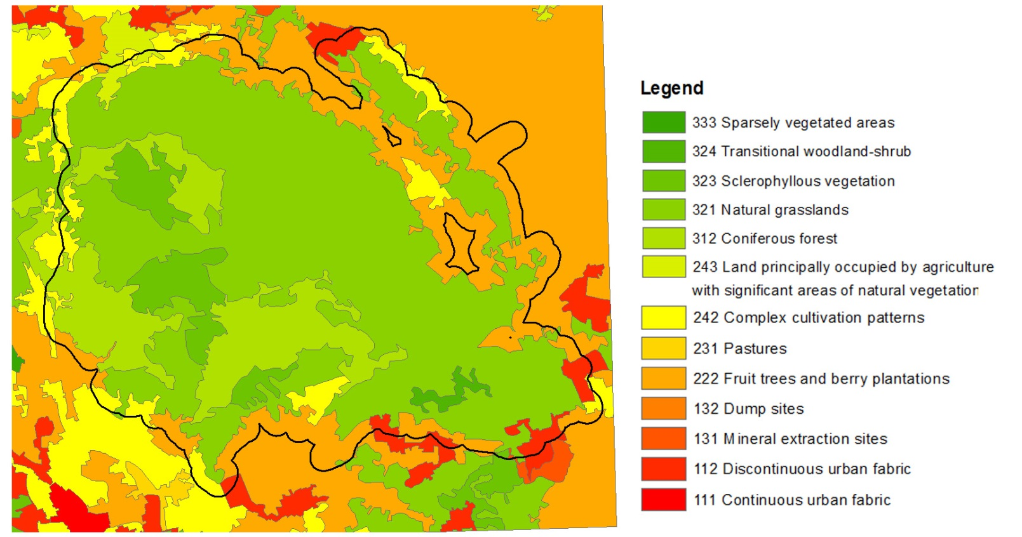
Early warning and monitoring
Corine Land Cover layers

Slide 7
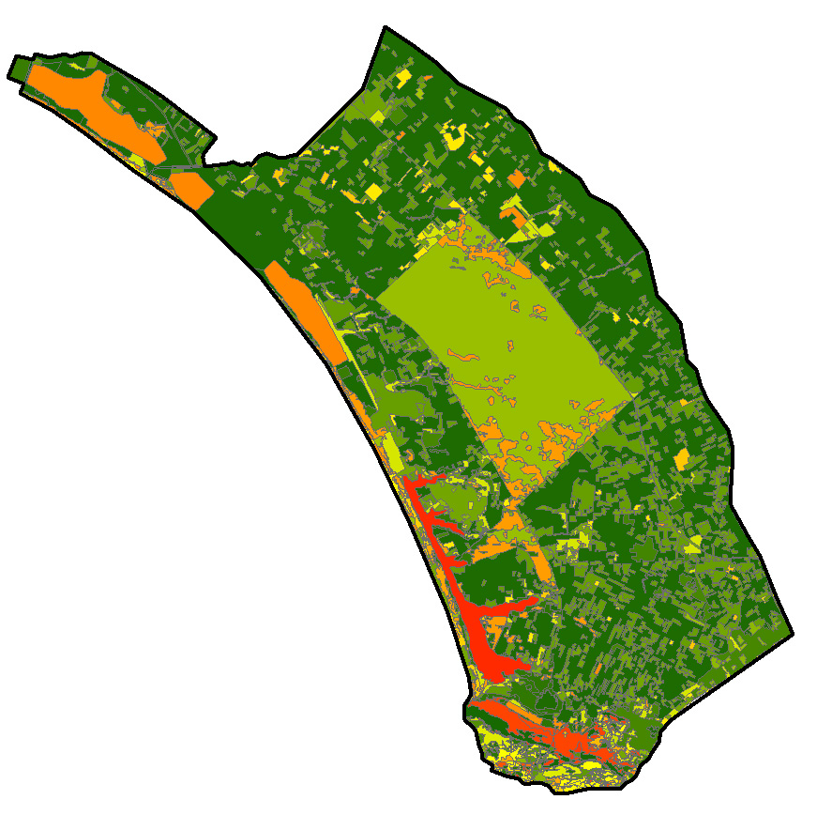
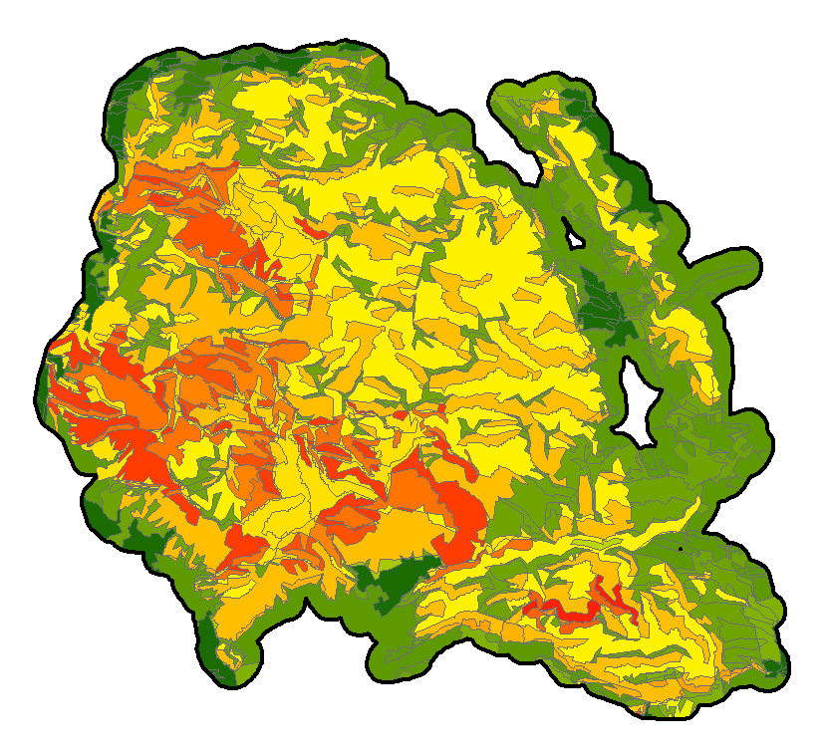
Early warning and monitoring
Circeo, Italy
El Tello, Spain

Slide 8
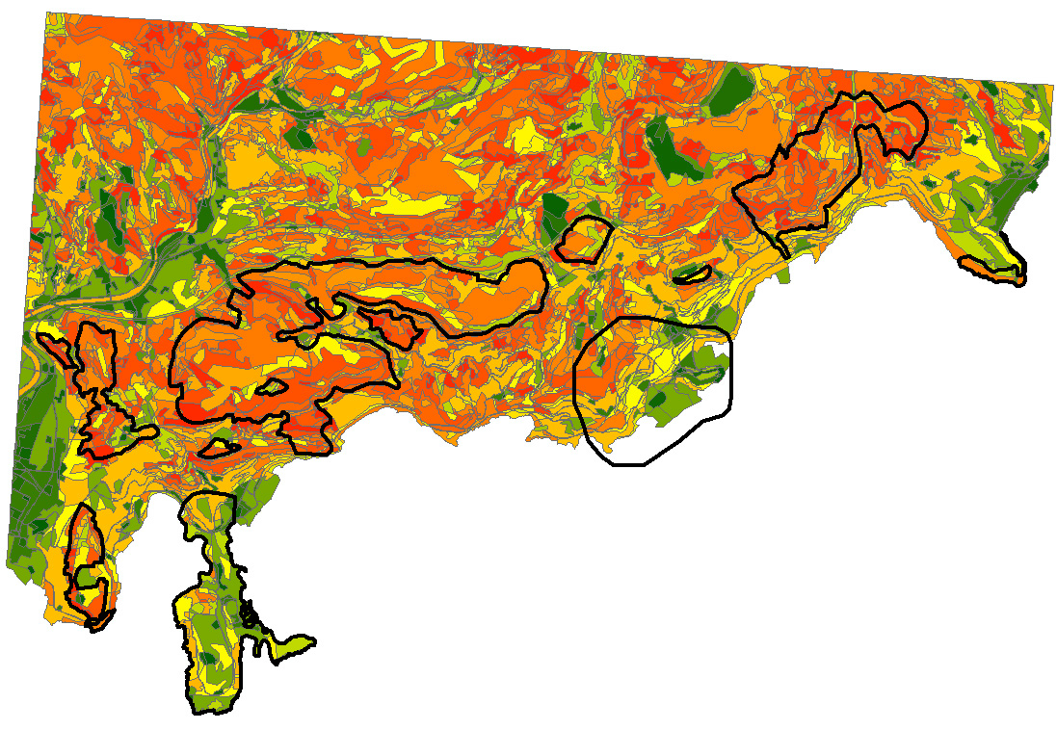
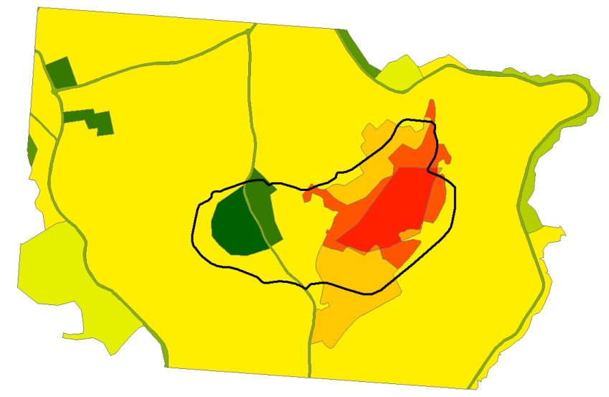
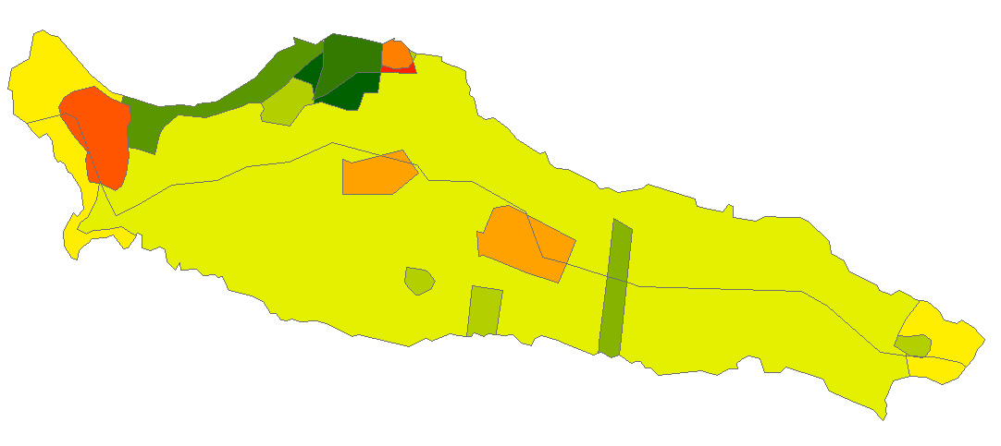
Early warning and monitoring
France

Slide 9
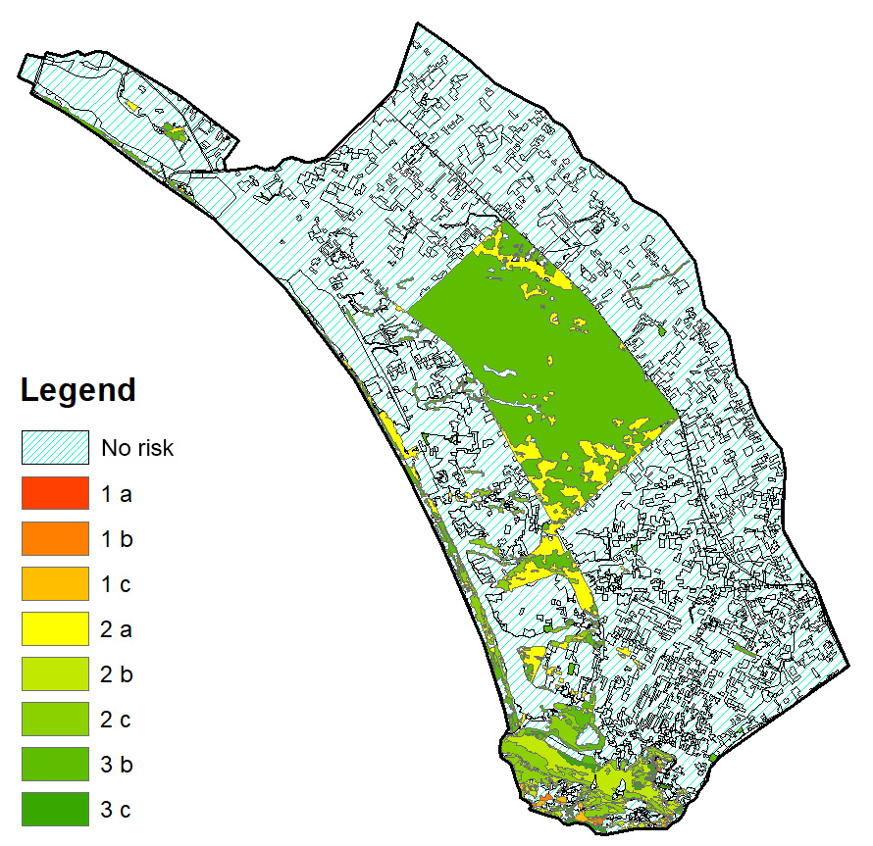
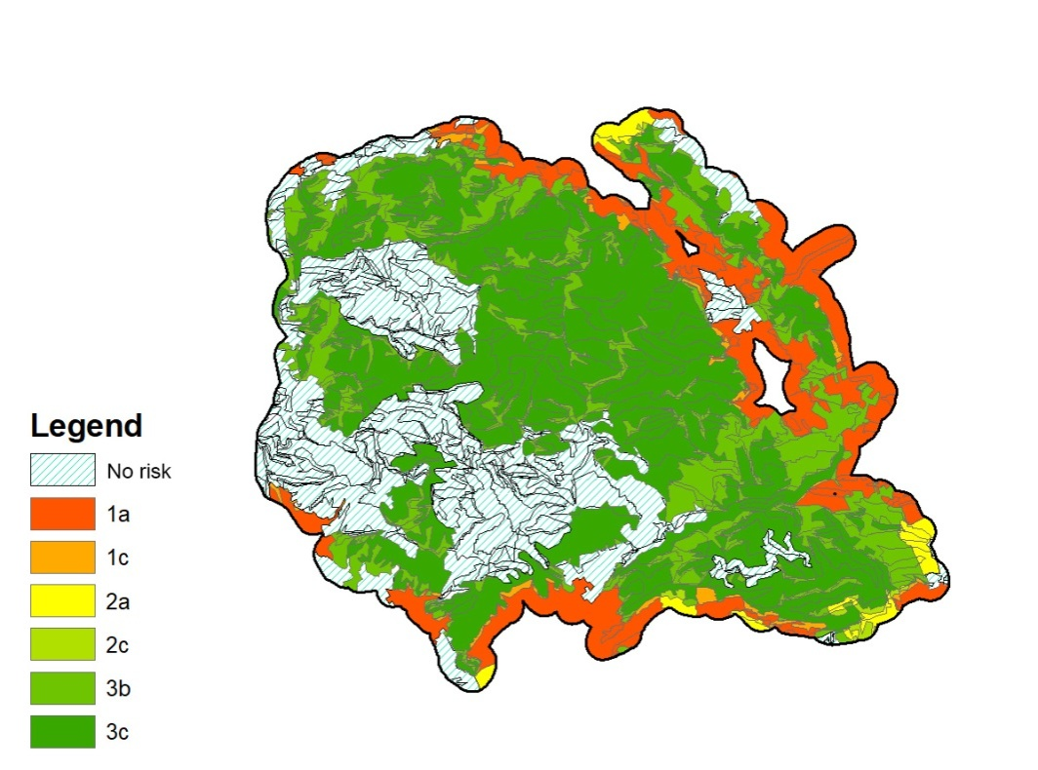
Early warning and monitoring
Risk Maps
Circeo, Italy
El Tello, Spain

Slide 10
Early warning and monitoring
2. Monitoring
Determination Xylosandrus best traps
Determination Xylosandrus lures
Determination of best distance for traps (monitoring and control)
Monitoring methodology

Slide 11
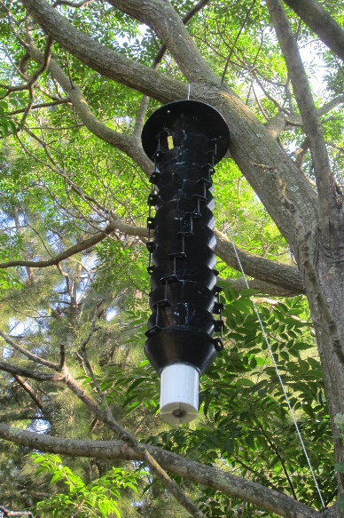
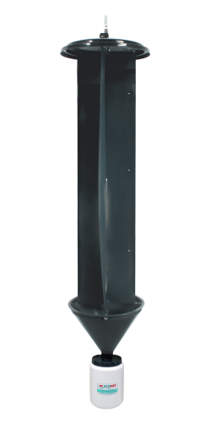
Early warning and monitoring
Captures by multifunnel traps not significantly different from those by CrossVane traps
Use of multifunnel more easy

Slide 12
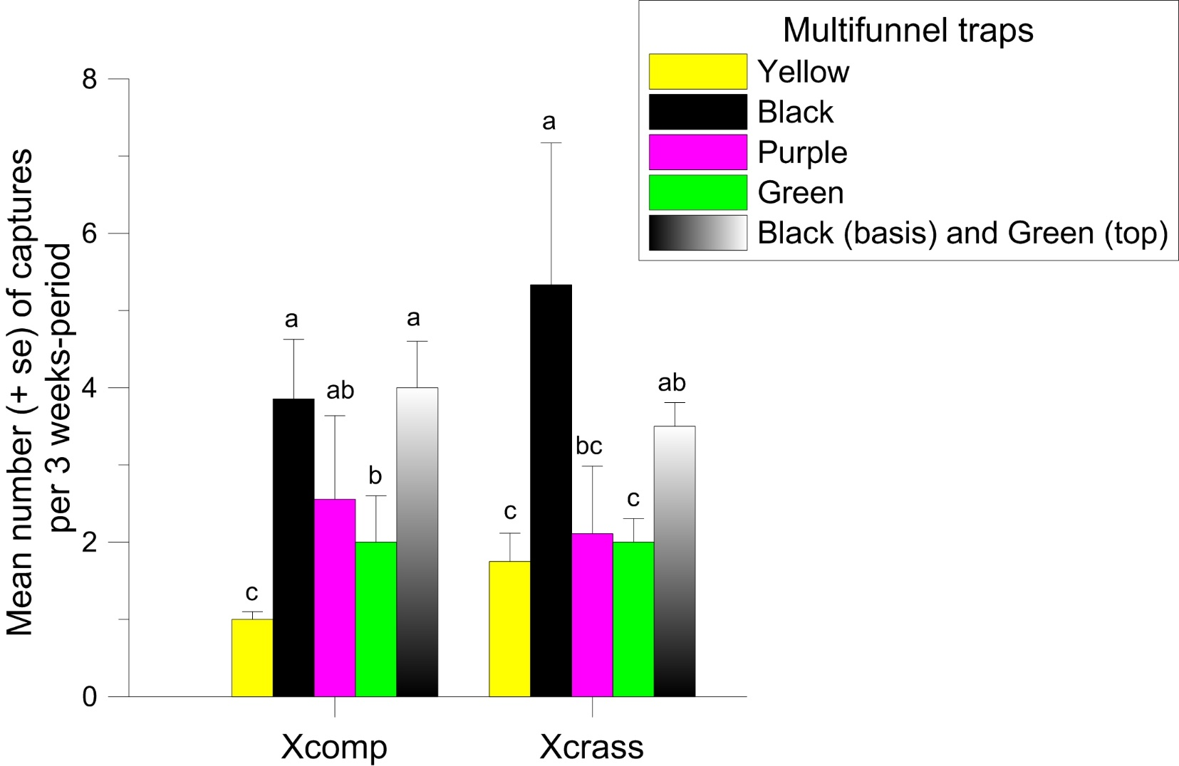
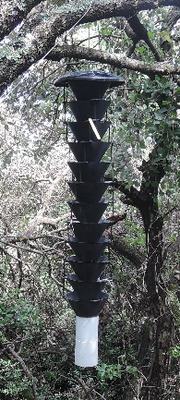
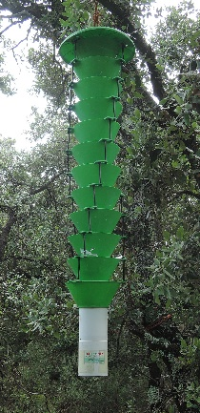
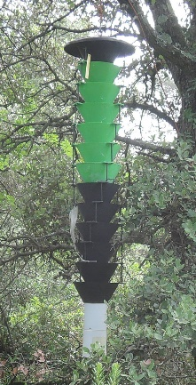
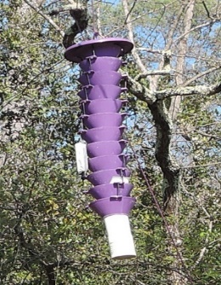
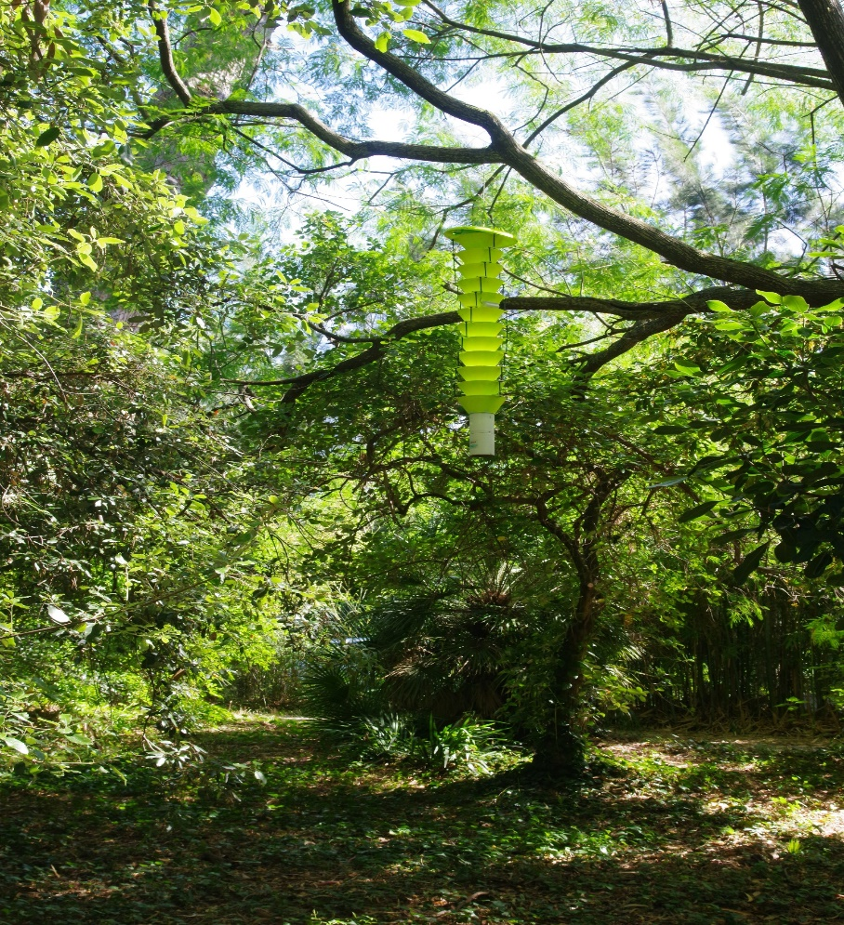
Black traps give the best result
Early warning and monitoring

Slide 13
Early warning and monitoring
Test of the effect of different blends of lures
Based on literature, the following 8 new lure blends were used, in single bait or in different combinations, with the 2018 lure as a control
quercivorol (1 ml- high dose)
α-copaene (2 ml)
quercivorol (1ml) + α-copaene (2ml)
quercivorol (1ml) + α-copaene (2 ml)+ Ethanol + (-) α-pinene;
quercivorol + Ethanol (UHR bag) + (-) α-pinene (2ml)
α-copaene + Ethanol (UHR bag) + (-) α-pinene (2ml)
Ethanol (UHR bag) +(E)-(±)-conophthorin
Ethanol (UHR bag) + (-) α-pinene (2ml)
Control: 8-pheromones generic blend used in 2018 + (-) α-pinene + Ethanol

Slide 14
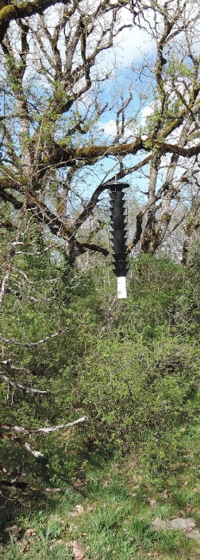
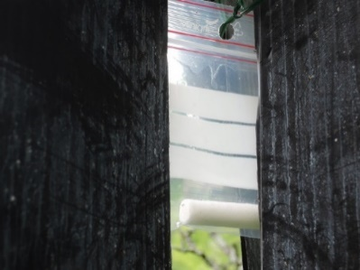
Early warning and monitoring
How did we test them?
Black multifunnel traps with wired-meshed bottom and insecticide net (alpha-cypermethrin BASF Pflanzenschutz Deutschland, Germany)
Test in blocks with the 9 randomized lures
4 blocks per site= 36 traps
Compound on dental cotton enclosed in polyethylene bags (except Ethanol UHR bag)
Compounds and insecticides changed every 3 weeks (except Ethanol UHR bag: 60 days)
Clockwise rotation of lures in each block at each change
Tests started in March until October, in Circeo National Park (IT) and in Antibes (FR)

Slide 15
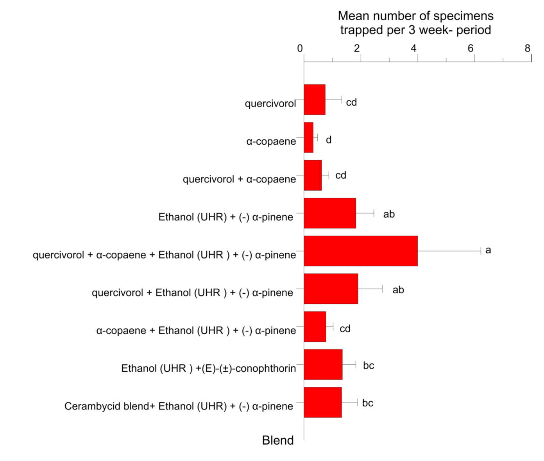
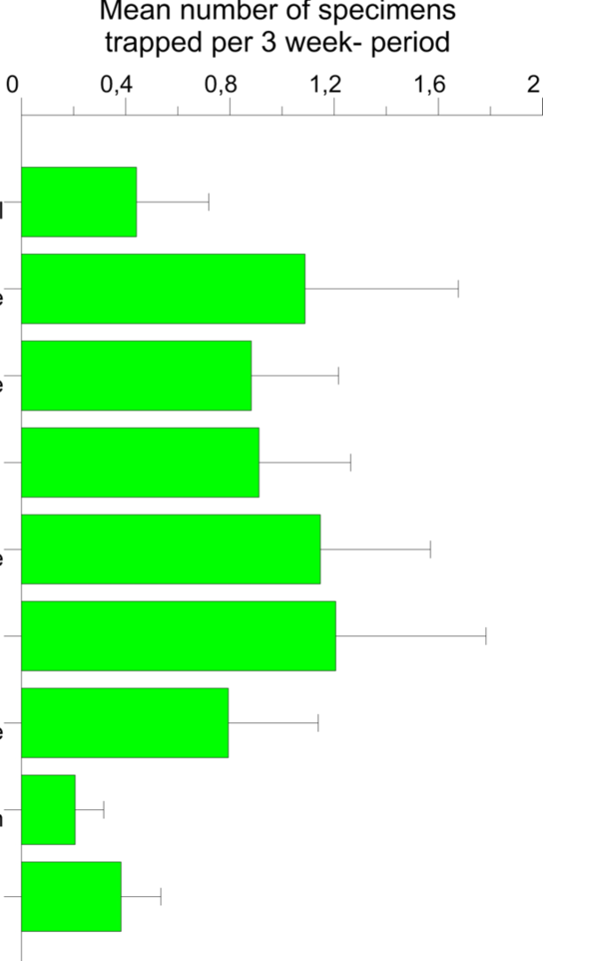
X. compactus
X. crassiusculus

Slide 16
Early warning and monitoring
  Definition of optimal trap density for Xylosandrus detection
Trap
10m
20m
30m
50m
Bois de la Garoupe: 2 transects
Circeo Park: 9 transects

Slide 17
Early warning and monitoring
The relationship between the relative trap capture and the distance between paired traps is fitted with a logistic curve. It allows to define the best distance for trap density

Slide 18
Early warning and monitoring
As a compromise, early detection of the 3 invasive Xylosandrus species in susceptible areas should rely on linear transects of attractive traps spaced at 20m from each other.
The length of the transect depends on the size of the area to be surveyed
The transect is better to be deployed along forest edge

Slide 19


Come disporre gli attrattivi sulle trappole a imbuto
Quercivorol, α-copaene, conofthorin, etanolo e miscela INRA # 3 devono essere posizionati al centro e α-pinene alla base della trappola come nelle foto:
Tutti i dispenser, eccetto l’etanolo, devono essere orientati verso l’interno della trappola!
A- I dispenser di quercivorol, α-copaene, conophthorin fissati da soli o su lati diversi dello stesso imbuto (se 2 prodotti) a metà della trappola
B- La miscela INRA # 3 fissata su un imbuto a metà della trappola
C- La sacca di Etanolo, lunghissima, è piegata a metà, un anello passante nei fori in alto, e legato al collegamento di un imbuto a metà della trappola
D- Il sacchetto di a-pinene è posto sul secondo imbuto dal basso.

Slide 20
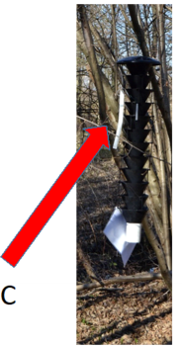
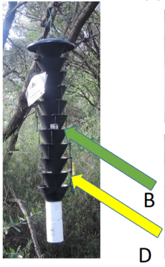
Early warning and monitoring
Take-home messages
What can I do?
  If I want to see if Xylosandrus entered my area: monitoring for early warning
  If I want to understand the dynamics of presence: monitoring
With what?
  With a black trap Multifunnel or CrosVane
  With the lure blend quercivorol (1ml) + α-copaene (2 ml)+
  ethanol + (-) α-pinene
How do I install the trap with lures?
  Quercivorol, α-copaene and ethanol should be hang in the
  centre of the trap, α-pinene on the base. Dispensers should
  be oriented towards the inside of the trap.
When?
  March-April through October-November
Where should I install the traps?
  Possibly not on trees, but in open spaces in the forest or along its margins. Transects are particularly indicated, distance between traps 20 metres.
C: Ethanol bag – B: dispensers of quercivorol and α-copaene – D: sachet with α-copaene

Slide 21
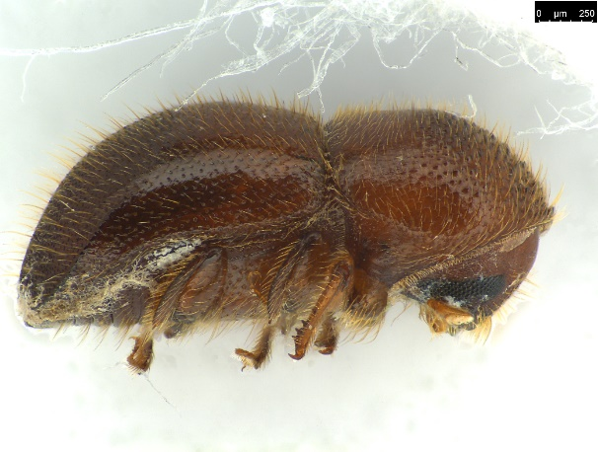
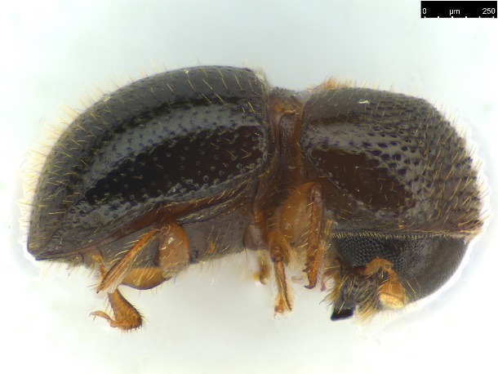
Early warning and monitoring
Take-home messages
How often should I check the traps?
  Every 3 weeks
How often should I substitute the lures?
  Every 6 weeks
What should I do with the samples?
  Store them in closable sachets, identified with collection date and trap reference, keep them at -10 °C until they can be provided for identification to entomologists
What should I do if I find infested trees?
  If infestation is ongoing and localized, trees or their infested parts could best be destructed. This is most effective if done after tree’s colonisation and just prior to the flight peak; alternatively during winter. Cut materials should be burned on-site, if not allowed they should be chipped. Consult an expert.
How can I simplify the work?
  By training your staff (materials - videos and pdf- in Italian, French and Spanish at www.lifesamfix.eu )
  By staying in touch with the monitoring network and national contacts
  By using X-Traps and raising awareness amongst visitors and nurseries

Slide 22
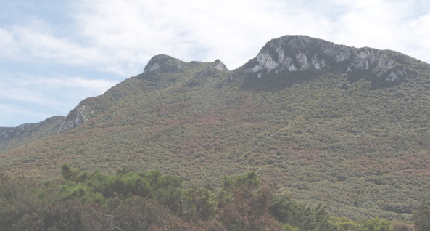
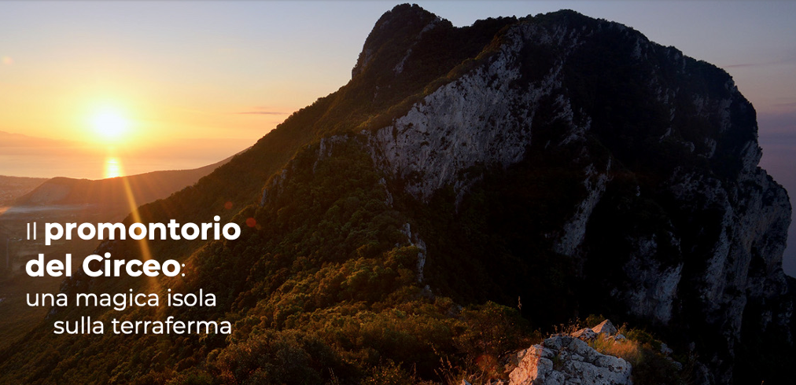
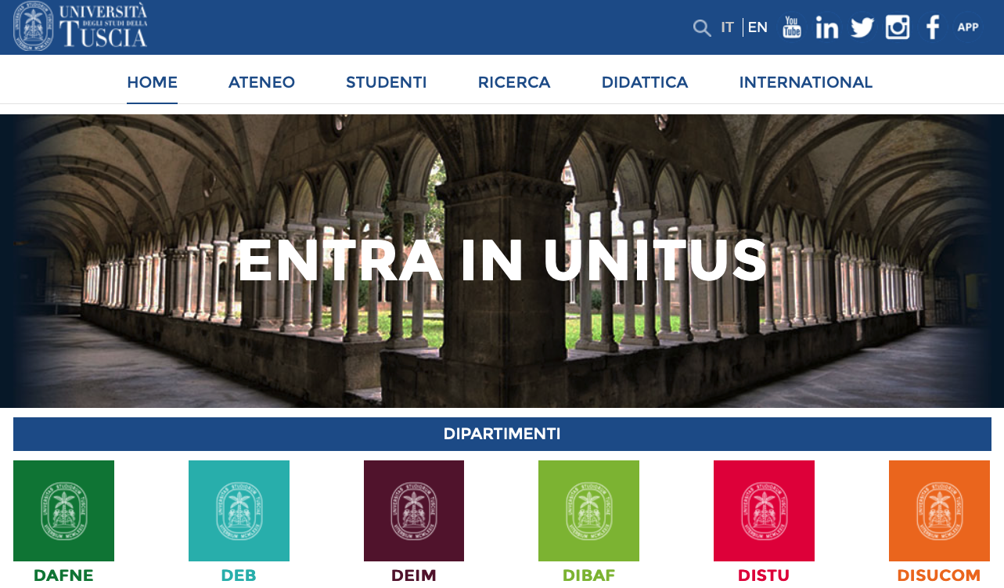
Early warning and monitoring
Thank you for the attention

Slide 23



The contents of this training package are the sole responsibility of the LIFE SAMFIX partnership and do not necessarily reflect the opinion of the European Union or its agency CINEA.
For more information:
www.lifesamfix.eu
E-mail: xylosandrus@parcocirceo.it
Address: Via Carlo Alberto 188, 0416 Sabaudia (IT)
Tel. +39 077 3512240
Follow us on and

