Slide 1
Training package for the prevention of Xylosandrus invasions and the application of early warning, monitoring and rapid response protocols
Module 1. The biology of Xylosandrus crassiusculus and Xylosandrus compactus
Module 2. Xylosandrus and associated fungi
Module 3. Invasion history and pathways
Module 4. Prevention: reducing vulnerability through forest interventions
Module 5. Early warning and monitoring
Module 6. Containment
Module 7. Supporting technologies: smart traps and app
June 2022

Slide 2
Authors:
Module 1: Massimo Faccoli, University of Padua
Module 2: Carmen Morales Rodriguez, University of Tuscia
Module 3: Teddy Urvois, INRAe
Module 4: Paolo De Angelis, University of Tuscia
Module 5: Stefano Speranza, University of Tuscia
Module 6: Alain Roques, INRAe
Module 7: Claudio Belli, Terrasystem Srl
Editing: Gertruud van Leijen, on behalf of Circeo National Park

Slide 3
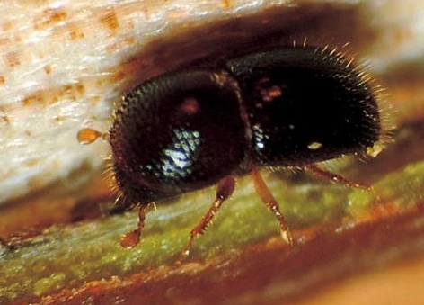
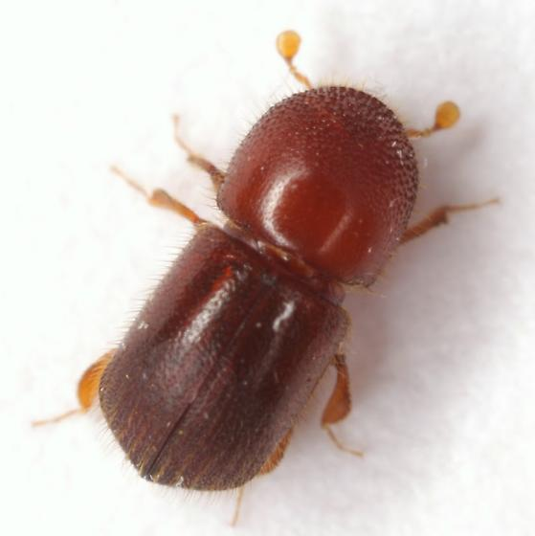
How did they get there ? Xylosandrus compactus and X. crassiusculus’ invasion history
Urvois Teddy, Alain Roques, Marie-Anne Auger-Rozenberg, Carole Kerdelhué, Charles Perrier, Jean-Pierre Rossi
Xylosandrus compactus
Xylosandrus crassiusculus

Slide 4
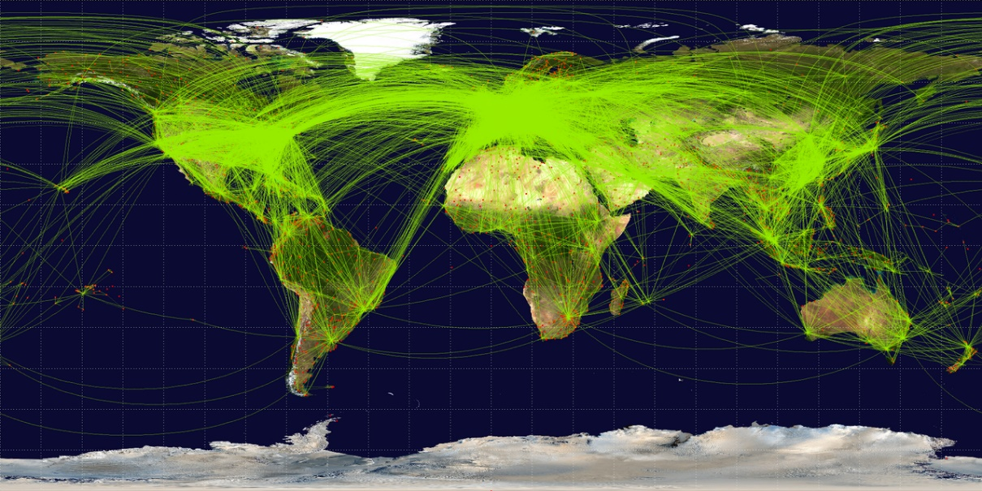
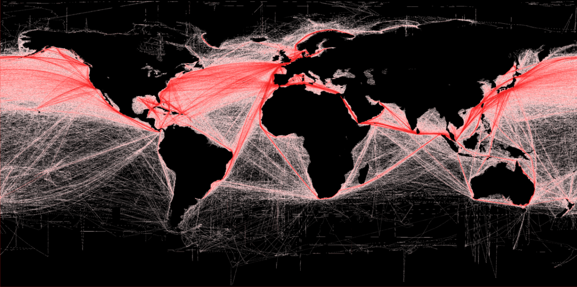
Biological invasions
Invasive species
Populations present outside their native range due to human intervention (volontarily or not)
Able to establish new viable populations and disperse
Facilitated by globalization
⇨ Favours dispersion and establishment
Notes:
Diagram showing the different invasion steps

Slide 5
Biological invasions
Invasive species
Populations present outside their native range due to human intervention (volontarily or not)
Able to establish new viable populations and disperse
Facilitated by globalization
⇨ Favours dispersion and establishment
Climate change can have an impact too
⇨ Changes in climatic parameters can impacts species distribution
Notes:
Diagram showing the different invasion steps

Slide 6
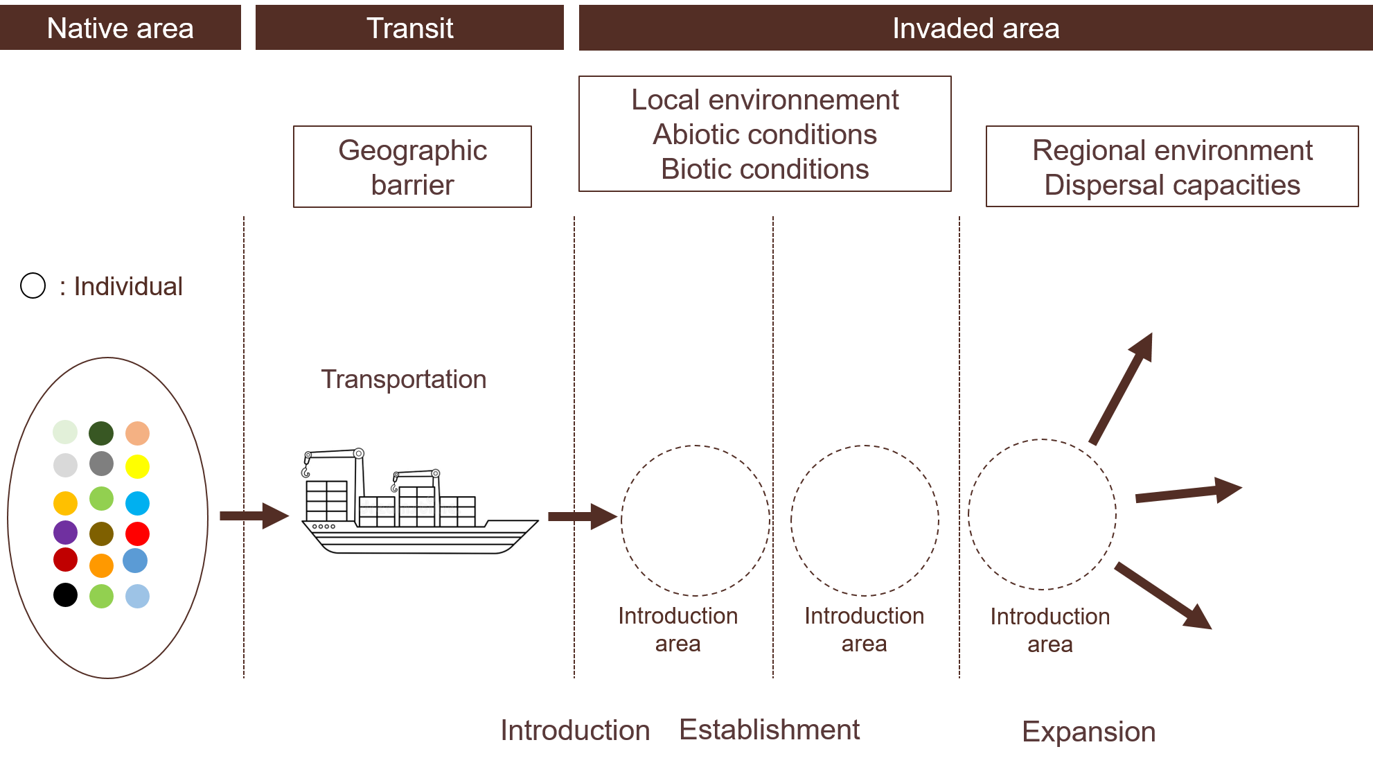
Invasion steps
Sampling, voluntary or not, random or not
Geographical barrier

Slide 7
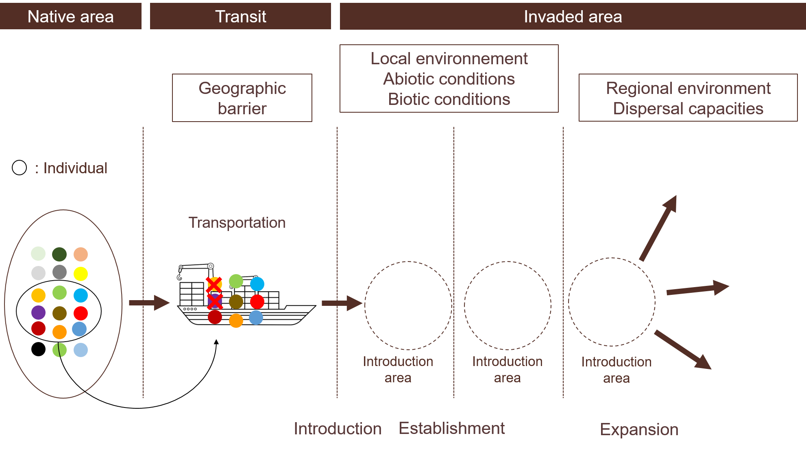
Invasion steps
Transportation: pass a geographical barrier
⇨ Mortality during transportation
Geographical barrier

Slide 8
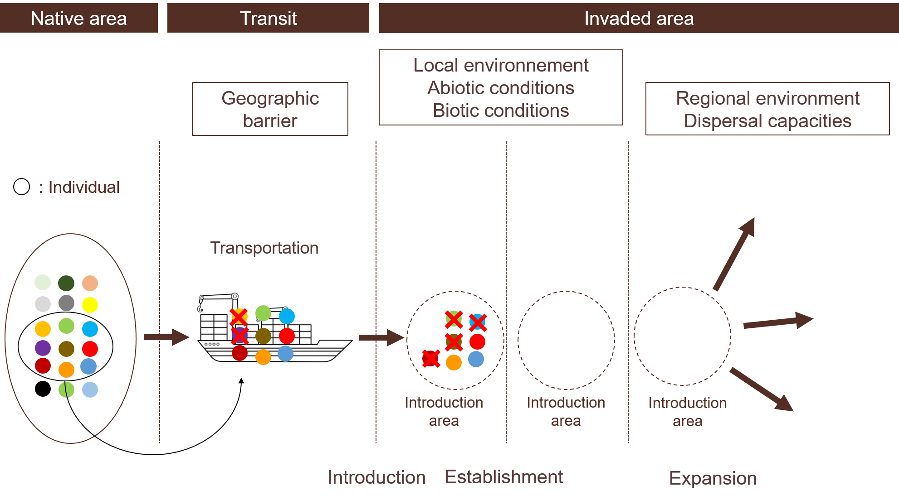
Invasion steps
Introduction
⇨ Mainly accidental nowadays
Geographical barrier

Slide 9
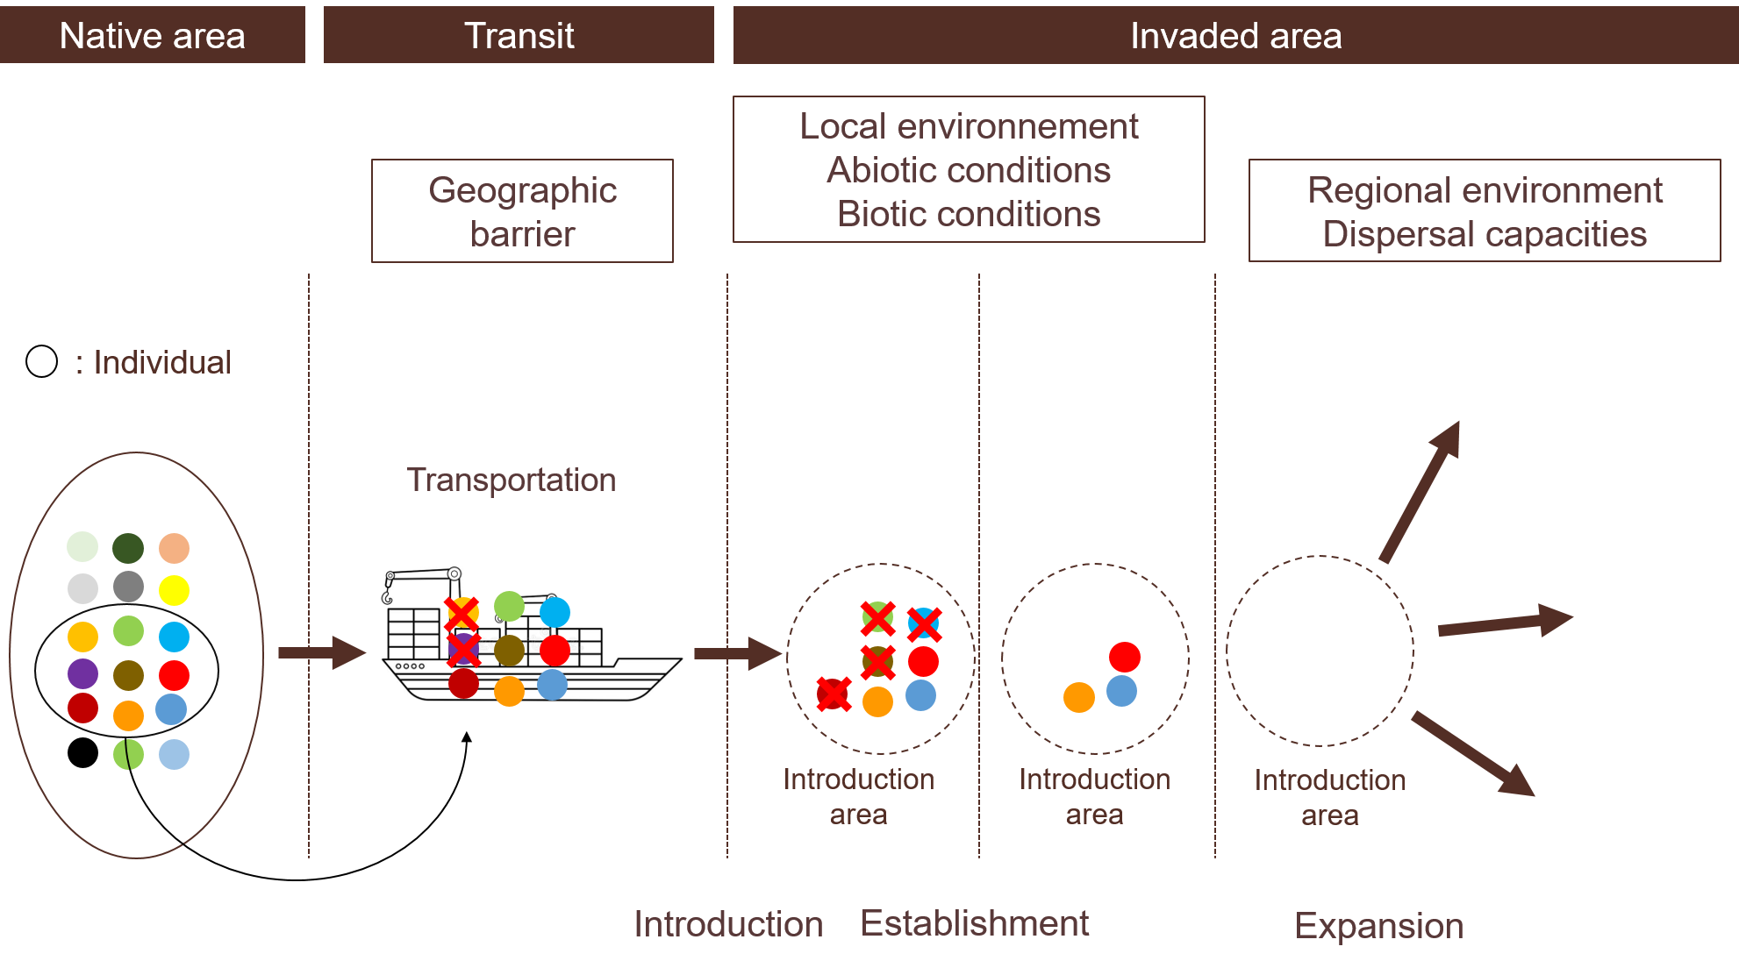
Invasion steps
Establishment: survival over several generations
⇨ Survive in the local environment
Geographical barrier

Slide 10
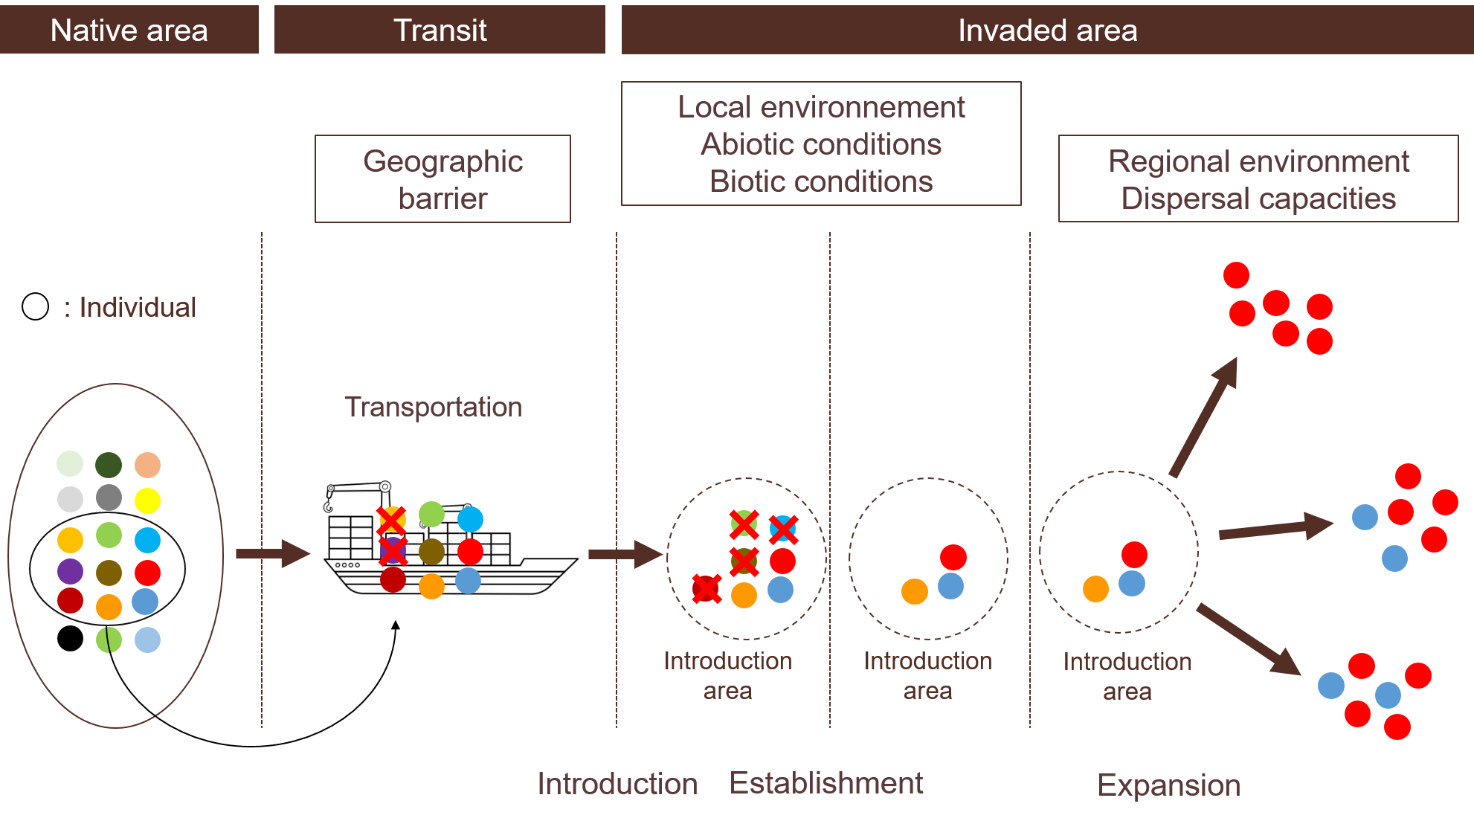
Invasion steps
Multiply and disperse
⇨ Active or passive dispersal
⇨ Survive in other environments
Geographical barrier

Slide 11
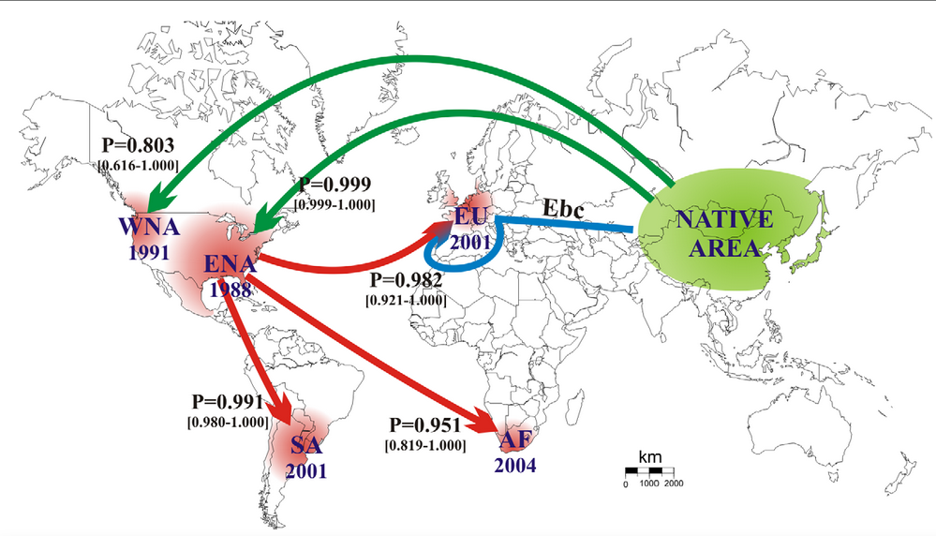
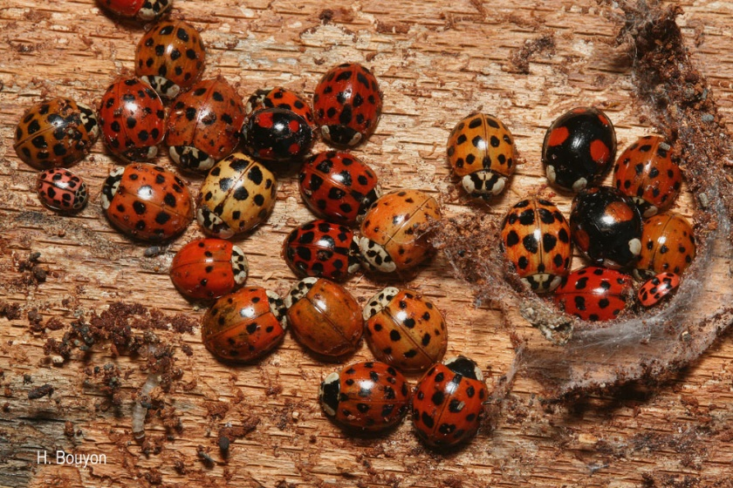
Understanding invasion history
Invasion from an invaded area
⇨ Bridgehead ( )
Harmonia axyridis
Harmonia axyridis’ invasion pathway
Lombaert et al. (2010)

Slide 12
Understanding invasion history
Invasion from an invaded area
⇨ Bridgehead ( )
Study invasion pathway
Direct observation
Invasion scenario testing
Genetic structure comparison
Harmonia axyridis’ invasion pathway

Slide 13
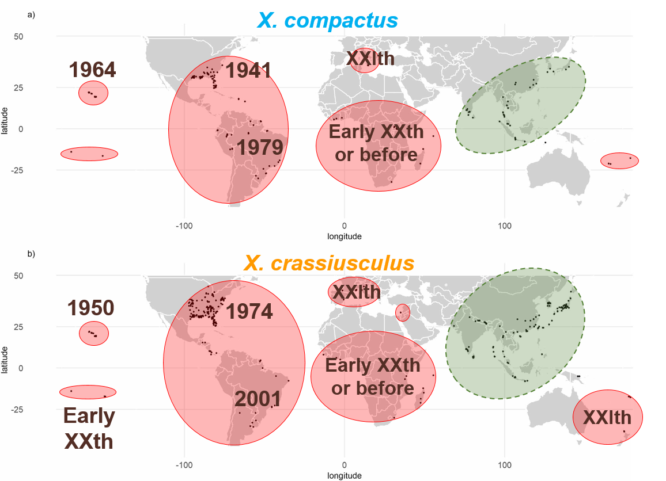
Native range
Xylosandrus compactus and X. crassiusculus
Invaded range
Native to Southeastern Asia
Boundaries unknown
Invasive worldwide
Europe recently invaded
First detection in Italy
X. compactus : 2003
X. crassiusculus : 2011
Can disperse a few kilometers actively
⇨ International plant trade or wood packaging material

Slide 14
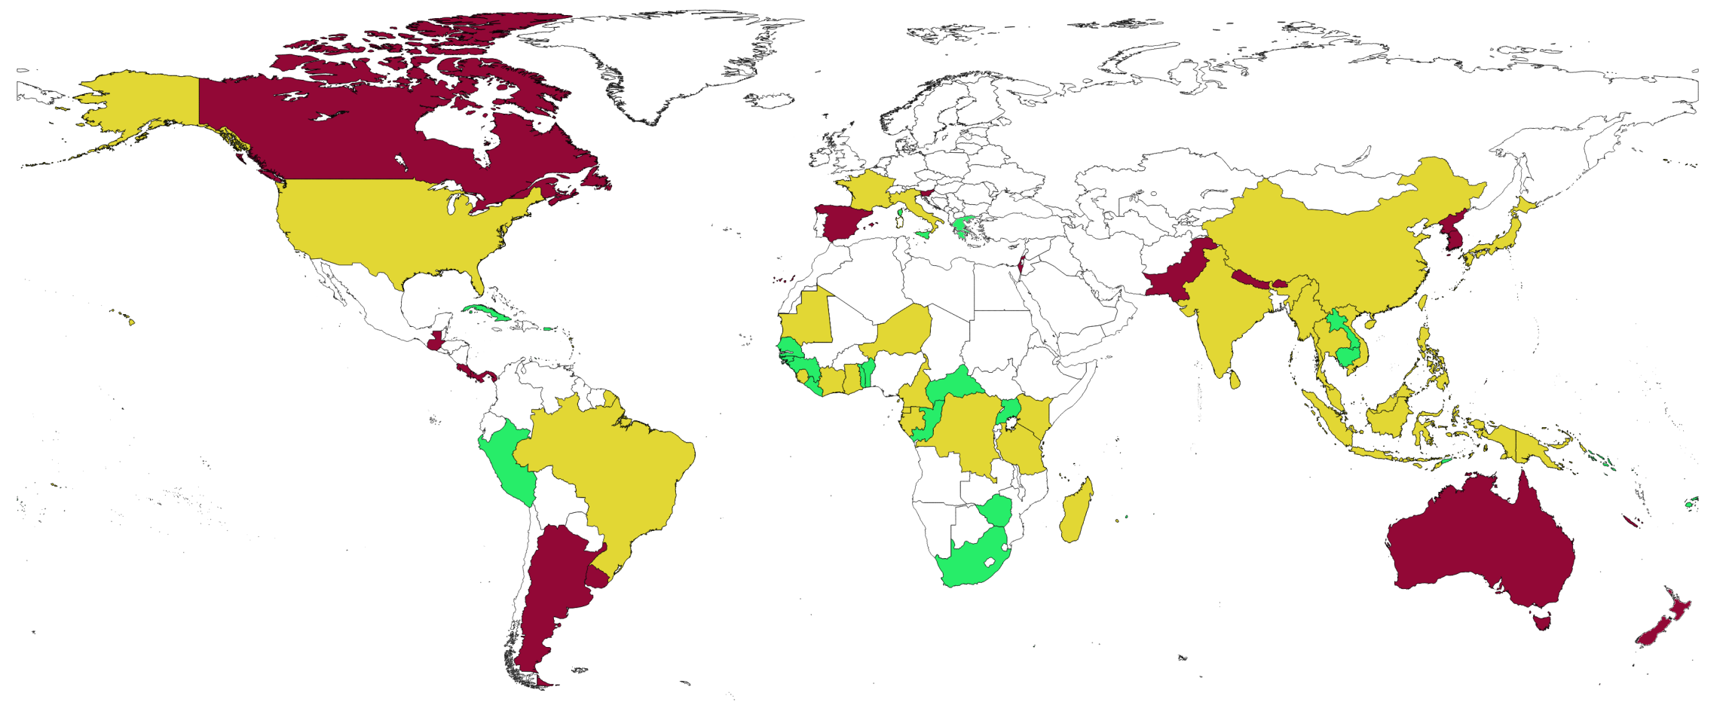
Questions and hypotheses
Close phylogenetically and ecologically
Similar native range
Invasive worldwide
⇨ Similar invasion history?
Not established
Xylosandrus crassiusculus
Xylosandrus compactus
Both species

Slide 15
Questions and hypotheses
Close phylogenetically and ecologically
Similar native range
Invasive worldwide
⇨ Similar invasion history?
First detection in Europe in Italy
⇨ Italy source of the invasion in Europe?

Slide 16
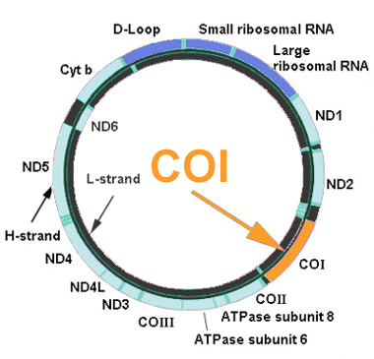
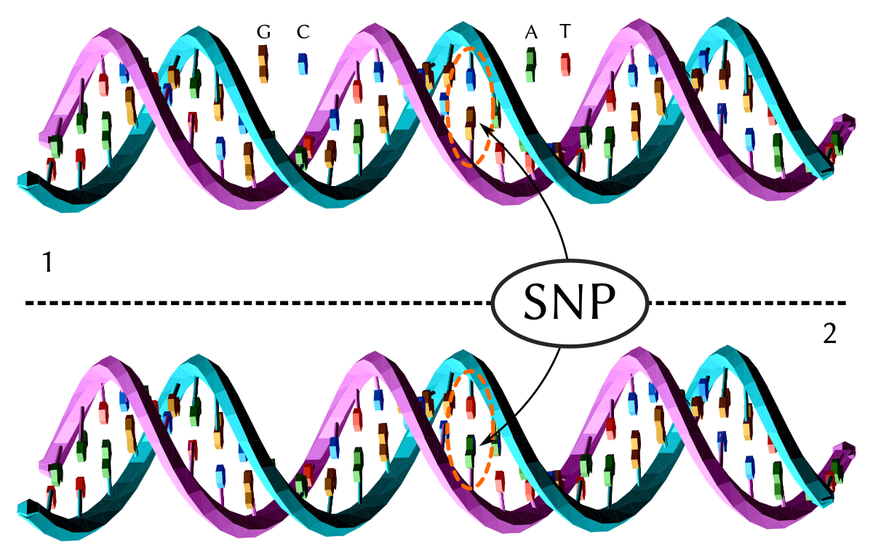
Material and methods
Sampling in the native and invaded range
2 complementary genetic markers
Mitochondrial : COI (barcode fragment)
Pangenomic : SNPs via RAD sequencing
Mitochondrial DNA
Nuclear DNA

Slide 17
Xylosandrus compactus’ invasion history
COI data:
96 specimens from 29 localities
Added 14 sequences from 10 localities from Genbank
5+4
2
Distribution of the 9 haplotypes sequenced

Slide 18
Xylosandrus compactus’ invasion history
COI data:
96 specimens from 29 localities
Added 14 sequences from 10 localities from Genbank
RADseq data:
114 specimens from 25 localities
⇨ Congruent results between markers

Slide 19
Xylosandrus compactus’ invasion history
Mid XXth?
Early XXIst
Mid XXth?
1941
Mid XXth?
1964
1979
Early XXth^{th} or before?

Slide 20
Xylosandrus compactus’ invasion history in Europe
Very low genetic diversity
1 single invasion + intracontinental dispersion
Does enough to decipher the invasion history in Europe
1 single invasion
End of XXth - Early XXIst
2015
2020
Shanghai region
2020
2011
2019
2019
2016

Slide 21
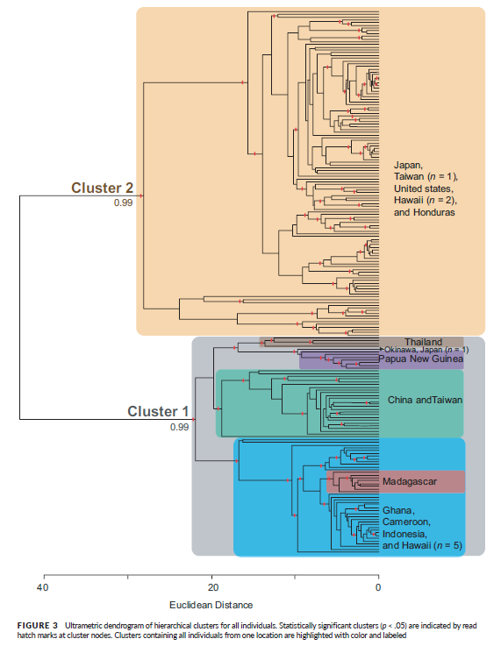
Xylosandrus crassiusculus’ invasion history
Several studies in the litterature
Different markers
Different geographical areas
⇨ Hard to conclude
Existing cryptic diversity?
ddRADseq
Asie, Amériques, Pacifique, Océanie
Storer et al. (2017)
Storer et al. (2017)

Slide 22
Xylosandrus crassiusculus’ invasion history
COI data:
188 specimens from 64 localities
Added 32 sequences from 24 localities from Genbank
Distribution of the 5 genetic lineages sequenced

Slide 23
Xylosandrus crassiusculus’ invasion history
COI data:
188 specimens from 64 localities
Added 32 sequences from 24 localities from Genbank
RADseq data:
206 specimens from 62 localities
⇨ Mostly congruent results between markers

Slide 24
Xylosandrus crassiusculus’ invasion history
Two genetically differenciated clusters
Mostly allopatric
Cluster 2 only present in Europe

Slide 25
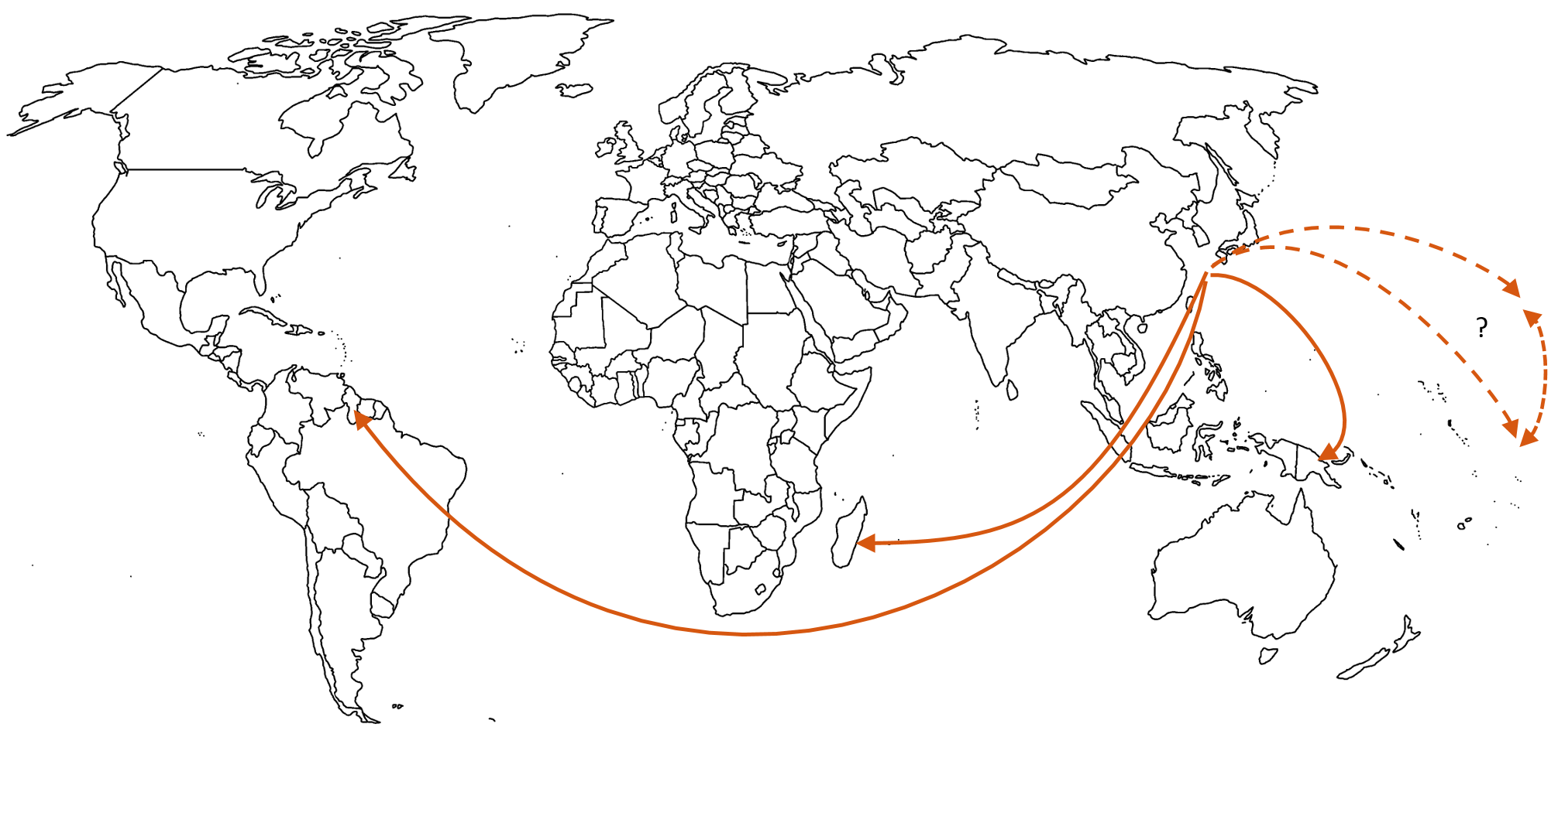
Xylosandrus crassiusculus’ invasion history
Cluster 1

Slide 26
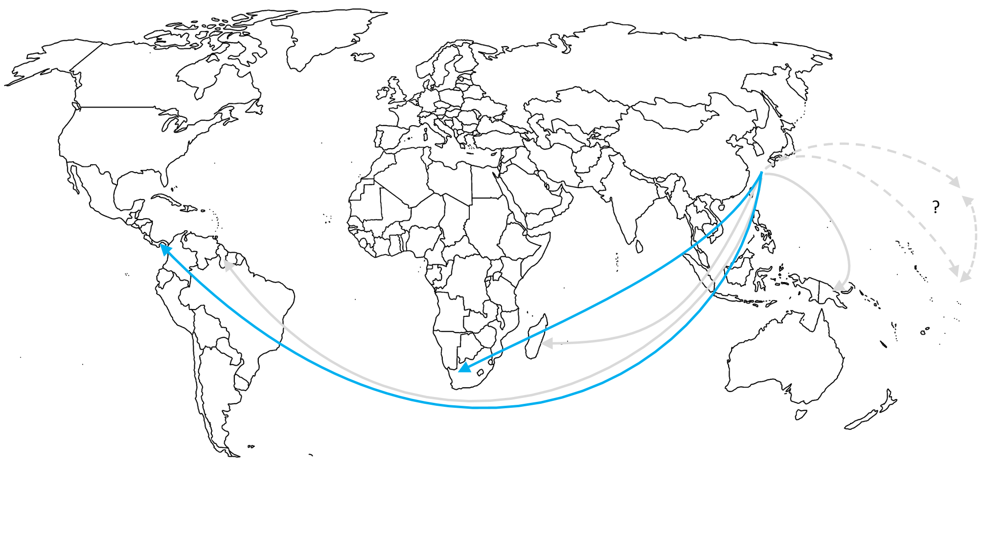
Xylosandrus crassiusculus’ invasion history
Cluster 1

Slide 27
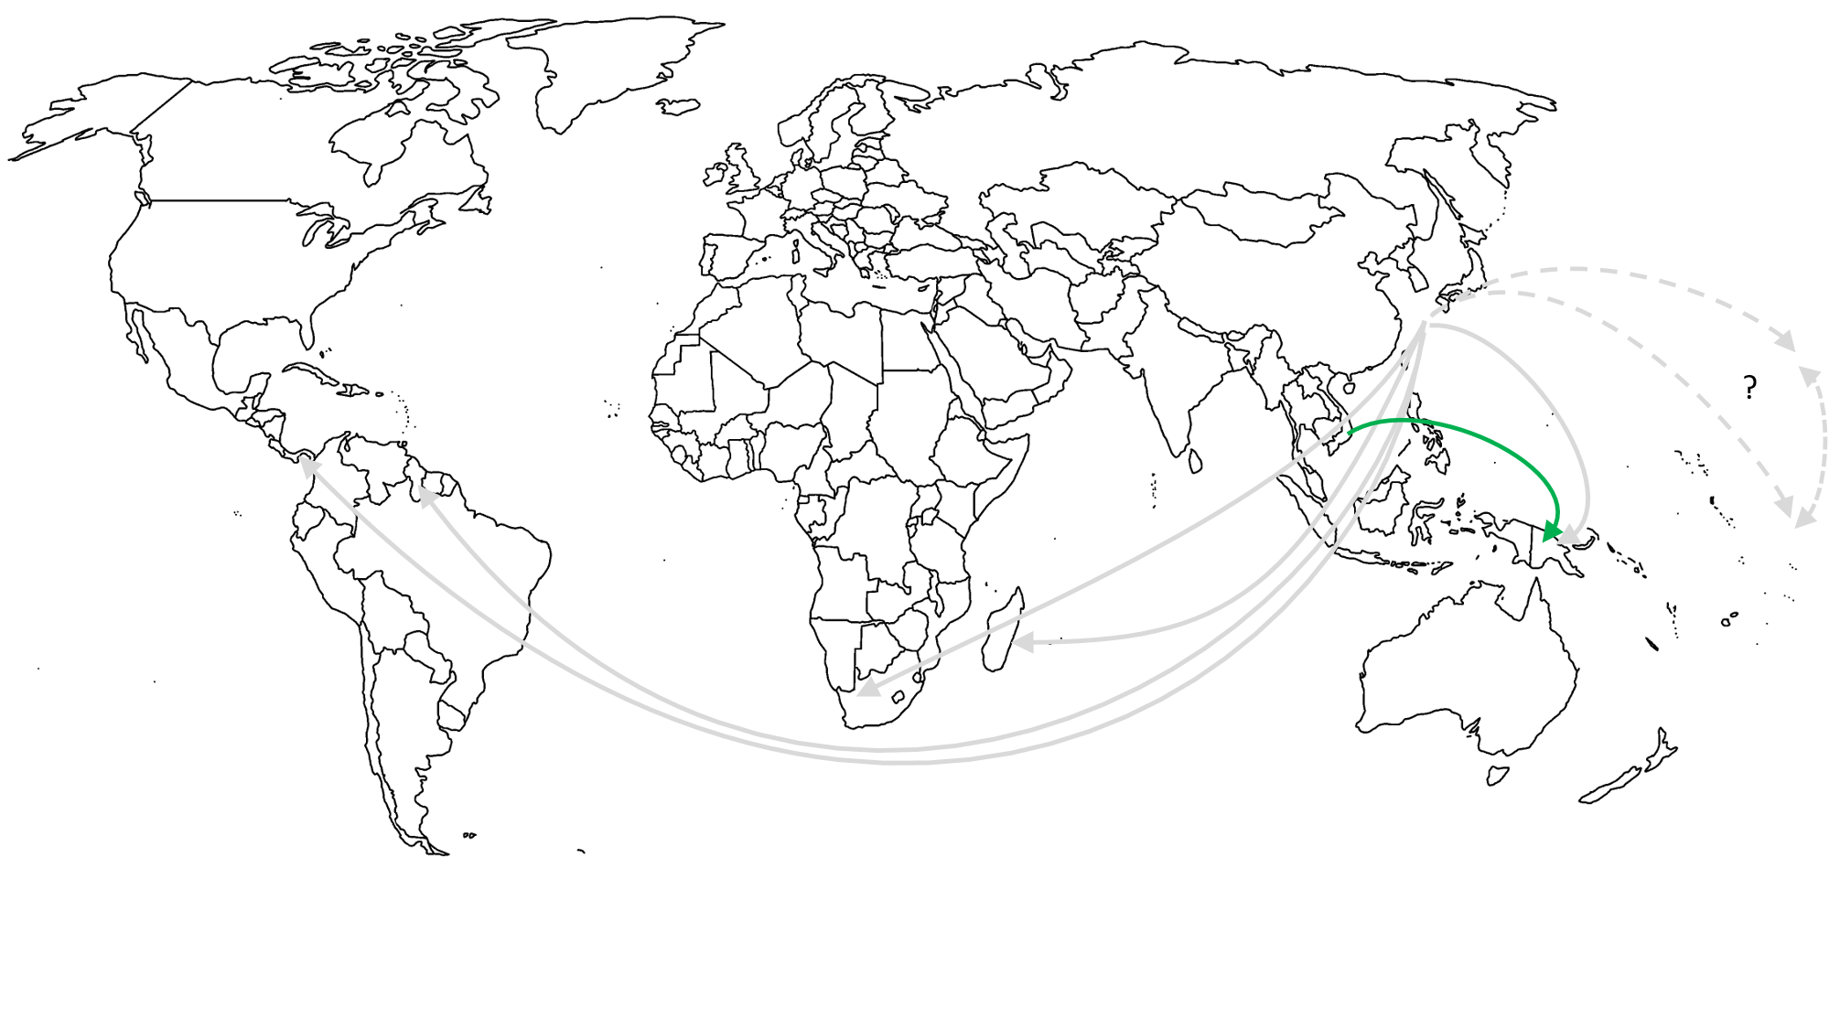
Xylosandrus crassiusculus’ invasion history
Cluster 1

Slide 28
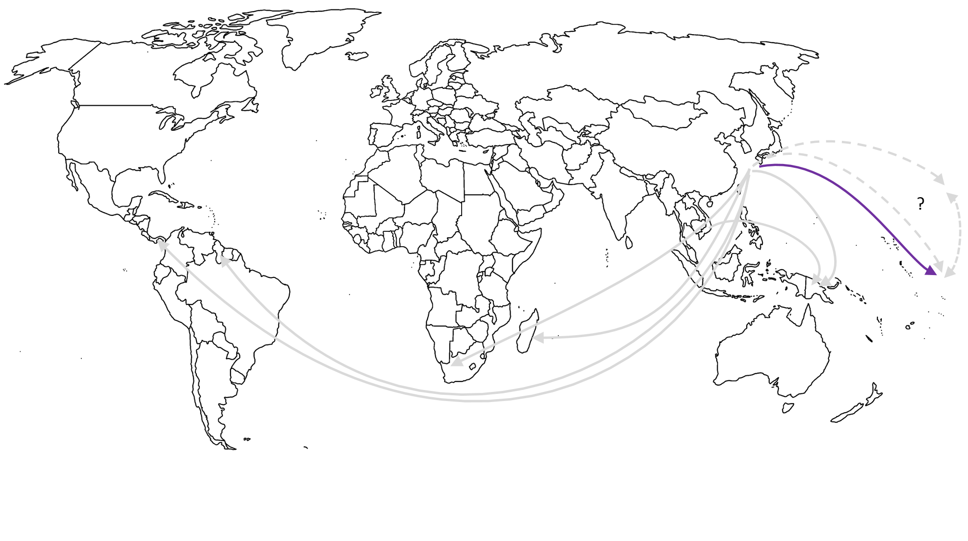
Xylosandrus crassiusculus’ invasion history
Cluster 1

Slide 29
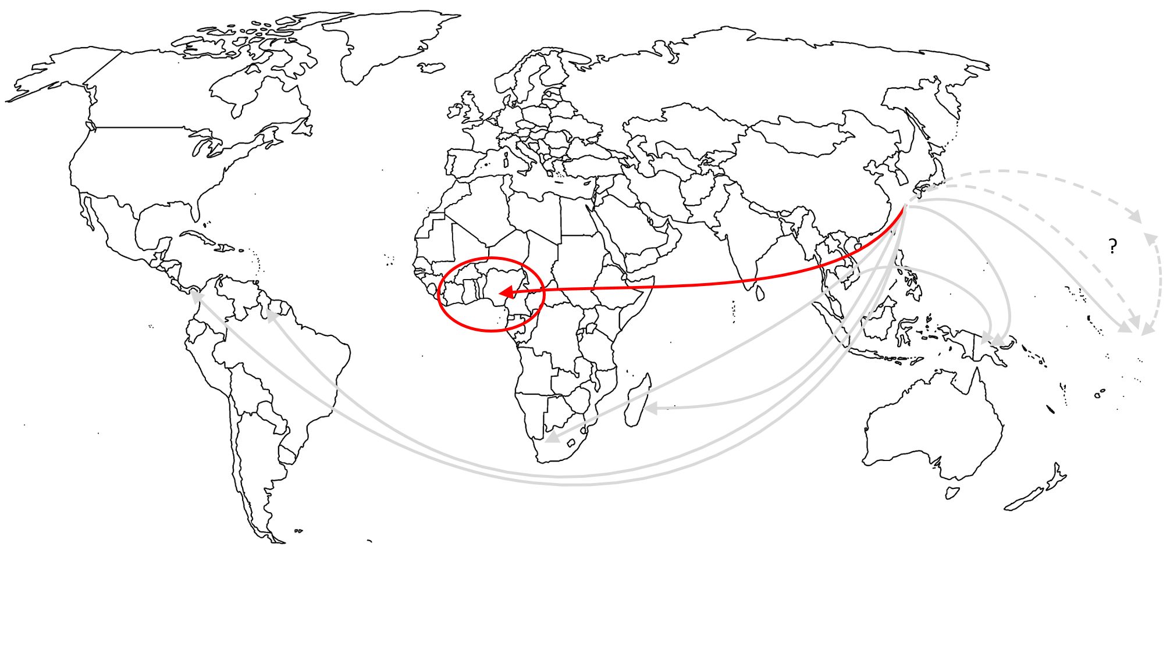
Xylosandrus crassiusculus’ invasion history
Cluster 1

Slide 30
Xylosandrus crassiusculus’ invasion history
Cluster 2
More complex situation
⇨ Close color show close genetic groups
⇨ Possibility of bridgehead

Slide 31
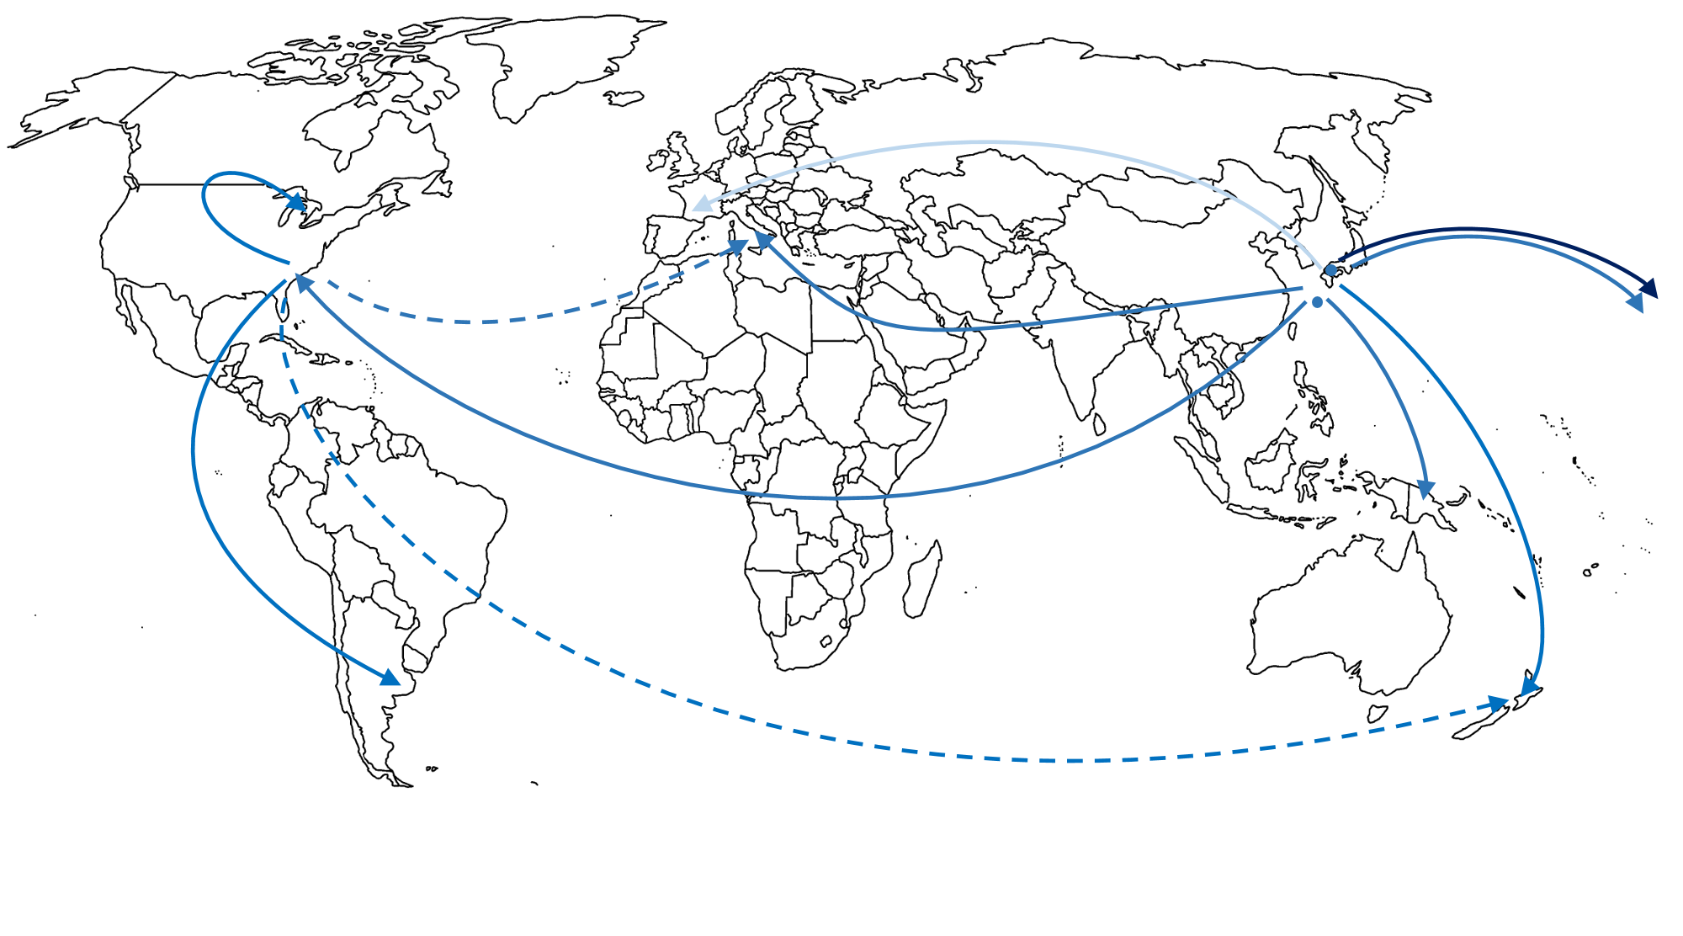
Xylosandrus crassiusculus’ invasion history
Cluster 2

Slide 32
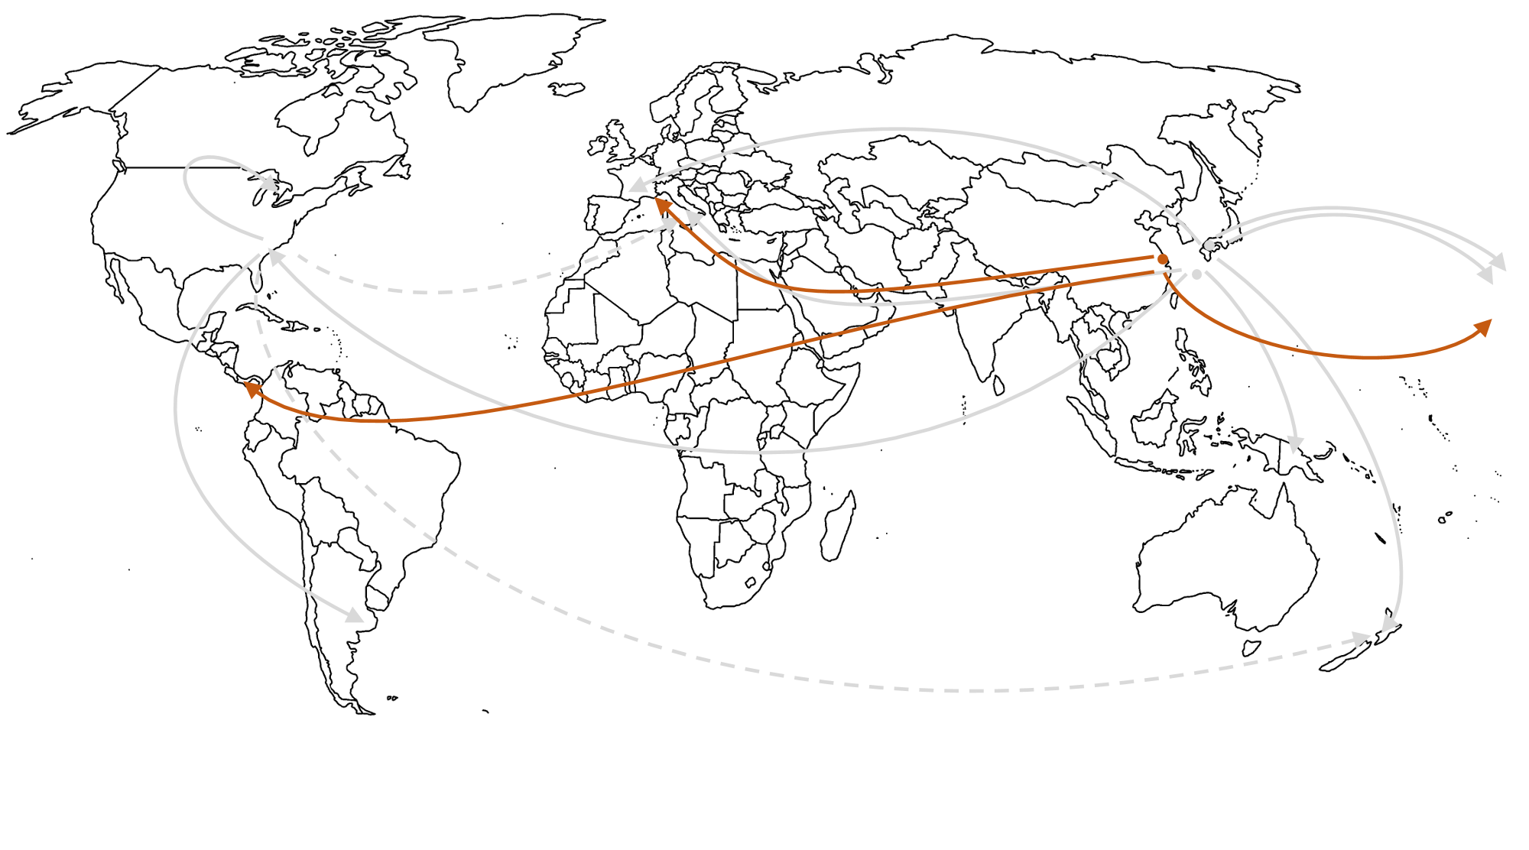
Xylosandrus crassiusculus’ invasion history
Cluster 2

Slide 33
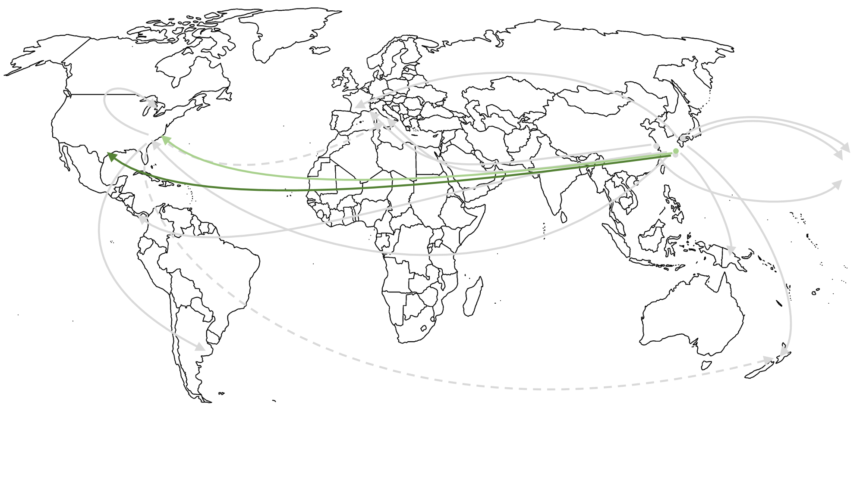
Xylosandrus crassiusculus’ invasion history
Cluster 2

Slide 34
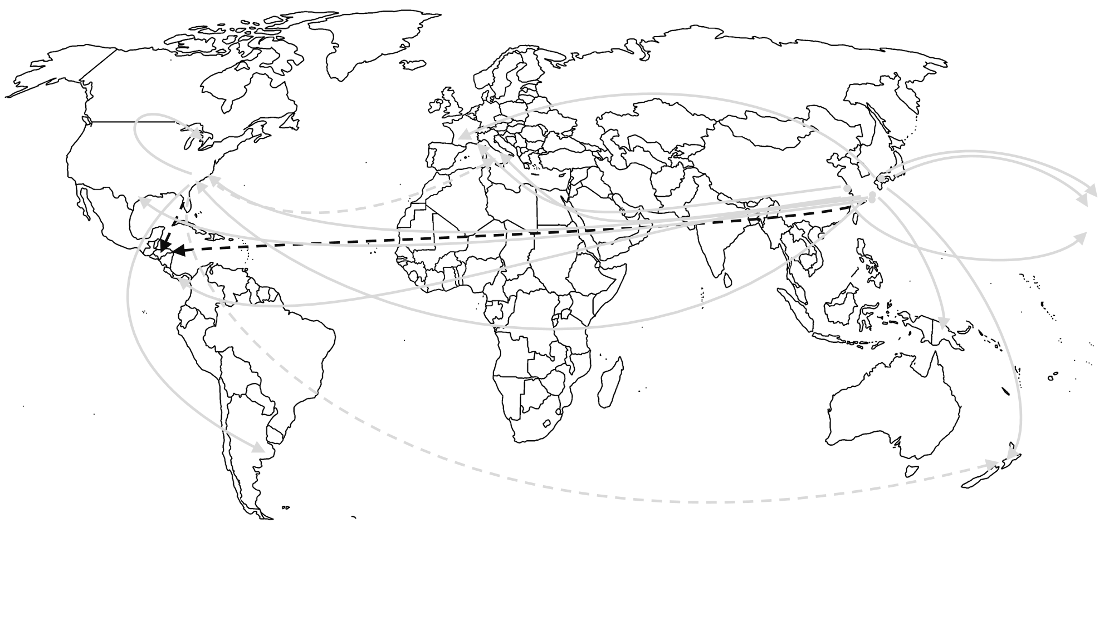
Xylosandrus crassiusculus’ invasion history
Cluster 2

Slide 35
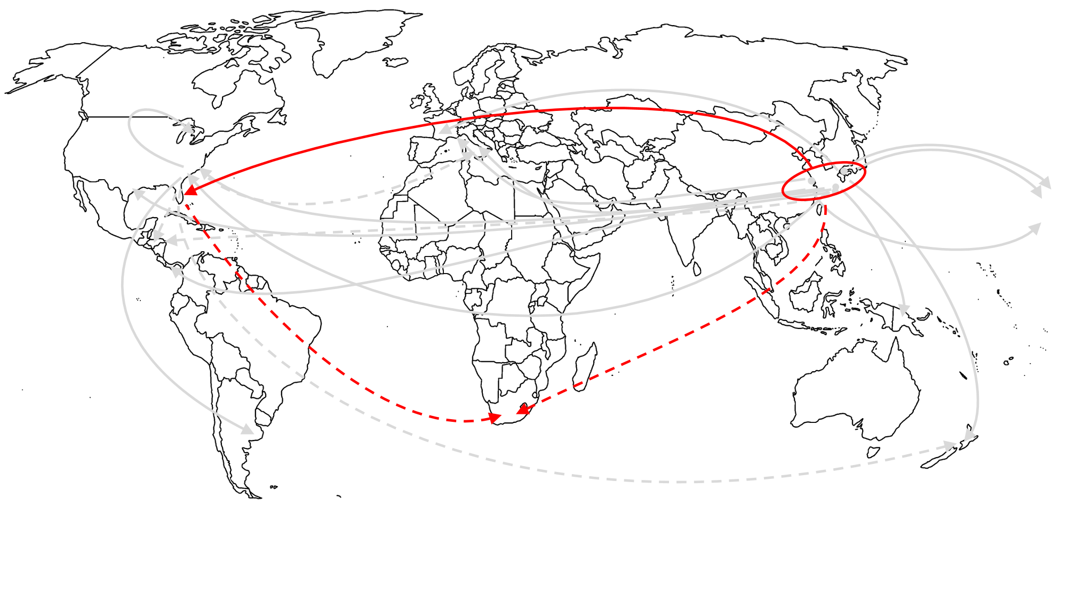
Xylosandrus crassiusculus’ invasion history
Cluster 2

Slide 36
Xylosandrus crassiusculus’ invasion history in Europe
Several invasions, only from Cluster 2
Shanghai area
Japan ?
2017
?
2019
2014
2011
2016
Japan
or USA ?

Slide 37
Questions and hypotheses
Close phylogenetically and ecologically
Similar native range
Invasive worldwide
⇨ Similar invasion history?
First detection in Europe in Italy
⇨ Italy source of the invasion in Europe?
Europe was invaded decades after the other continents
Climate change can impact species’ distribution
⇨ Did recent climate change enable European invasion?

Slide 38
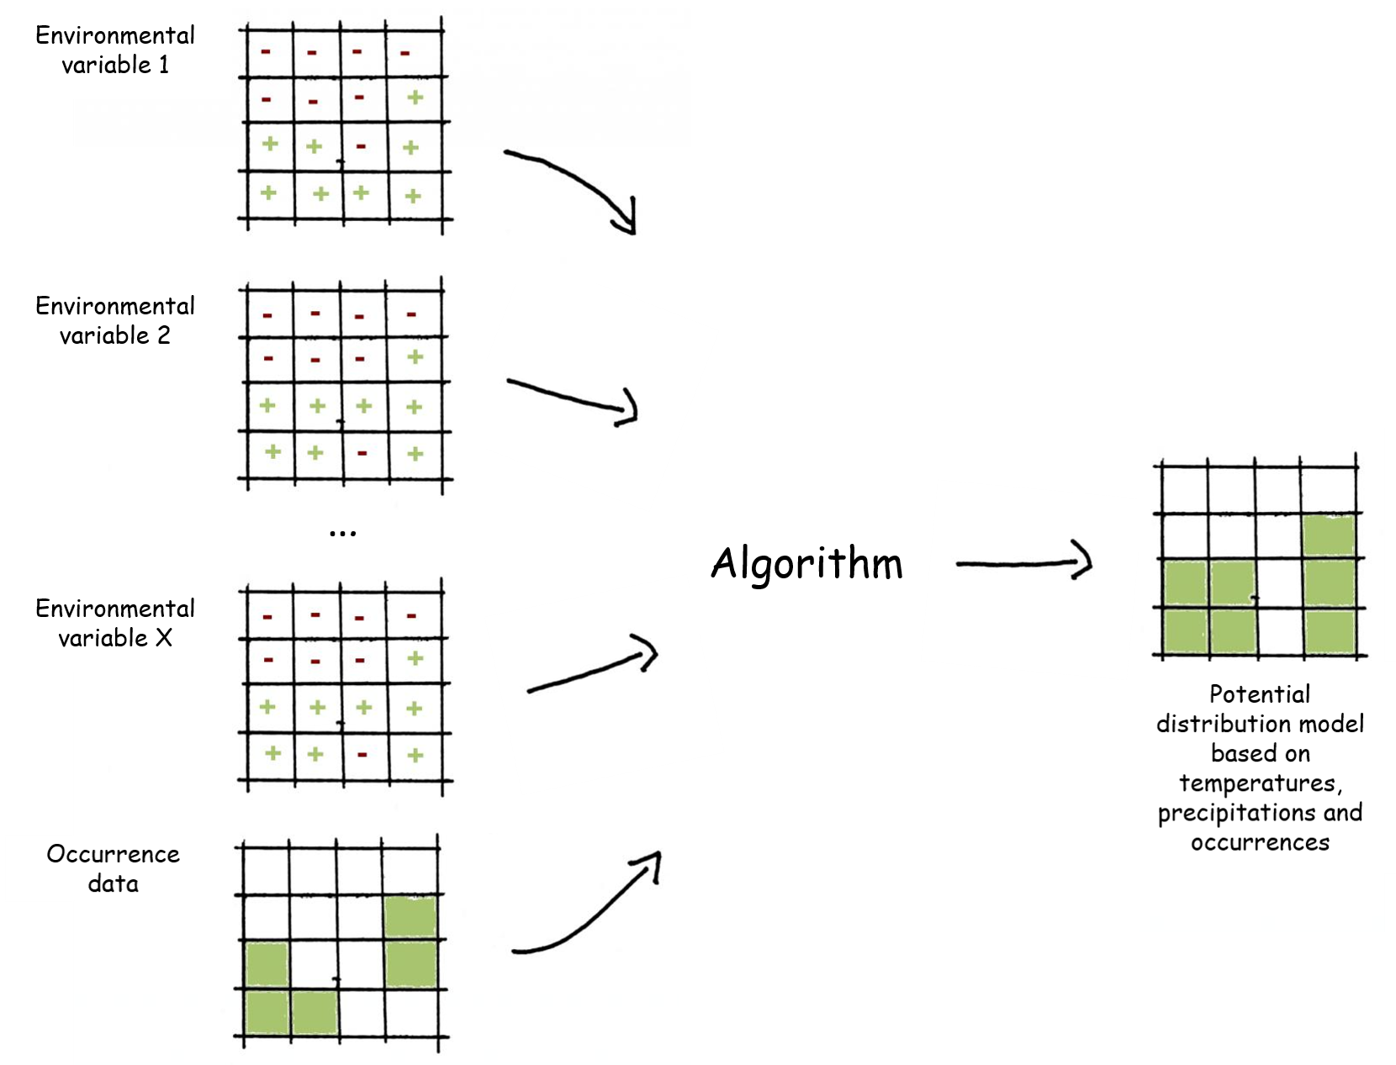
Species Distribution Modelling (SDM)
1
2
4
5
Variable shaping the species’ distribution
2
1
3
4
1
2
3
3
3
1
1
2

Slide 39
Species Distribution Modelling (SDM)
Environmental variables from the past ⇨ Potential distribution in the past
1
2
4
5
2
1
3
4
1
2
3
3
3
1
1
2

Slide 40
Unsuitable
Xylosandrus crassiusculus’ Cluster 2
Marginal
Suitable
Data from each decade of the XXth century
Optimal
1901 - 1910
1941 - 1950
1981 - 1990

Slide 41
Unsuitable
Xylosandrus crassiusculus’ Cluster 2
Marginal
Suitable
Data from each decade of the XXth century
⇨ Europe already suitable at the beginning of the XXth
⇨ Similar results obtained with X. compactus
Optimal
1901 - 1910
1941 - 1950
1981 - 1990

Slide 42
Unsuitable
Xylosandrus crassiusculus’ Cluster 2
Marginal
Suitable
Data from each decade of the XXth century
⇨ Europe already suitable at the beginning of the XXth
⇨ Similar results obtained with X. compactus
⇨ Climate change not responsible for European invasion
⇨ Recent invasion due to modification in international trade?
Optimal
1901 - 1910
1941 - 1950
1981 - 1990

Slide 43
Thank you for your attention!

Slide 44
The contents of this training package are the sole responsibility of the LIFE SAMFIX partnership and do not necessarily reflect the opinion of the European Union or its agency CINEA.
For more information:
www.lifesamfix.eu
E-mail: xylosandrus@parcocirceo.it
Address: Via Carlo Alberto 188, 0416 Sabaudia (IT)
Tel. +39 077 3512240
Follow us on and

