Slide 1


Training package for the prevention of Xylosandrus invasions and the application of early warning, monitoring and rapid response protocols
Module 1. The biology of Xylosandrus crassiusculus and Xylosandrus compactus
Module 2. Xylosandrus and associated fungi
Module 3. Invasion history and pathways
Module 4. Prevention: reducing vulnerability through forest interventions
Module 5. Early warning and monitoring
Module 6. Containment
Module 7. Supporting technologies: smart traps and app
June 2022

Slide 2
Authors:
Module 1: Massimo Faccoli, University of Padua
Module 2: Carmen Morales Rodriguez, University of Tuscia
Module 3: Teddy Urvois, INRAe
Module 4: Paolo De Angelis, University of Tuscia
Module 5: Stefano Speranza, University of Tuscia
Module 6: Alain Roques, INRAe
Module 7: Claudio Belli, Terrasystem Srl
Editing: Gertruud van Leijen, on behalf of Circeo National Park

Slide 3
Biology of Xylosandrus crassiusculus and Xylosandrus compactus
(Coleoptera: Curculionidae, Scolytinae)
  Massimo Faccoli
  University of Padua

Slide 4

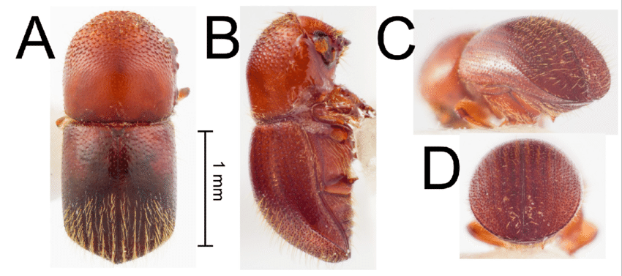
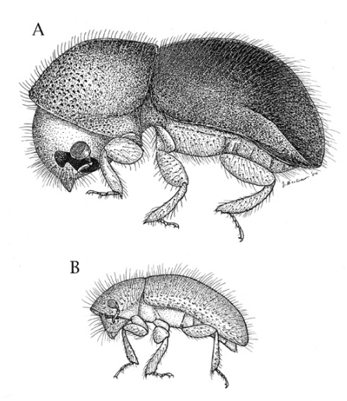
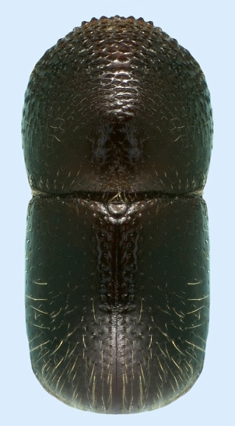
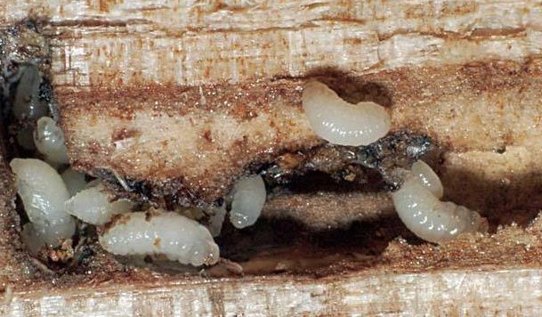

X. crassiusculus
Female: 2-2.5 mm, reddish, winged
Male: 1.5 mm, very rare, wingless
X. compactus
Female: 1.6-1.8 mm, blackish, shiny, winged
Male: 0.9-1.3 mm, very rare, wingless
Larvae: «C»-form, white, legless

Slide 5
Host-plants:
Species strongly polyphagous on broadleaves!
X. crassiusculus
X. compactus
More than 120 host-plants from 46 families
In Europe: Acer, Alnus, Betula, Castanea, Cornus, Dispyros kaki, Ficus carica, Fraxinus, Malus, Platanus, Populus, Prunus, Quercus, Salix, Ulmus, Vitis, Ceratonia siliqua, Cercis siliquastrum…
More than 220 host-plants from 62 families (inc. pines and cypress!)
In Europe: Laurus nobilis, Pistacia lentiscus , Quercus ilex, Ruscus aculeatus , Ceratonia siliqua, Viburnum tinus, Arbutus unedo, Phillyrea sp., Tilia cordata, Pittosporum

Slide 6
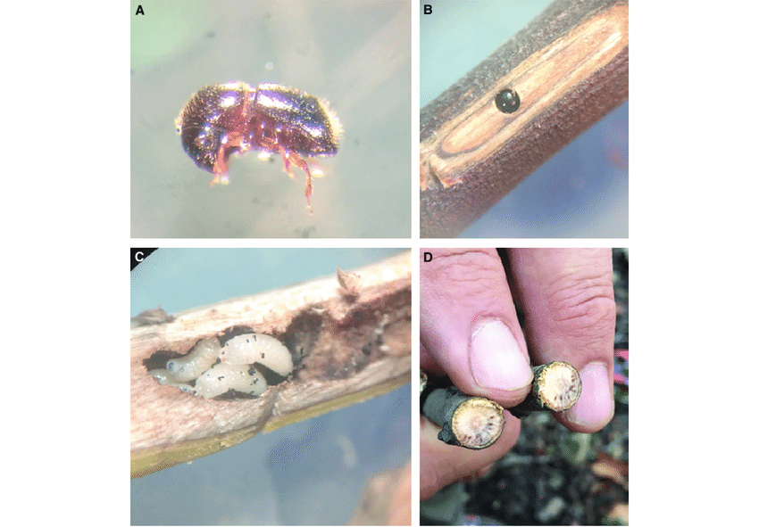
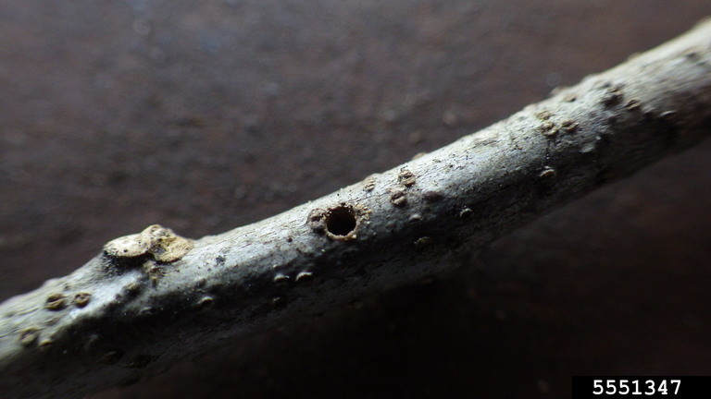
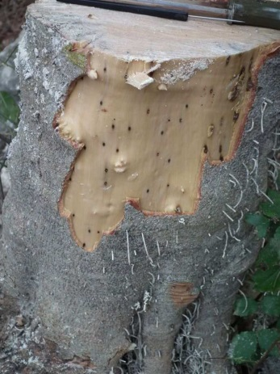
Host-plants
X. crassiusculus infests medium-large braches
X. compactus infests twigs and small branches

Slide 7
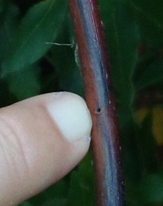
The biology
Penetration hole of X. compactus
Adults active from March to October (with variations according to climate and latitudes)
Only females flight and infest new hosts
Females bores small circular holes (<2 mm) penetrating in the wood
Female of X. compactus boring in the host

Slide 8
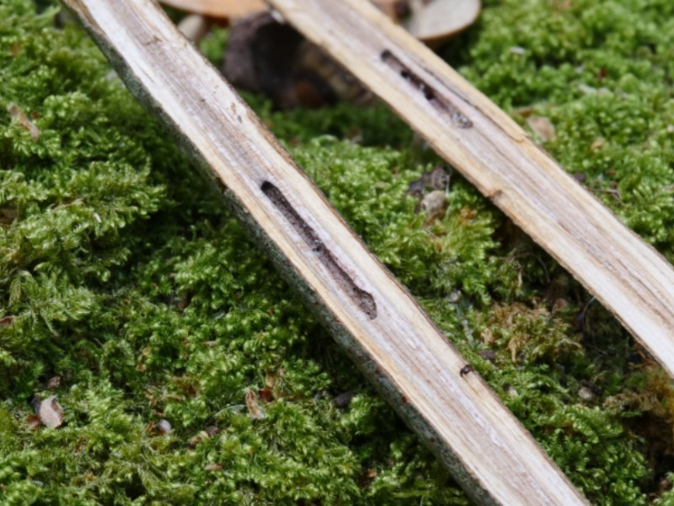
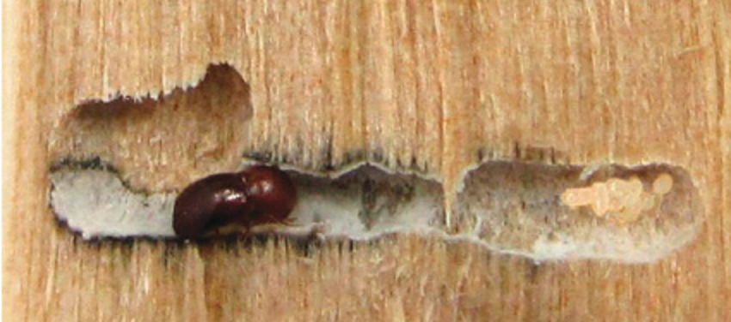
X. compactus
The biology
The mother tunnel enlarges forming a chamber where females lay eggs
During host colonisation, females infect the tree with symbiotic fungi
Symbiotic fungi
Eggs
Female
X. crassiusculus
Fungal browning

Slide 9
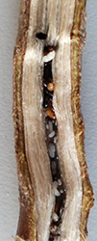
X. compactus bores long and narrow tunnels in the pith of the twigs
The biology
X. crassiusculus bores large chambers deeply in the wood

Slide 10
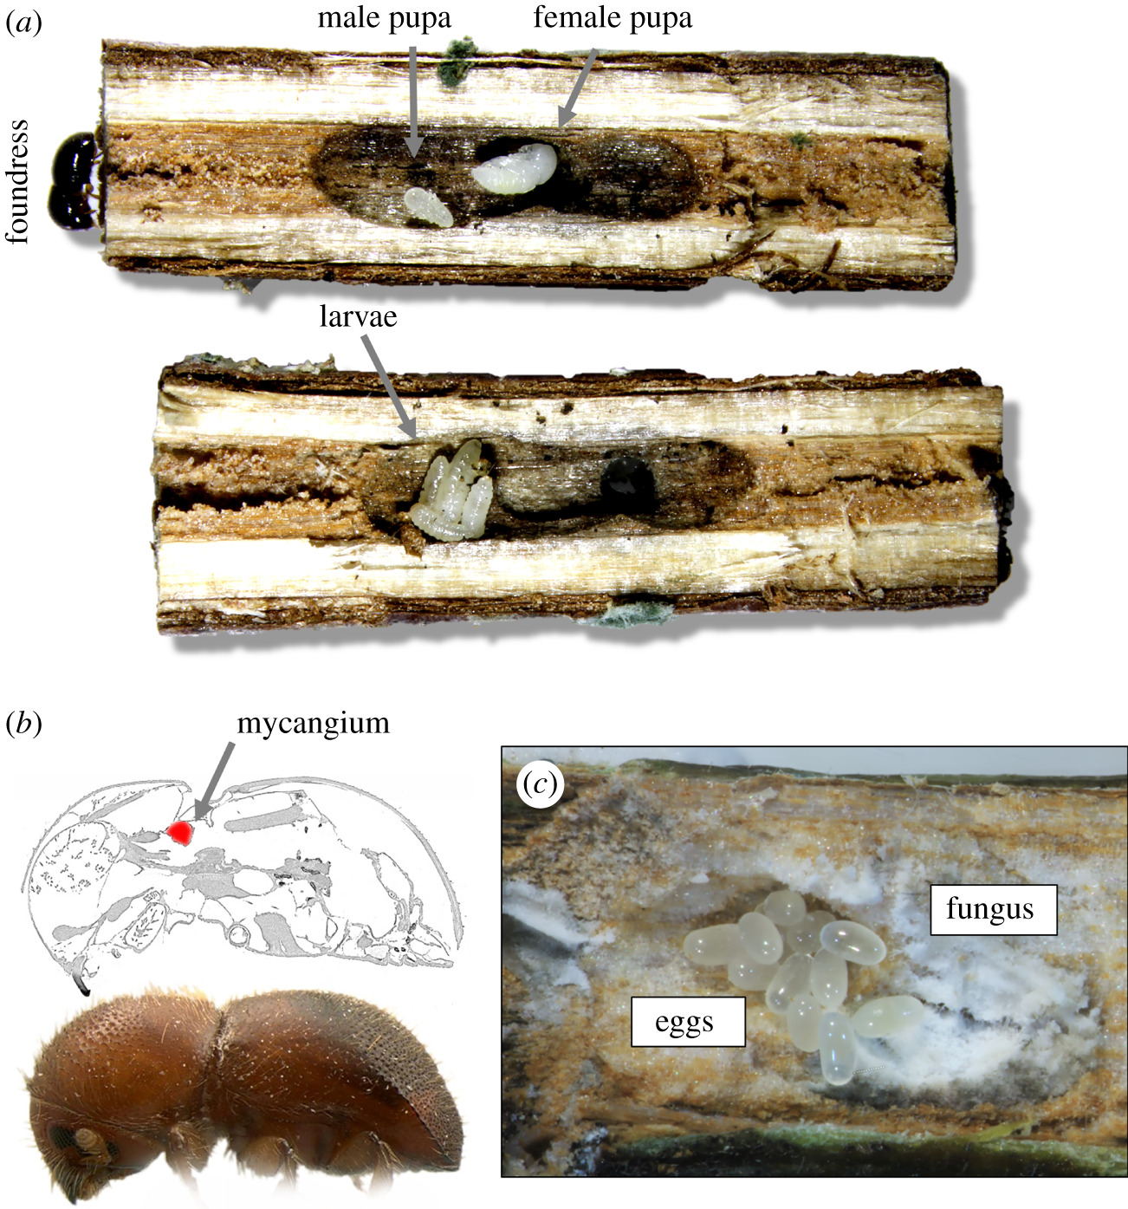
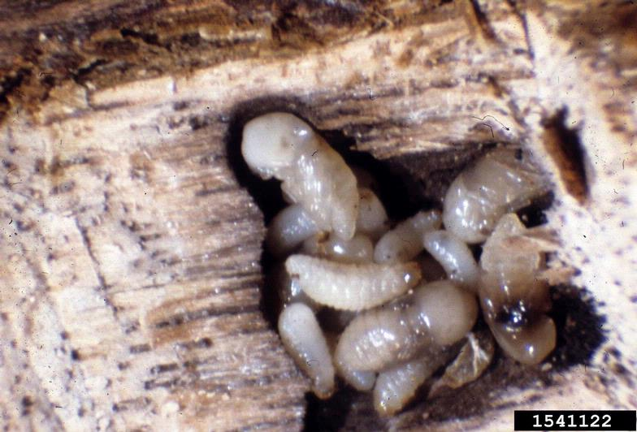
The biology
Gregarious larvae feed on the symbiotic fungi which grow inside the chamber.
This makes development very quick and dramatically increases the number of potential host trees!

Slide 11
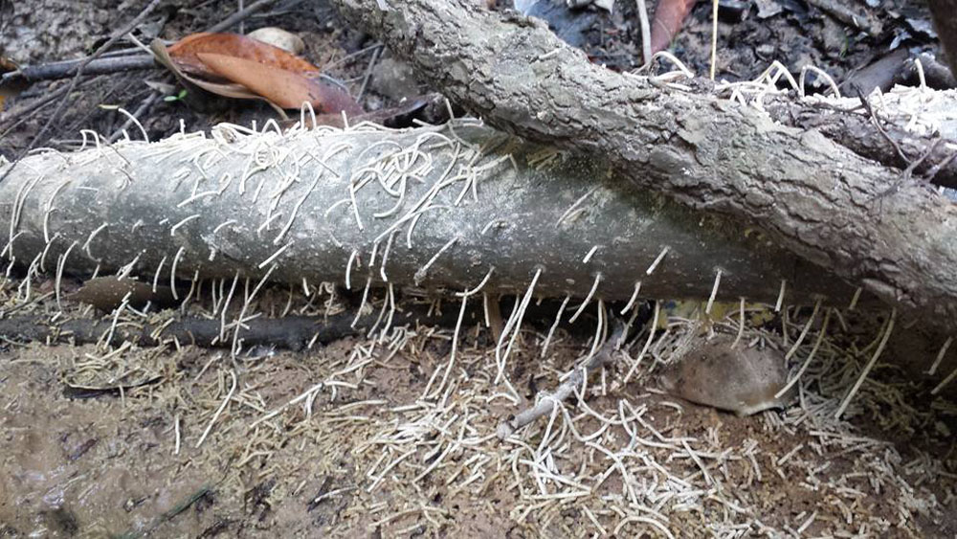
The biology
Xylosandrus crassiusculus produces characteristic long and white noodles emitted from the penetration holes

Slide 12
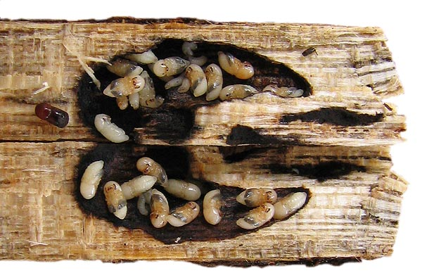
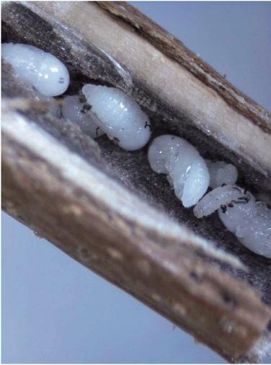
Pupae of X. crassiusculus
The biology
After about 30-40 days, mature larvae develop into pupae and then into new adults
Pupae of
X. compactus

Slide 13
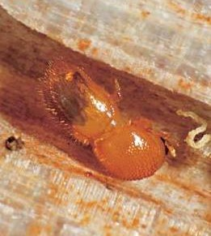
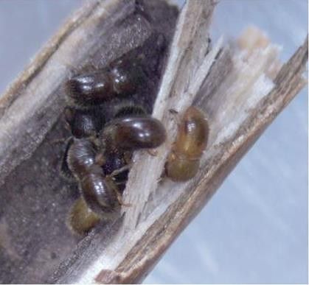
The biology
New adults are clear, tender, and continue to feed on symbiotic fungi to reach sexual maturation
Tender adults sexually immature

Slide 14
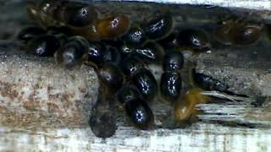
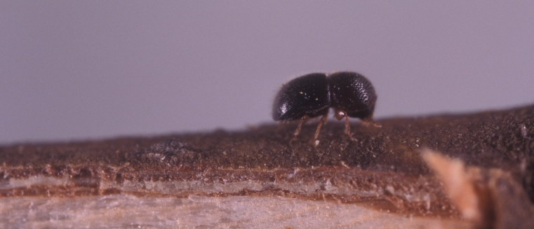
The biology
Females of X. compactus ready to emerge
After mating, males die in the chamber while the females emerge through the entrance hole, collecting new spores of the symbiotic fungi and becoming ready to colonize new hosts
Newly emerged female of
X. compactus

Slide 15
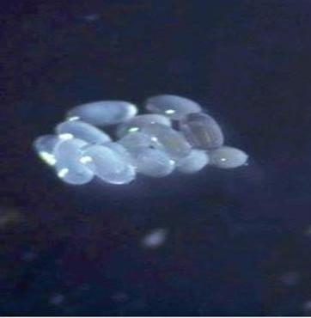
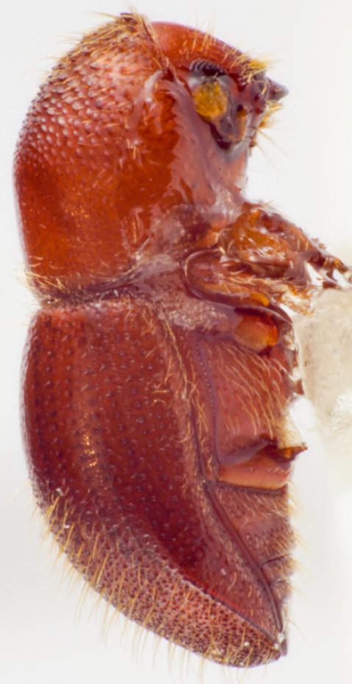
Full development (eggs-adults) takes about 40-50 days (with variations according to climate and latitudes) producing in average 3 generations per year, with adults overwintering within the hosts.
About 40-50 days

Slide 16
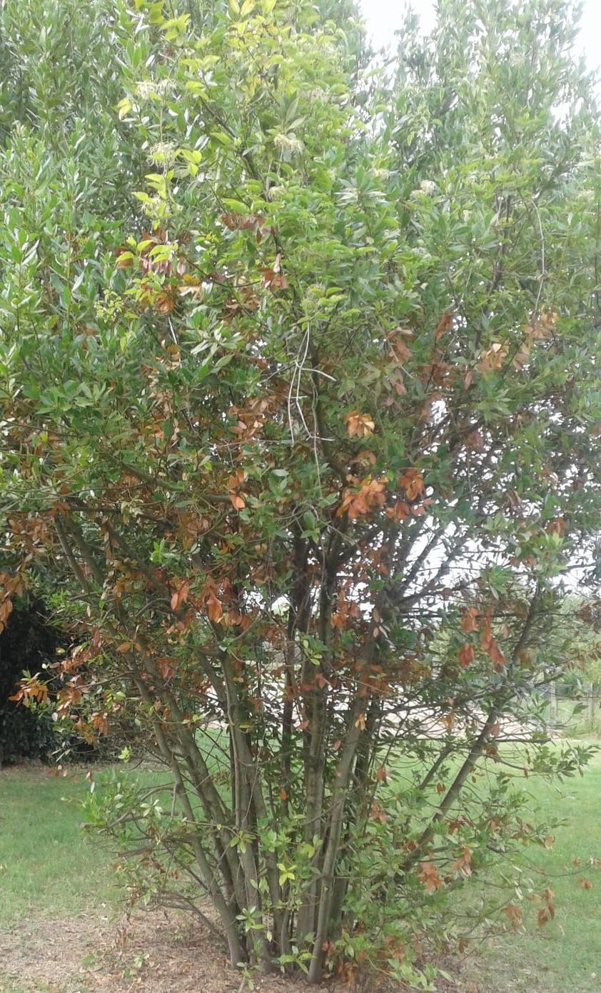
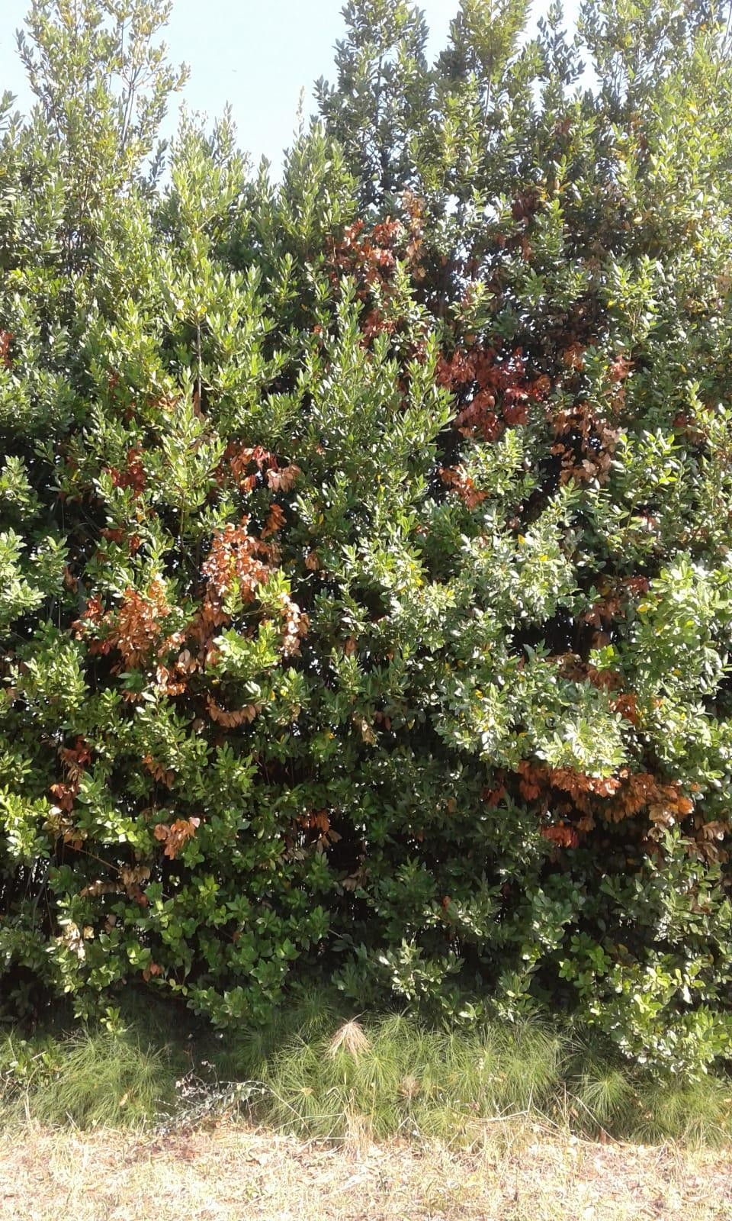
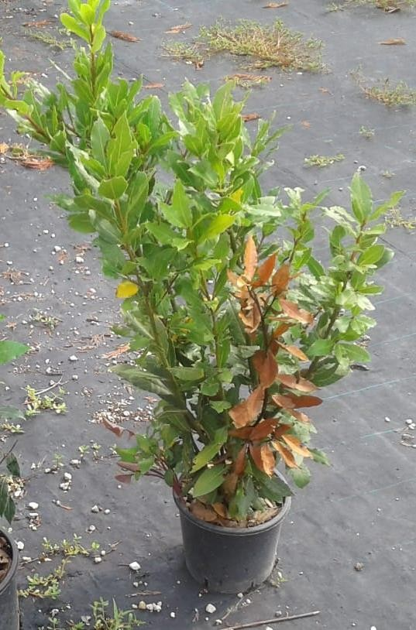
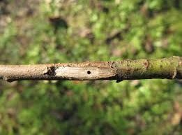
DAMAGE
X. compactus: strong damage on ornamental
trees and hedges. Rarely kills the plants

Slide 17
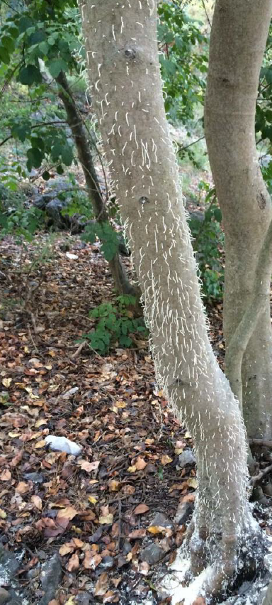
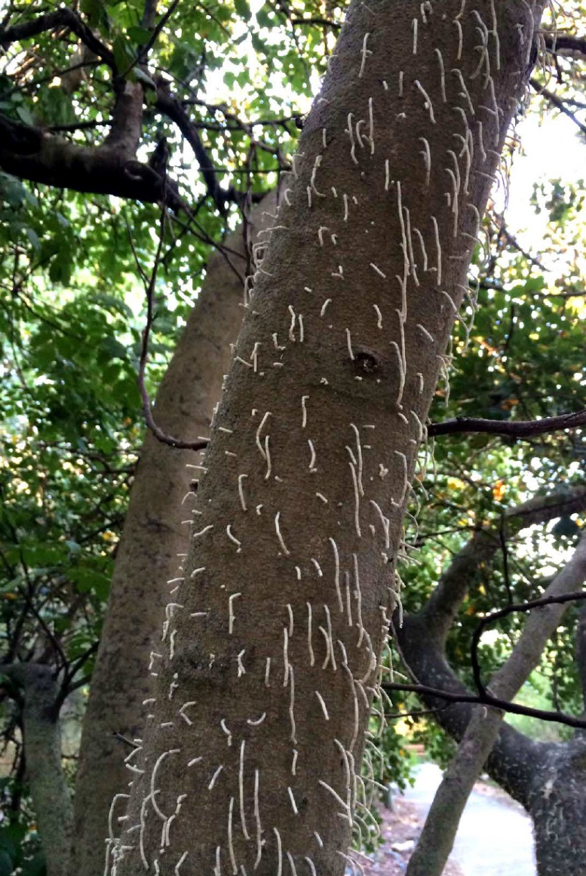
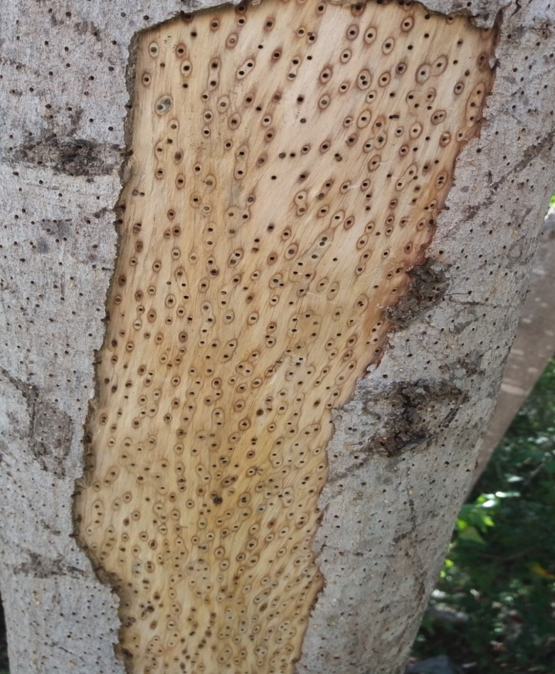
DAMAGE
X. crassiusculus: colonises whole stems and branches massively, often killing trees

Slide 18
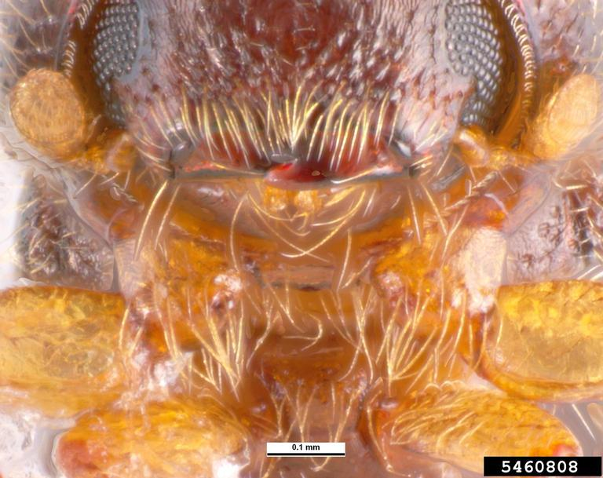
Thanks for your attention!

Slide 19



The contents of this training package are the sole responsibility of the LIFE SAMFIX partnership and do not necessarily reflect the opinion of the European Union or its agency CINEA.
For more information:
www.lifesamfix.eu
E-mail: xylosandrus@parcocirceo.it
Address: Via Carlo Alberto 188, 0416 Sabaudia (IT)
Tel. +39 077 3512240
Follow us on and

